Slide 1
MAGIC MILK
Notes:
45-50 mins (10 mins at end for worksheet)
If taking a younger class, hide slide 17!
- ASK TEACHER IF ANY SEND NEEDS IN CLASS/TRIGGERS
Table set up:
Clear trays with sets of mammals
Laminated tummy size chart
Paper slip with either cherry, walnut, plum and egg (one for each table if taking a younger class)
Front of classroom:
Small clear tray with measurement jugs, pouring jug with liquid, teaspoon, and syringe.
Other resources:
Play foam ready to hand out during class
Worksheet to hand out at end of class (depending on class/teacher if stay or take home)

Slide 2
HELLO!
Notes:
Introduce self and today’s session. If you forget my name, just call me miss.
Class agreement:
Hands up if you have a question or answer to a question
Respect one another (when I’m speaking you can respect me by listening, and then I can do the same for you)
Lesson objectives:
To learn about how animals feed their young
And how human babies are fed

Slide 3

QUESTION TIME
Notes:
You’ve noticed that I’ve put lots of animals on trays.
Direct class to look at animals and have a discussion about what characteristics can they spot, what do they know about these animals, what fun facts do they know, what can they spot.
Walk round classroom and discuss with tables in relaxed manner
Max 5 minutes, flick to next slide during activity

Slide 4
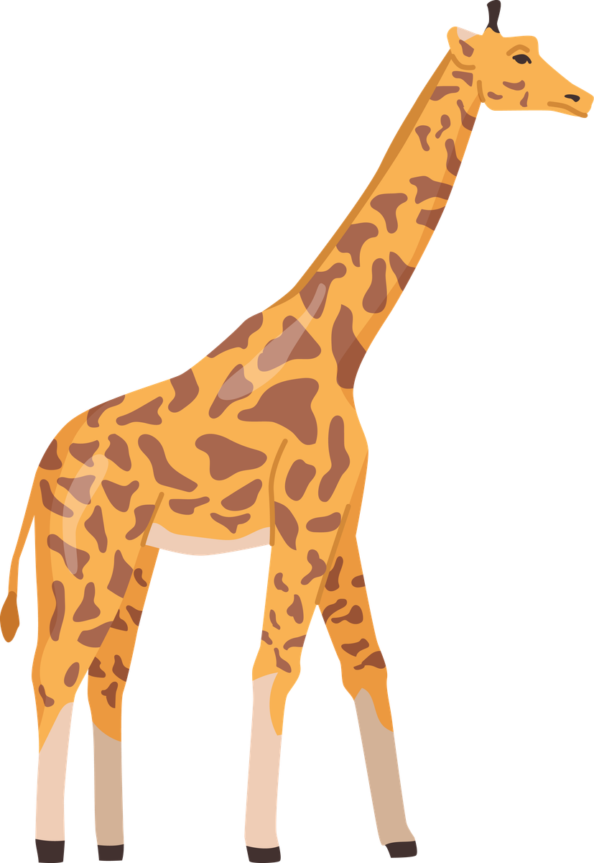
WHAT ANIMALS ARE THESE?
Notes:
Put animals back on trays, for younger class ask to join me back on the floor/mat.
Only take a few responses. If responses are not what I am after, hands down…
What did you notice about these animals?
What characteristics do they have?
What did you spot?
Focus on individuals that mentioned the following…
(In pairs, mummy and baby, live in different places)
What do these animals have in common…
What type of animal…are they mammals? No1
Aim is to get to the point that every animal on the tables/board is a mammal.
Now we have a really interesting video to watch all about mammals, and your job is to listen out for all the interesting facts and tell me anything you learnt at the end.
What will I have to do if the volume gets too loud? Turn it off which isn’t fun
Turn listening ears on

Slide 5

Notes:
Play video (if a younger class may be able to sit on mat/floor in front of screen)
Can anyone tell me a fun fact they learnt?
If answers aren’t helpful, reiterate question: I know you saw lots of mammals, but did anyone hear any special facts about those mammals?
Lungs to breathe
Warm blooded/endothermic
Hair/fur
Give birth to live young
How many mammals we have in the world: 6 thousand

Slide 6
WHAT IS A MAMMALS FIRST SOURCE OF FOOD?
Notes:
Ask what is a mammals first food? Milk.
All mammals need milk to survive! Now what do you think would happen in the wild if that baby was split up from its mother, or couldn’t feed from its mother for whatever reason? Would die.
So that first milk is very important for that baby to survive, and now we are going to watch a video all about how mammal feed their babies.

Slide 7
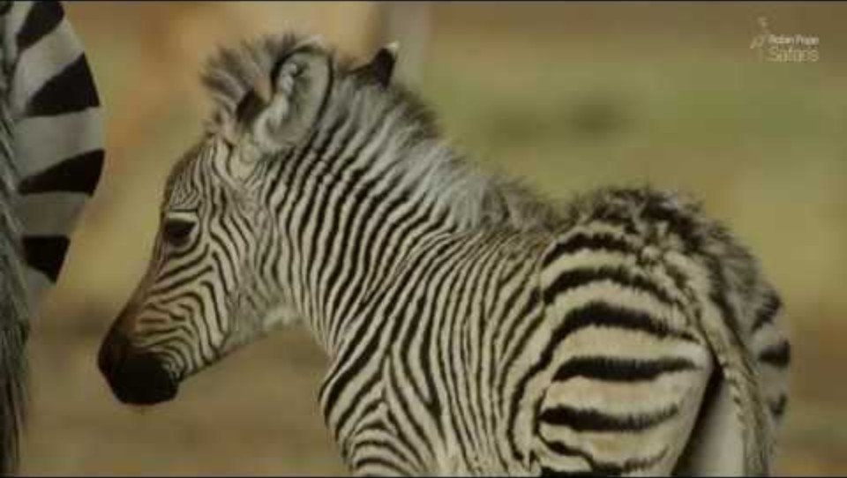
Notes:
Play video (if a younger class may be able to sit on mat/floor in front of screen). Discuss video
ACTIVITY BREAK (can use now or later if fidgeting):
Who can dance link a monkey? FREEZE
Who can stomp like an elephant? FREEZE
Who can jump like a kangaroo? FREEZE
Who can shake like a sheep? FREEZE
Finally, who can raw like a lion? FREEZE

Slide 8
CAN YOU NAME ANY OTHER MAMMALS?
Notes:
Now can anyone name any other mammals? Maybe one that you haven’t seen yet.
Aim is to get the answer human! If they don’t get the answer, then give clues:
What mammal walks on two legs, has hands, can communicate, has hair…
Yes! That’s right, we are all mammals in this room.

Slide 9

HUMANS
What is a humans first food?
Notes:
Yes! That’s right, we are all mammals in this room.
Lets check:
Do we have hair?
So we have lungs, can we take a big deep breath? (take deep breath with class)
If we are a female mammal, can we give birth to live young?
Are we warm blooded?
However, if older, ask what characteristics do we have that an animal has… (go through each one)
Exactly, so just like all the animals we saw on the video and our tables, we are also mammals.
So, what is a humans first food?

Slide 10
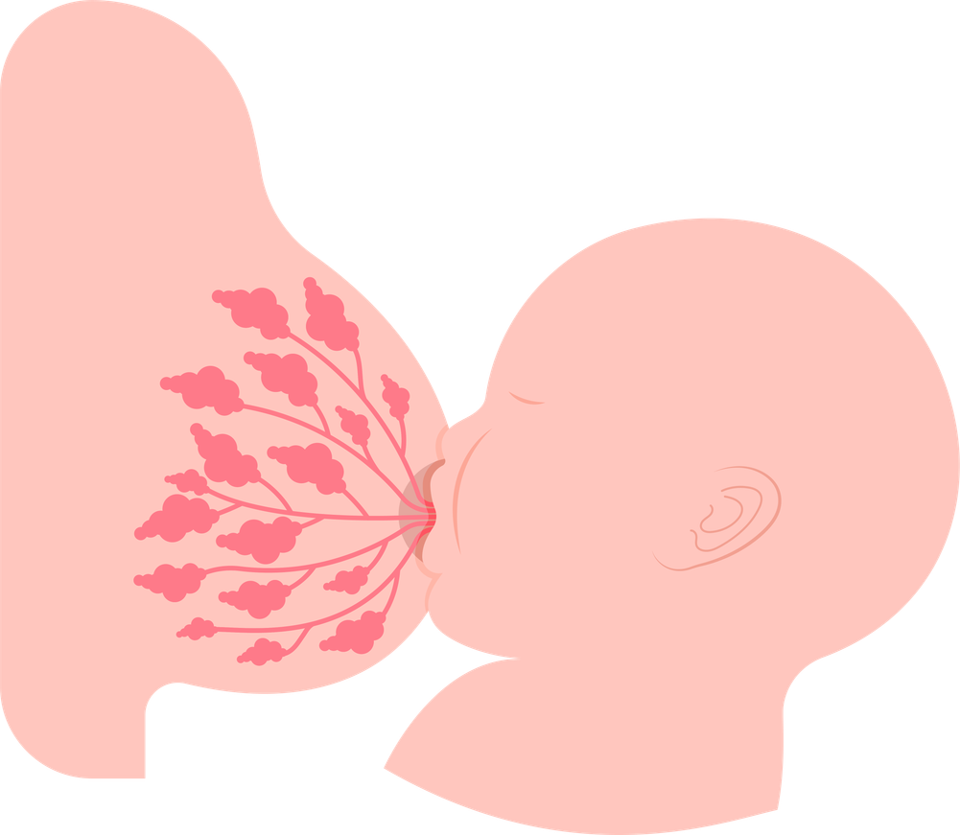
Breastmilk
Formula Milk
Notes:
Yes, that’s right! Milk.
Do you know what, we are actually really lucky as humans because we have two types of milk that we can feed our babies.
Now what is super natural, like we saw on the video, is mummy’s can actually feed their babies from their brest. Babies can have breast milk and it’s designed especially for them.
Or babies can have something called formula milk., and that’s something we can buy from a shop
Formula milk has everything the baby needs in it nutritionally, but breast milk is MAGICAL! It’s designed for a human baby and is ever changing – it has special things inside of it, for example, to protect baby!
Because what would happen to the animal baby if they cant have their milk? Die. That’s why we’re so lucky as humans, if that mummy is struggling to feed her baby, we have the option of formula milk too.

Slide 11
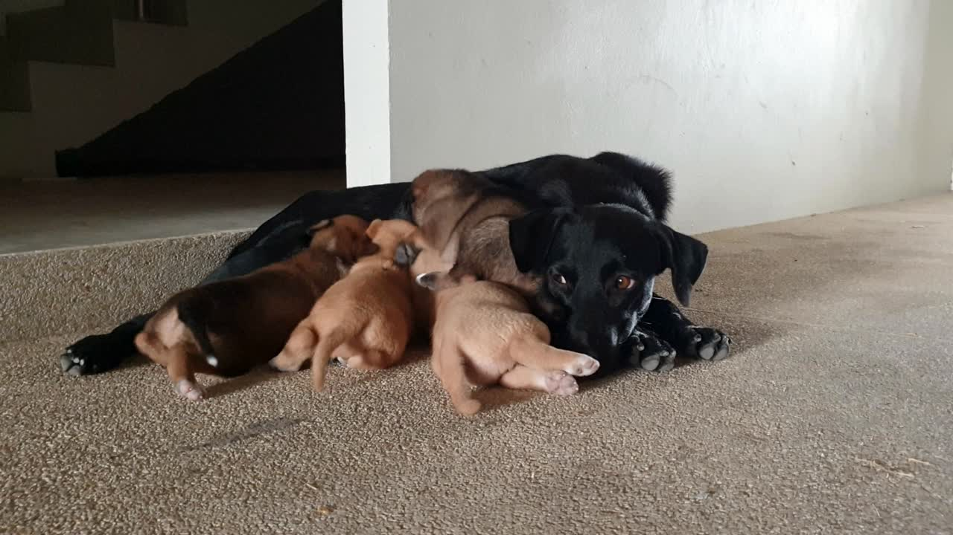
Notes:
This is my friends dog called Lucy and she has just had puppies! Can you guess how many puppies she had? 7
What is Lucy doing? Feeding her puppies!
How amazing is that, that Lucy can produce enough milk to feed her puppies, to help them grow and survive. They are having milk from their mummy.

Slide 12
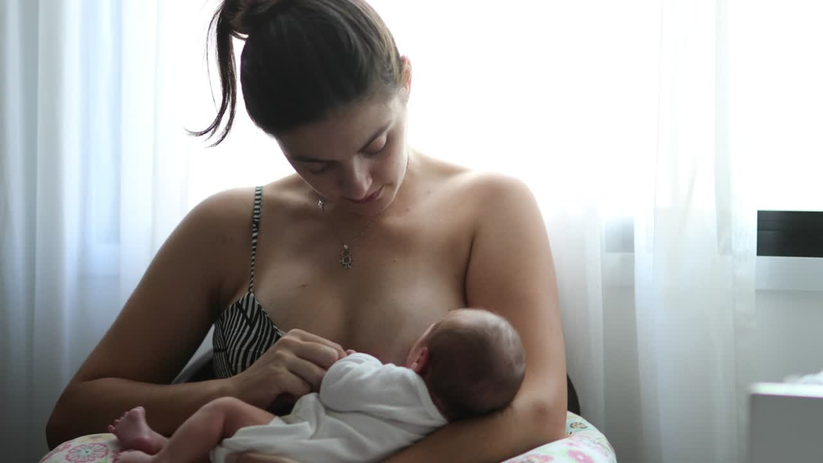
What is this mammal doing?
Notes:
Now what is this mammal doing? Yes, this mammal is breastfeeding their baby.
If react strongly (older classes): It’s it strange how we had that reaction to the mummy feeding her baby, but no one had that reaction to all the animals on the video feeling their babies. It is completely normal and natural, this is how babies survive.
How, what do you think this baby feels when they are so close to their mummy and all snuggled up?
Safe
Warm
Cozy
Loved
And how do you think the mummy feels?
Relaxed
Calm
Loved
And just remember, it is really natural for a mammal to feed their baby this way.

Slide 13
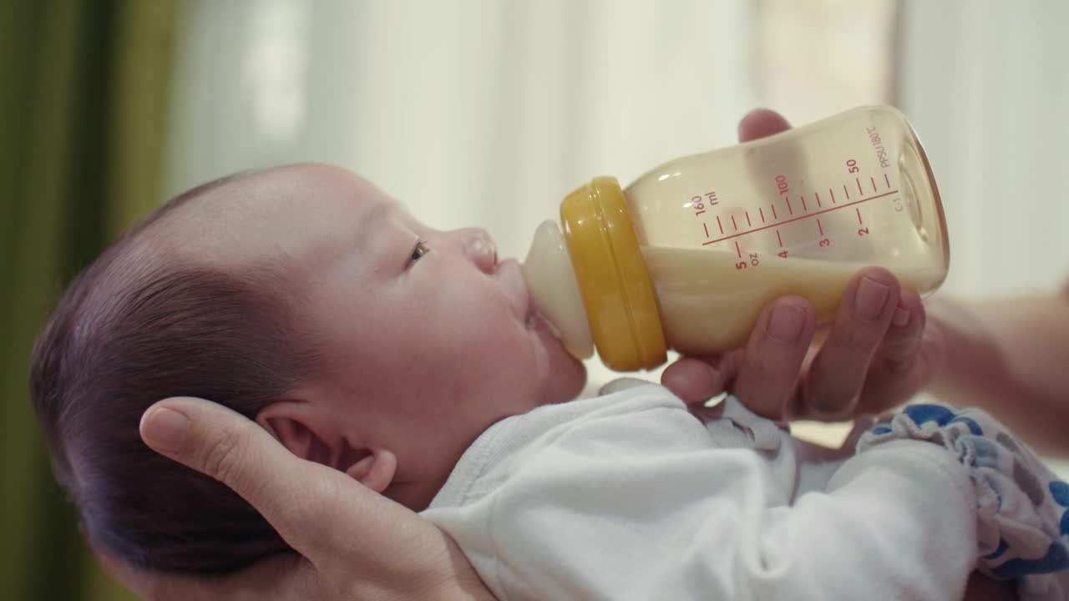
Formula Milk
Notes:
And what is this baby doing? Drinking formular milk/milk from a bottle.
And remember, formular milk gives the baby everything they need nutritionally, but isn’t a live liquid/substance and doesn’t change to suit the babies needs.
For older ones:
Sometimes we have to be careful when we bottle feed because we can actually overfeed a baby, why do you think that is? Great answers!

Slide 14
TASK TIME
Notes:
Introduce play foam:
Don’t worry, everyone is going to get their own ball of play foam
We don’t mix!
Now if we are silly with the play foam (snap shut), we will have to put it away!
(If it’s a reception class, can sit in a circle during task)
On your tables there’s a worksheet with some really random things on it like a cherry, a walnut (you might not know what a walnut is but I will come round if you are struggling), a plum, and a big chicken egg.
For younger class, tell them to try to create the shape on their table (paper slip)
For older class, ask them to create any shape of their choice – use discretion
Change to next slide. 5 minutes max, walk round and assist

Slide 15
CAN YOU MAKE...
Notes:
During task (5 minutes)
Bring class back together. Go through each shape and ask them to hold up their examples. Point out good examples.
Collect and put away.

Slide 16
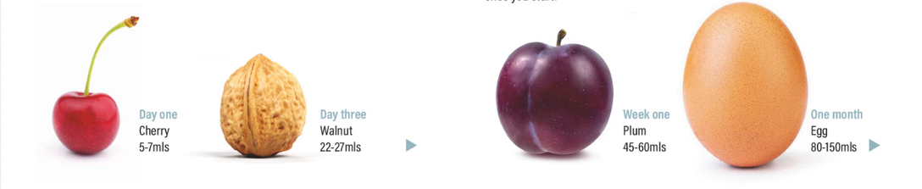
WHAT DO YOU THINK THESE SIZES REPRESENT?
Notes:
Now I've asked you to make some really strange shapes haven’t I? And there’s a reason why. I am so excited to share this with you…
Older:
Now what do you think these shapes represent?
Sizes getting bigger
Days (one, three, one week, one month)
Mls (measurement size) – check understanding
I can’t wait to tell you! Now everyone hold up the size of a cherry with your hand, have a look through it, show it to your friend, and now put it to your belly. Because this was the size that your belly wall when you were 1 day old! Do we think that’s a little or a lot?
And as you grew, when you were 3 days old, your tummy grew to a walnut size. Work through each size…
This shows you as a baby gets older, their tummy sizes get what? Bigger! And they can fit more milk in their bellies as they grow.
This is why breastfeeding is really natural and we have to be careful with bottle feeding because sometimes we can overfeed a baby. That’s why babies need little and often.

Slide 17
COLOSTRUM
TRANSITIONAL
MATURE
Notes:
Hide slide unless Y5 and up.
Because we now know some facts about tummy sizes, I was to share with you that there is actually 3 types of breast milk, and these are designed to fit in the babies belly as they grow.
Colostrum: cherry size, a bit thicker and yellow
Transitional: between walnut and plum as babies belly continues to grow, more liquidy
Mature: egg size, same milk they continue on for however long that mummy decides to feed for

Slide 18
LIVING CELLS
A living cell is like a tiny building block that makes up all plants, animals, and people, and it works like a little factory to keep things alive and growing
Notes:
For younger years (R-Y2): keep it simple, mention lego and read slide
I want to talk a little bit about something called living cells, and this might be something you’ve not yet heard about, but might learn about in your science lessons!
Right, who has played with lego before? Now I want you to imagine that living cells are like lots of little lego blocks (act out with hands). And all these living cells are like building blocks that make up plans, animals, and people! They are like little factory workers that keep things alive and growing. We are all made of living cells!
They make us who we are so we grow up to be nice and strong and healthy.

Slide 19
TEASPOON
How many living cells are in one teaspoon of colostrum?
Notes:
Get teaspoon out and fill with some fake milk, walk around the classroom with teaspoon.
Ask how many living cells do you think are in this teaspoon of breast milk?
Take guesses (hands up)
Usually guess low, tell them higher so they continue to guess
Are you ready for the answer…

Slide 20
TEASPOON
Up to 3 million!
Notes:
It’s up to 3 million! So there are up to 3 million living cells in this one teaspoon of breast milk. How amazing is that!
Breastmilk is so magical.
It contains everything a baby needs as well as protective factors for them, helping baby to grow and develop for the first 6 months a beyond.

Slide 21
TASK TIME
Notes:
Ask for 4 vols or ask the teacher to pick 4 vols…

Slide 22
Notes:
Vols either come up to the front in a line or I walk around to them with the syringe and beaker (for older children, get them involved by bringing them up to the front of the class / for younger children, bring it to them and display amounts on small tray at the end).
What I’m going to do now is show you how much milk fits in each tummy size.
I ask the class to look on the worksheet, or board to see what amounts we need to fill the beaker up with for:
1 day old baby
3 days old baby
1 week old baby
1 month old baby
Get class to shout out: how old is this baby, say correct answer and move on to next one – make this quick.
Display all 4 at end, and go over cherry, walnut, plum, and egg for each amount.
Ask questions: (if you have the time/older class)
What is happening to the amounts of milk? Getting bigger
Are you surprised by the amount?
Why do you think babies need to feeding little and often?
What might happen if we feed a baby too much or too fast?
Do you eat and drink the same amounts everyday?

Slide 23
TRUE OR FALSE...
A baby only needs breastmilk for the first 4 months of it’s life.
Breastmilk is forever changing, it is never the same milk, it can even contain more water on a hot day!
Breastmilk protects a baby from germs, infections & builds their immune system. A mothers body can also detect when baby is not well & create a medicine like milk for baby.
Notes:
(5 mins left of session…) Right, I have some final questions for you. If you think it is true put your thumbs up / if you think it is false, put your thumbs down.
Red: True (what happens when we are really hot and have been doing lots of running around? Water! Yes, and a baby is no different. So, the mummy detects that it is a super hot day, and makes more hydrating milk for the baby / and baby are super clever so they know to feed more often when it is hot because they are thirsty)
Blue: False (actually need milk for the first 6 months, and when their tummies are ready, that’s when we can introduce them to solid foods. That is when you tired your first foods, and you were introduced to lots of different tastes and textures)
Yellow: True (so if a baby was a bit unwell, mummy is able to design a medicine like milk for that baby to help them get better and fight off any germs)

Slide 24
DID YOU KNOW...
A mother who is breastfeeding can become very thirsty!
A mother and her baby should feel relaxed and calm whilst feeding.
You can choose to breastfeed your baby anywhere, it is protected by the law.
Notes:
Did you know…
Green: Why do you think that is? What do you think we could do to help if a mummy is really thirsty because she is breastfeeding?
Orange: Remember the baby we saw before, how did they feel when feeling? When mummy is calm, she is actually able to produce more milk. And when baby is relaxed, they are able to feed better and bond with mummy.
Blue: What do you think this means, ‘protected by the law’? So, when something is protected by the law, it means that if a mummy was feeding her baby in a café, and someone said ‘ew, I don’t want to watch you feed you baby’, then that mummy is protected by the police and the law to feed her baby anywhere!
And if you were out having a meal, you are eating and drinking, why shouldn’t a baby be able to do the same, otherwise they would be hungry!

Slide 25


  ALL BABY MAMMALS NEED WHAT TO SURVIVE?
  HOW SMALL IS BABY’S STOMACH WHEN THEY ARE BORN?
  HOW LONG SHOULD A BABY HAVE MILK FOR?
  WHY IS BREASTFEEDING GOOD FOR A BABY?
  HOW CAN WE SUPPORT A MOTHER TO FEED HER BABY?
  IS BREASTFEEDING PROTECTED BY THE LAW?
Notes:
Right, let’s see what you’ve learnt…shout out the answers!
Run through each one and check knowledge.

Slide 26

THANK YOU!
Notes:
It sounds like you’ve been listening so well! And you have learnt lots of facts about how mammals, including humans, feed their babies! Thank you.
Pass put work sheets! Ask teacher when is best to complete them (ideally save 10 minutes at end for worksheet)

