Slide 1


www.halton.gov.uk

Slide 2

Sleep & Screens Education
Delivered by Halton Health Improvement Team
Notes:
Learning opportunity's links to Department For Education Guidance
H1. How to make informed decisions about health ( increase knowledge /awareness for CYP to make informed choice)
H2. Elements of a balanced Healthy Lifestyle
“Good Health is not just the absence of disease or illness, it is a state of complete physical, mental and social wellbeing”
CHECK WITH CLASS TEACHER TRIGGER’S
Delivery – Introduce yourself where you’re from what you will be covering in today’s session.
If this is not the 1st session recap on prior session and explain the Topic to be covered this visit.
Class Agreement – Ask the children what they want to have within the agreement.
You may need to prompt the class with suggestions
Put hand up when asking/answering questions ( so we can all hear what is being said – explain if people shout out we don’t hear what's been said )
Respect each other
Write the Agreement on a board or flip chart.
Use this to refer-back to throughout the session as and when need to.
Explain how the session is to give them more knowledge to enable them to make healthier lifestyle choices as they grow up so they can take care and look after their health and make their own choices with screen use and how to get a good sleep each night.
Find out what the class think Health means -
Ask the class what does it mean when we say the words Health/Healthy lifestyle – explain elements physical, mental and social to Health
Being Active
Eating Healthy Foods
Having good friendships and connecting with others – Clubs
Good Sleep Bedtime routines
Not too much screen time
Staying away from harmful substance smoking /alcohol/drugs
Learning something new
Doing the things that are beneficial to being healthy
Being aware of different emotions and our feelings
Aims of the session are. By the end of the session the children will be able to:
Know how to look for basic info on a food label
Be able to compare 2 similar products and decide which is a healthier choice
Explain the difference between natural and added sugar
Know what the sugar guidelines are for their age group
Be able to suggest healthier swaps for a range of sugary food and drinks
Class agreement (ground rules) Children may come up with their own
e.g. Don’t shout out
Don’t talk over other people
Listen to each other
Be respectful

Slide 3
By the end of today’s workshop, you will be able to:
1. Explain why apps and games are designed to keep us using our screens.
2. Describe two ways too much screen time can affect your health.
3. Choose healthy screen habits that help keep you in control.
Notes:
Ask the class what do we mean by screens?
Answers can include:
Phones
Game consoles
Tablets
Tv’s
Laptops
PC’s

Slide 4


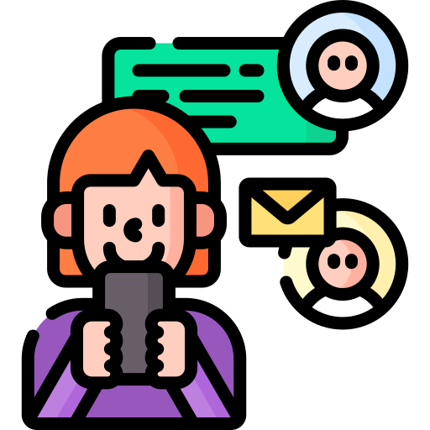



Why do we ‘need’ screens?
Notes:
Ask the children why do we need screens?
Answers they may give are:
For gaming, homework, watch Youtube, watch programmes, read books online, connect with friends.
Explain to children that in this day and age screens are very important in today’s society. Not a day will go by without having the need to use a screen.
BUT Just like the cavemen once discovered fire, they quickly learned that they must use it responsibly or they could end up in danger.

Slide 5
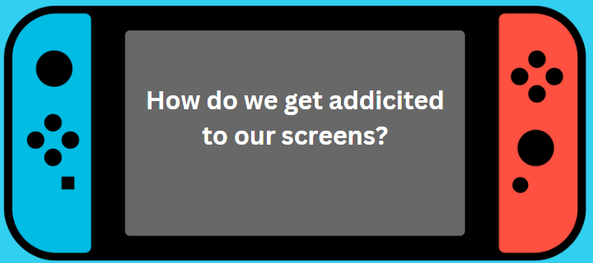
Design your own app!
Notes:
Split into groups.
Challenge:
Design the most addictive app in the world.
What would it include?
Then reveal...
"Congratulations...
You've just designed exactly what companies already do."

Slide 6
Endless Newsfeed
Always Available
Algorithm
Bright Colours
FOMO
Online Gaming
Micro Feedback

Slide 7
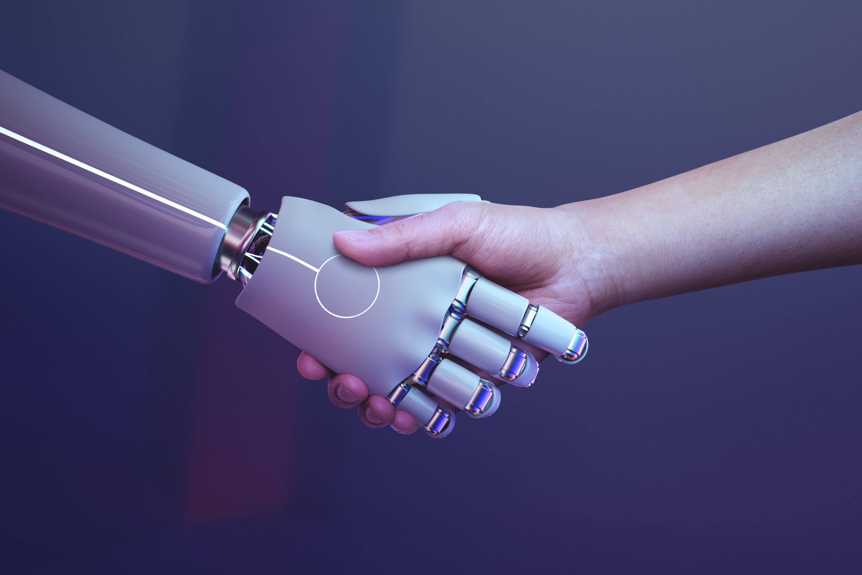
AI - How does it know me?
Notes:
Ask the children have they heard of AI?
Children hear "AI" constantly but rarely understand it.
AI is like a super-fast helper that notices patterns.
Example:
You watch 5 football videos.
AI thinks:
“Jake likes football."
It now shows:
football videos
football adverts
football games
football shirts
Can AI ever get it wrong?
Absolutely.
This opens discussion nicely.
Model answer should you need one - "AI has read and learnt from lots and lots of information, but it doesn't actually understand things like people do. Sometimes it guesses the wrong answer, a bit like when you answer a question in class but you're not quite sure.“

Slide 8

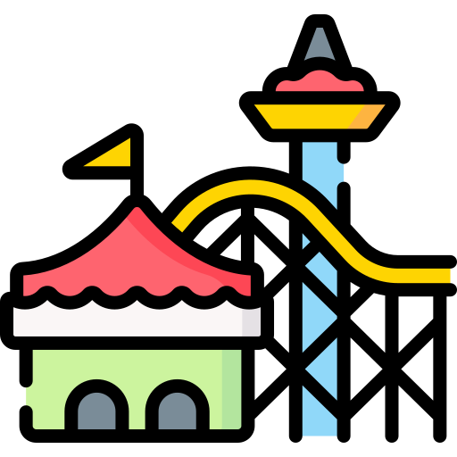

With the time we spend on our screens we could travel to…
Blackpool within 1 hour.
Notes:
Ask the children this riddle:
What is free, but priceless. You can’t own it but you can use it, You can’t keep it but you can spend it and once you have lost it you can never get it back? TIME
Have you ever thought about what happens to ‘time’ when we are on screens? When we are on our screens, we hardly notice the time go by.
What if we told you…

Slide 9

With the time we spend on our screens we could travel to…
London in 4 hours!
Notes:
or

Slide 10

With the time we spend on our screens we could travel to…
Inverness (Scotland) in 6 hours!
Notes:
Even…

Slide 11

With the time we spend on our screens we could travel to…
Paris in 8-9 hours!
Notes:
AND!
What else could you do with all that time?
Hand experiement

Slide 12
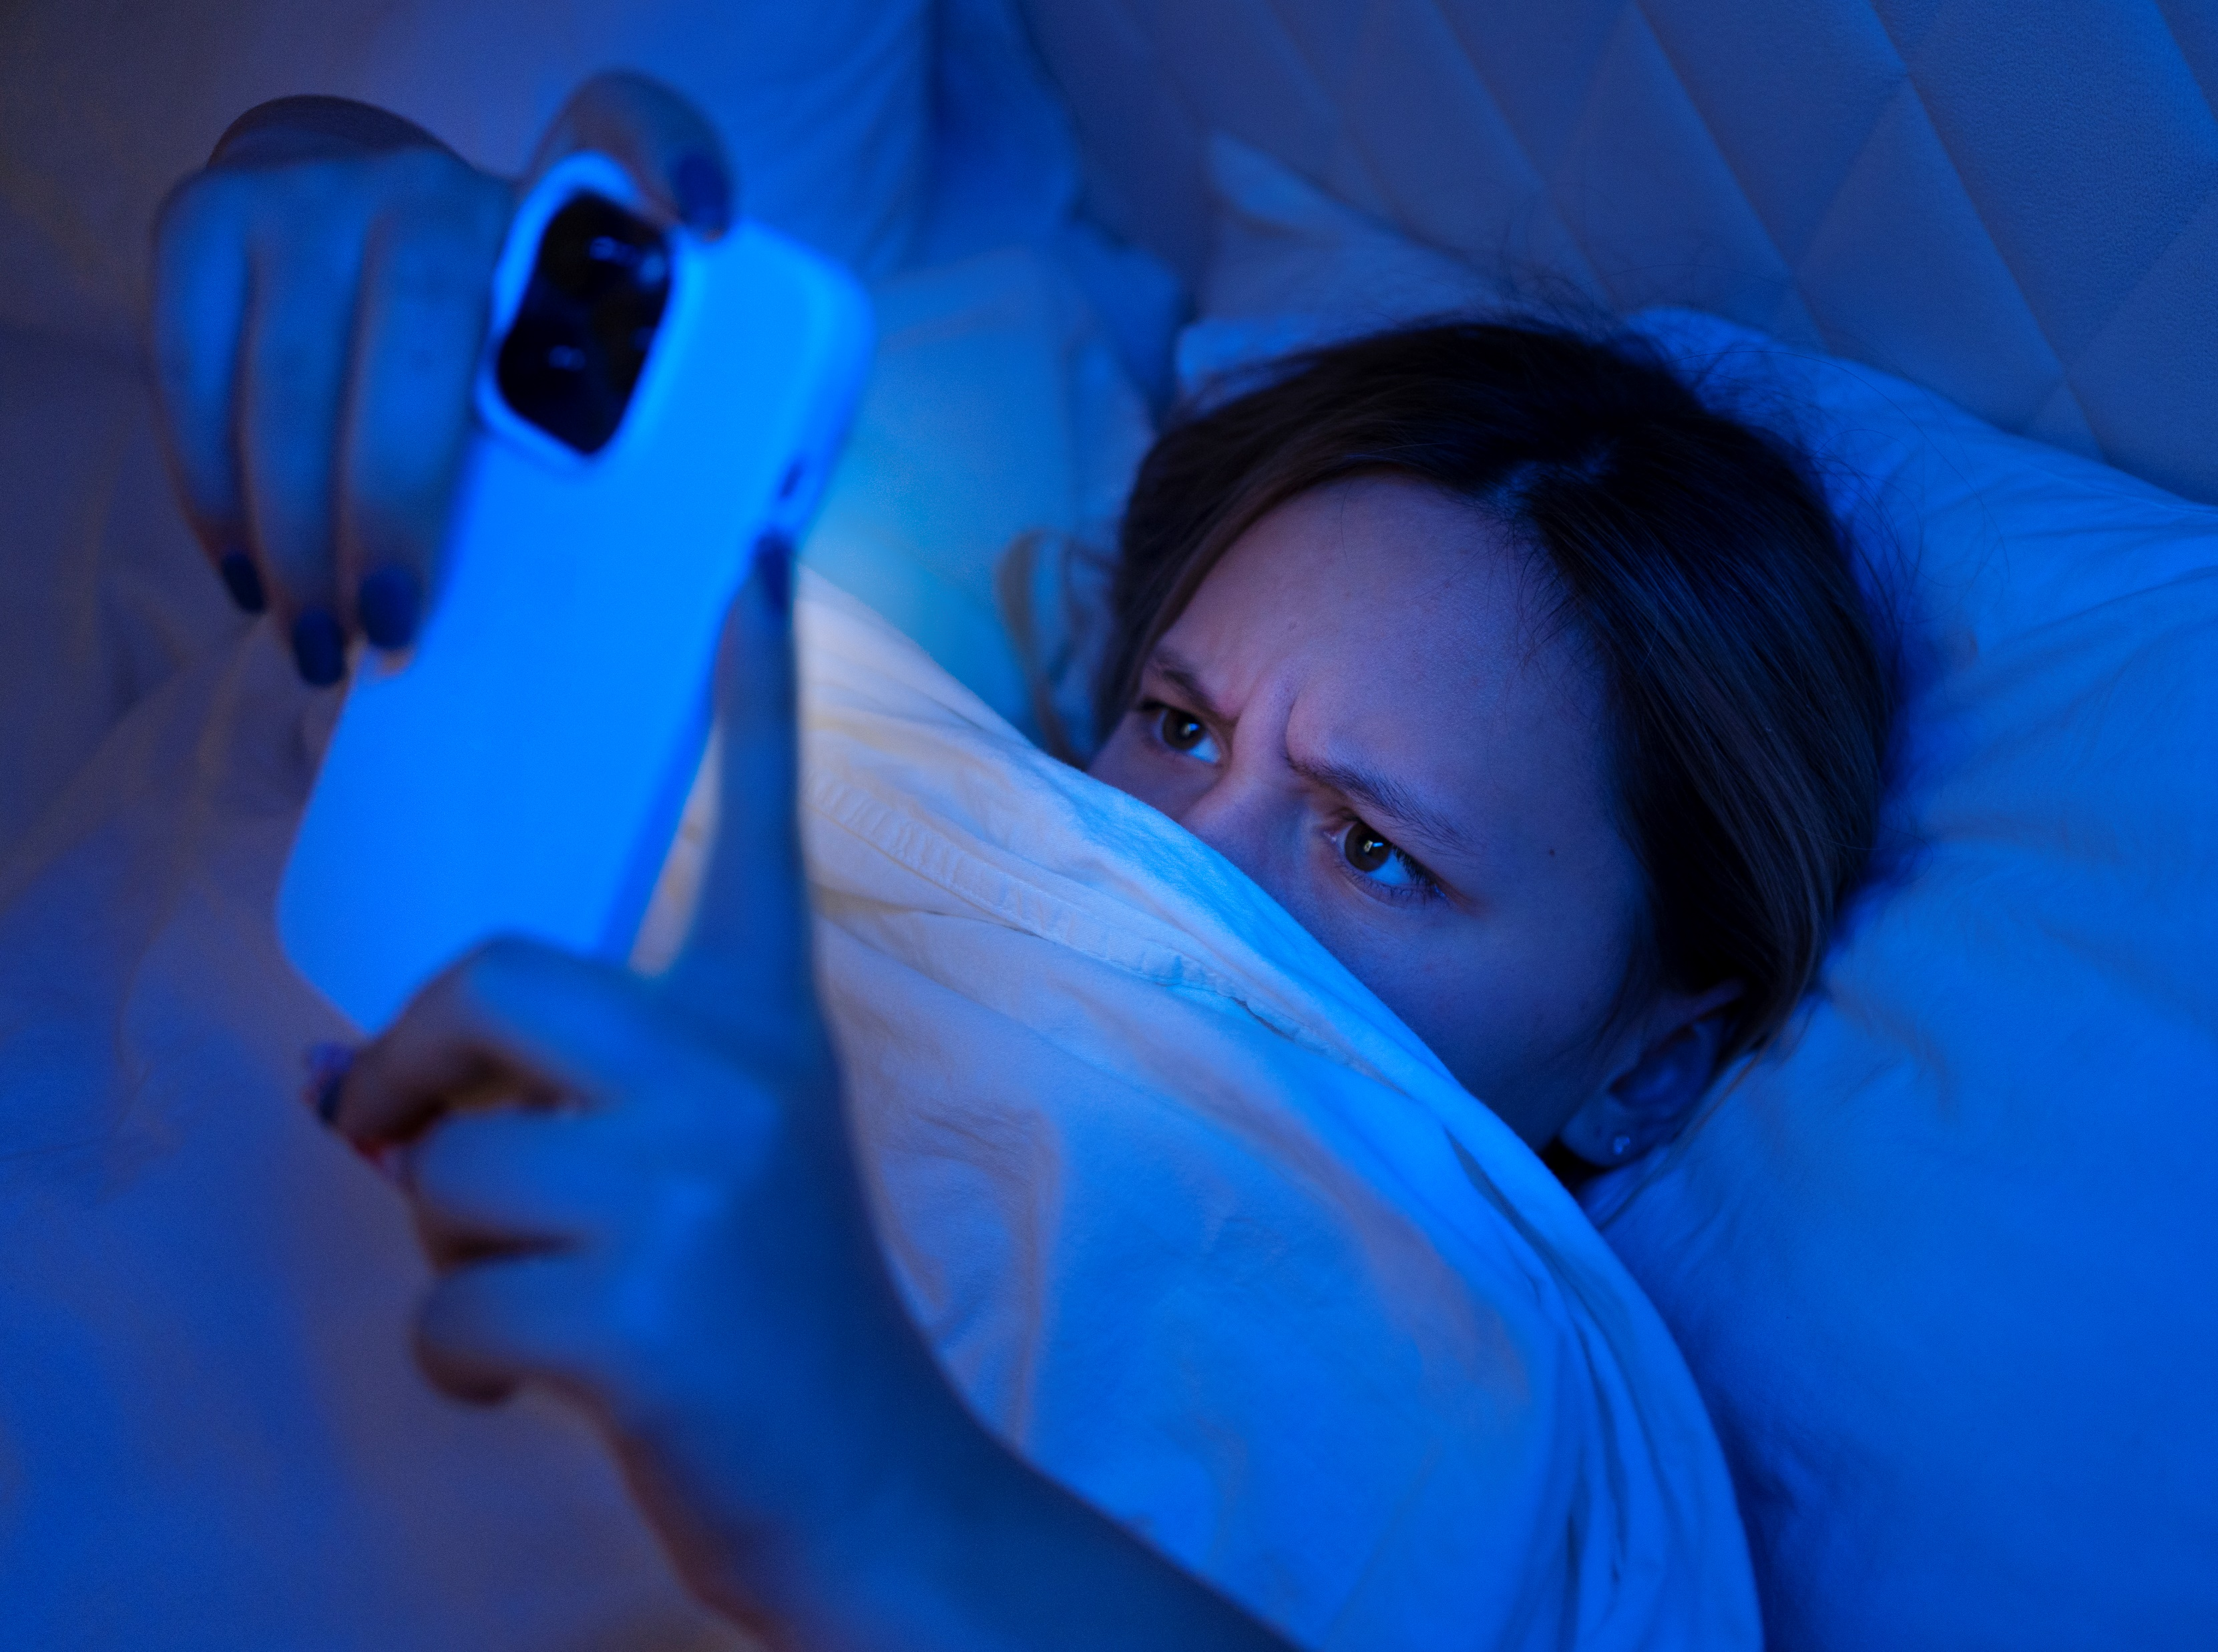
How do screens impact our lives?
Reduces physical activity
Affects concentration/alters your brain pathways
Changes how we interact with people
Mindless snacking
Interferes with sleep
Prevents being ‘present in the moment’
Helps with learning
Connect with friends
Entertaining
Notes:
As we know, screens are not all bad. They do help with learning, connect us with friends and are just all round entertaining.
It’s the overuse of screens that can be harmful to our health.
We will look at the negative impacts in more detail…

Slide 13
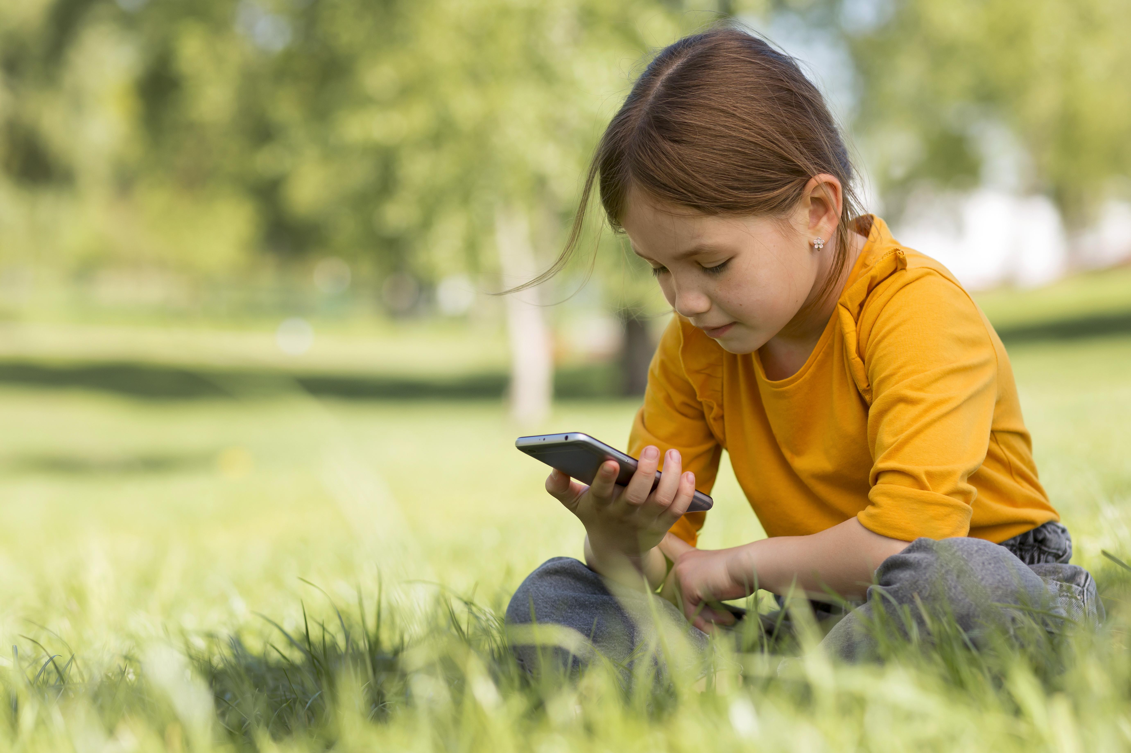
Affects concentration
Changes how we interact with people
Mindless
Snacking
Notes:
We have put these three together because they all go hand in hand.
Using screens excessively can change how we interact with others. When we are speaking to people online, we cannot usually see their facial expressions or hear the tone of their voice. This can make it easier for people to be mean or rude because they cannot always see how much their words might upset someone.
Concentration can also be affected. The digital world is training our brains to expect information instantly. Think about YouTube Shorts, TikTok, fast search engines and online games - there is very little waiting. Research suggests that constantly switching our attention can make it harder to concentrate on tasks that require focus for longer periods.
Screens can also affect our eating habits. Our bodies are really clever. They tell us when we are hungry and when we are full. However, if we are completely focused on a screen, we might not notice those signals.
Ask the class:
"Have you ever watched a film at the cinema or at home and suddenly realised your popcorn, crisps or sweets have almost disappeared?"
Explain that:
Sometimes we eat because we are hungry.
Sometimes we eat because we are bored.
Sometimes we simply aren't paying attention because our focus is on the screen.
Explain that eating meals without screens can help us notice when we are full and gives families the opportunity to talk about their day. Meal times and even car journeys are valuable opportunities for conversation and connection.
Activity
Ask the children to hold one hand in front of their face and focus on it.
Ask:
"What do you notice about the world around your hand?"
Expected answers:
The world goes blurry.
I can't see everything properly.
My hand is all I can focus on.
Explain:
When we focus very hard on one thing, everything else becomes less noticeable.
Screens can sometimes have the same effect. When we are completely focused on a screen, we may miss conversations, opportunities to move our bodies, or even the signals our own body is giving us, such as feeling hungry, full or tired.

Slide 14
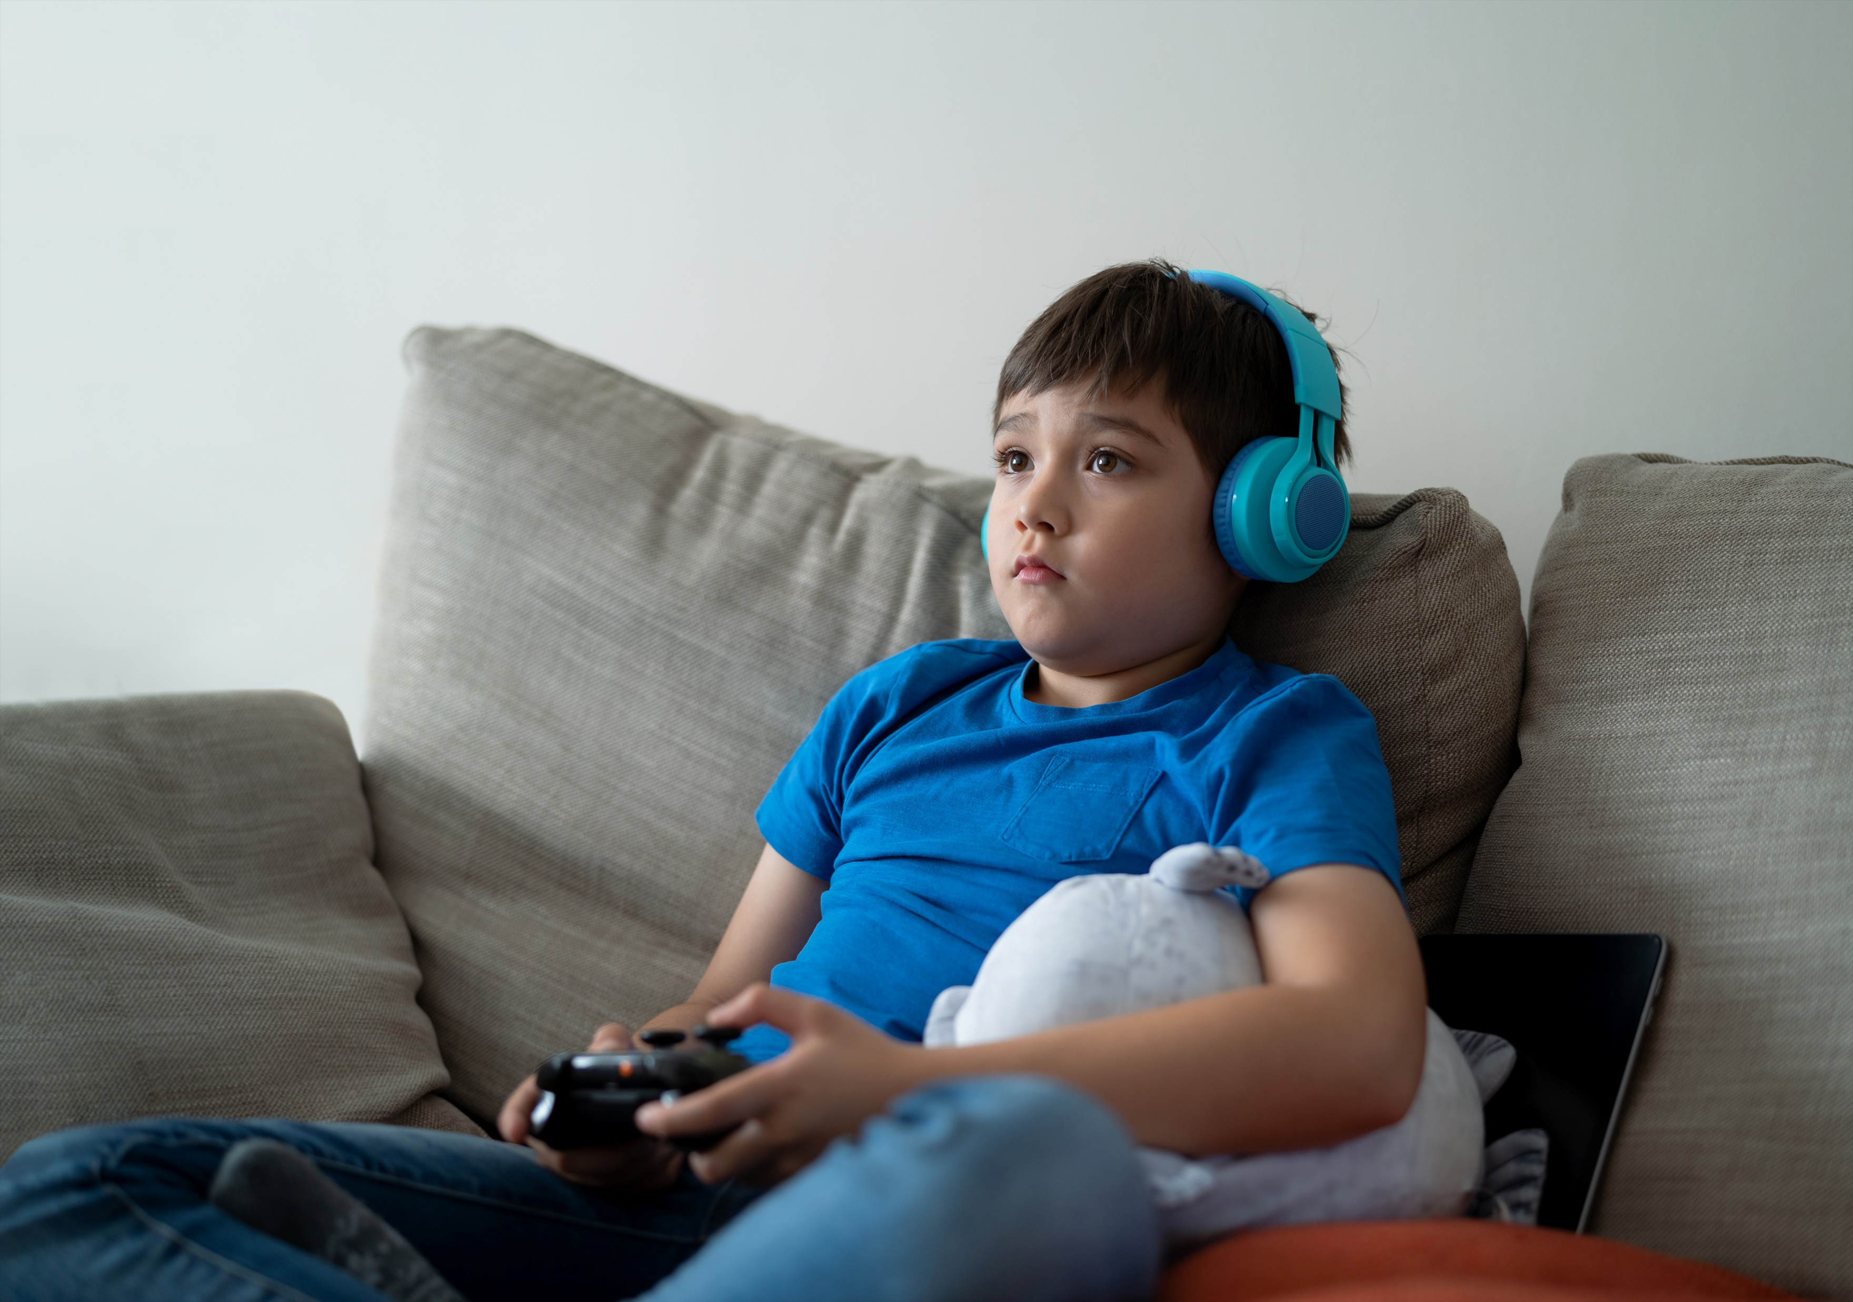
Reduces physical activity…
Think about the time spent travelling… If we’re not moving, we are burning very little energy.
Notes:
We have just shown how far we could travel in the time we spend on our screens.
Explain that when we spend long periods sitting on our screens, we are usually moving much less than our bodies need.
Ask the class:
"Where does our body get its energy from?"
Expected answers:
Food
Drinks
Explain that our bodies use this energy every time we move. Walking, running, climbing, dancing and playing all help our bodies grow and develop.
Explain that movement is important for healthy muscles, bones, our heart and even our brain. Regular movement can help us feel more awake, improve our concentration and give us more energy.
Brain Break – Let's wake our bodies up!
Explain:
"We've been sitting for a little while now. Let's wake our bodies and brains up with a quick movement break."
Ask the children to:
Stand up.
March on the spot for 20 seconds.
Reach both hands up as high as they can.
Touch their toes (or as far as they comfortably can).
Complete 5 star jumps (or continue marching on the spot if preferred).
Take one deep breath and sit back down.
Ask:
"How does your body feel now compared to one minute ago?"
Expected answers:
More awake.
Warmer.
More energetic.
Ready to learn.
Reinforce the message:
Even a short movement break can help wake up our bodies and brains.
If we spend long periods on our screens, it's important to take regular breaks to move our bodies.

Slide 15
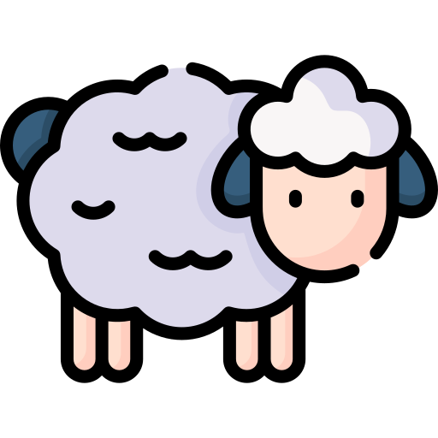
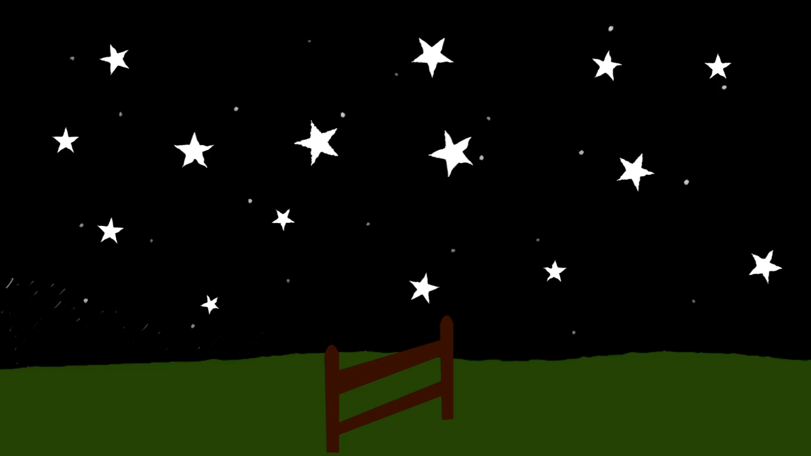
Notes:
Let’s count how many sheep you see on the screen DO NOT SHOUT OUT.
Ask the children to raise their hand if they counted 7 sheep.
Ask the children to raise their hand if they counted 8 sheep.
Please note you can change this method of answering as some children may answer with the majority, especially if they did not pay attention at all.
The correct answer is 8. It is really difficult to concentrate on more than one thing at a time. In fact, multi tasking is a myth.
What your brain can do is switch really quickly from one focus to another, but the longer you spend focusing on one thing, the more difficult it is to bring your focus back to that first task.
This is why it is illegal to use a mobile phone and drive.

Slide 16
Notes:
Let’s count how many sheep you see on the screen DO NOT SHOUT OUT.
Ask the children to raise their hand if they counted 7 sheep.
Ask the children to raise their hand if they counted 8 sheep.
Please note you can change this method of answering as some children may answer with the majority, especially if they did not pay attention at all.
The correct answer is 8. It is really difficult to concentrate on more than one thing at a time. In fact, multi tasking is a myth.
What your brain can do is switch really quickly from one focus to another, but the longer you spend focusing on one thing, the more difficult it is to bring your focus back to that first task.
This is why it is illegal to use a mobile phone and drive.

Slide 17



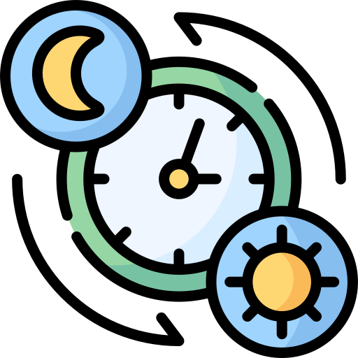

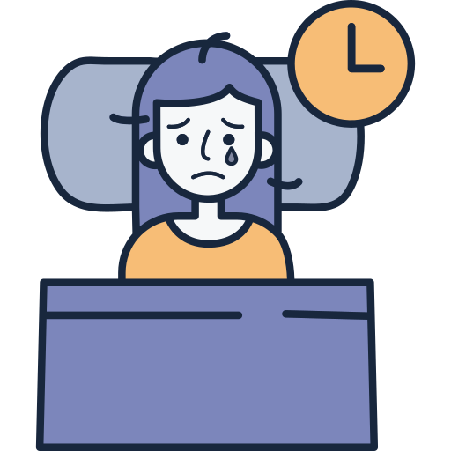

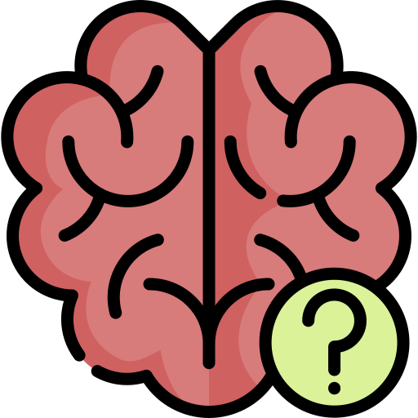

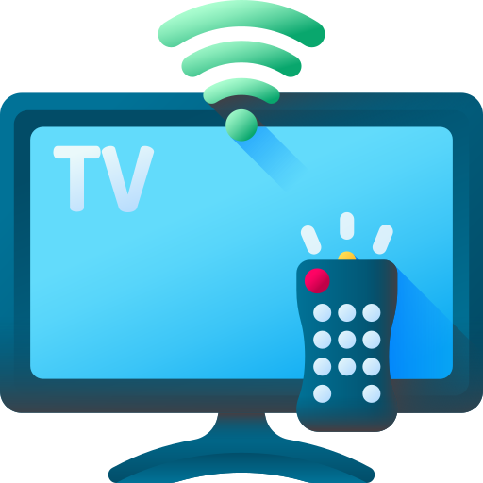
Screens can interfere with sleep …
Notes:
Explain that for thousands of years our brains have used light and darkness to know when it is time to be awake and when it is time to sleep. During the day, natural daylight contains lots of blue light. This sends a message to our brain that it is daytime and helps us feel awake and alert. Explain that screens, TVs, tablets and phones also give off blue light. Bright lights in our homes can have a similar effect. Our brains produce a hormone called melatonin. Melatonin helps us to feel sleepy and prepares our body for sleep. If we use screens close to bedtime, the blue light can reduce the amount of melatonin our brain produces. This can trick our brain into thinking it is still daytime. Ask the class: "Has anyone ever said, 'I'll just watch one more video' or 'I'll just play one more game'?"
Explain that although some people fall asleep while using a screen, the quality of their sleep may not be as good because their brain has stayed alert for longer. Poor quality sleep can make it harder to: concentrate in school
remember new information
manage our emotions
feel awake and ready to learn
Reinforce the key message: Screens are not bad, but giving our brain a break from blue light before bedtime can help us get a better night's sleep.
Your brain uses light to know when it's time to be awake or asleep.

Slide 18

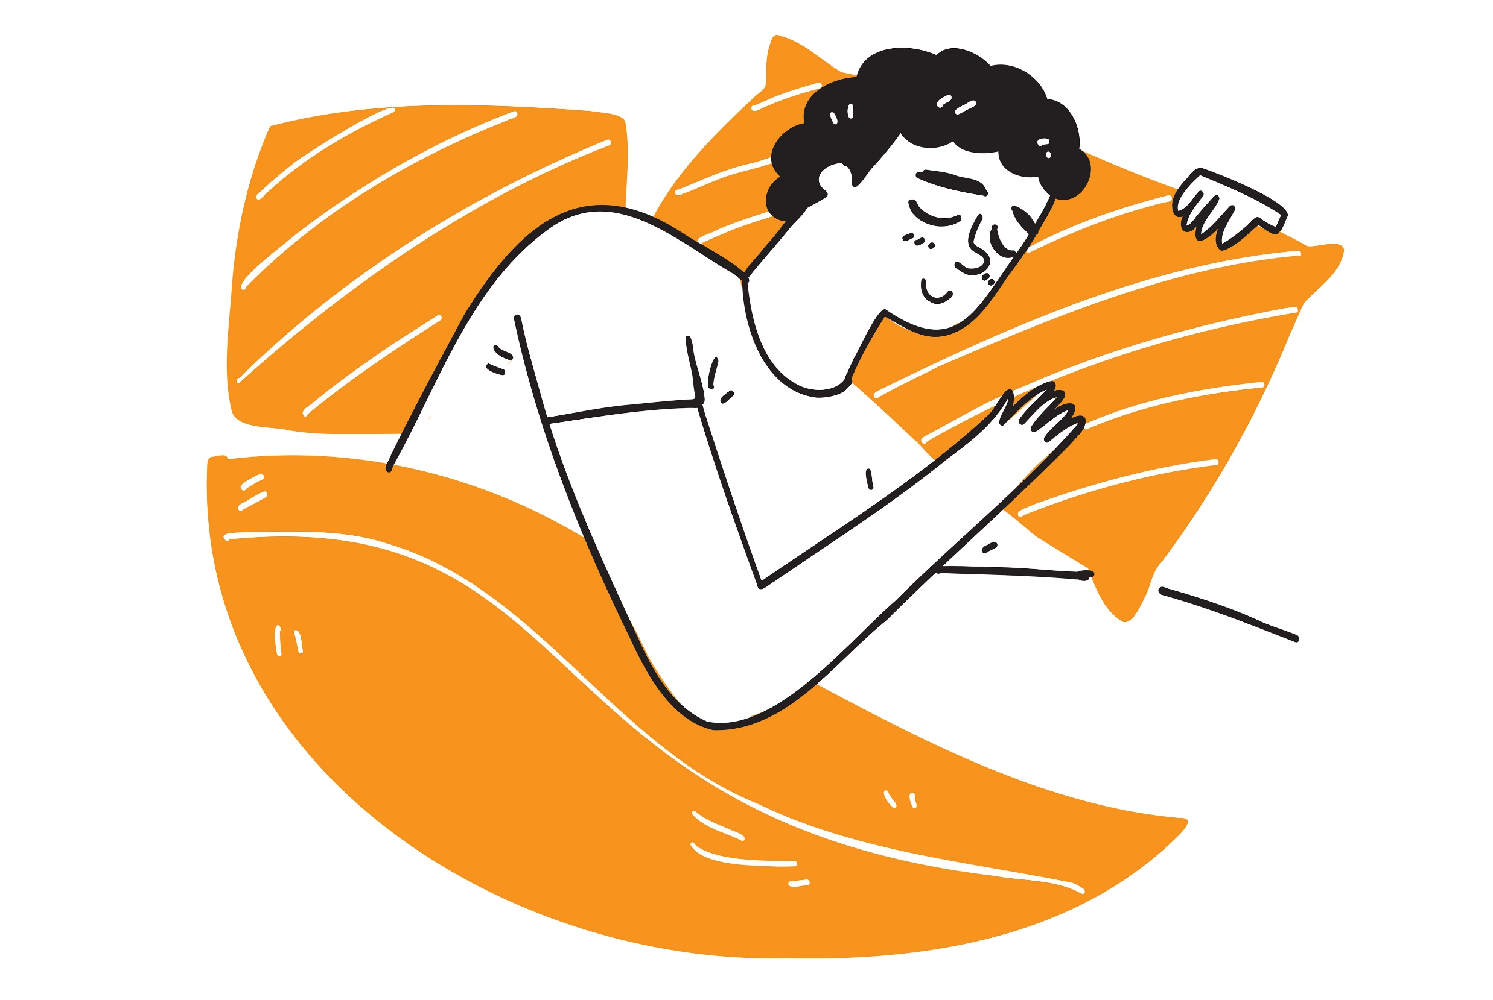
Sleep helps with:
Growing strong
Remembering things
Memory storage
Appetite
Staying well
Emotions
Mood and behaviour
Energy
Notes:
Explain:
"You might think your brain goes to sleep when you do, but actually it's one of the busiest times of the whole day."
Play the Inside Out clip.
Ask:
"Can anyone remember one of the jobs Riley's brain was doing while she was asleep?"
Expected answers:
Sorting memories.
Keeping important memories.
Throwing away unimportant memories.
Continue:
"Let's imagine this classroom."
"At the end of the school day we've all been working really hard."
"There are books on the floor, paper everywhere, pencils on the tables and chairs not pushed in."
"Every night the cleaner comes in and gets the classroom ready for the next day."
"Imagine if the cleaner didn't come in tonight."
Ask the class:
"What would the classroom look like tomorrow morning?"
Expected answers:
Messy.
Untidy.
Hard to find things.
Distracting.
Continue:
"Could you still learn?"
Children will usually say:
"Yes."
Then say:
"Exactly. You could still learn, but it would probably be harder."
"You might spend time moving things out of the way."
"You might get distracted."
"You might not be as ready to learn as you normally would be."
Then bring it back:
"Sleep is a bit like having a cleaner for your brain."
"While you're asleep your brain sorts today's memories, clears away waste and gets everything ready for tomorrow."
"If we don't get enough good quality sleep, our brain hasn't had as much time to do all of those important jobs."
Finish with:
"That's why sleep helps us learn, remember, concentrate and feel ready for a new day, so when we stay on our screens too late, we're not just missing out on sleep... we're missing out on everything sleep is helping our bodies do."

Slide 19
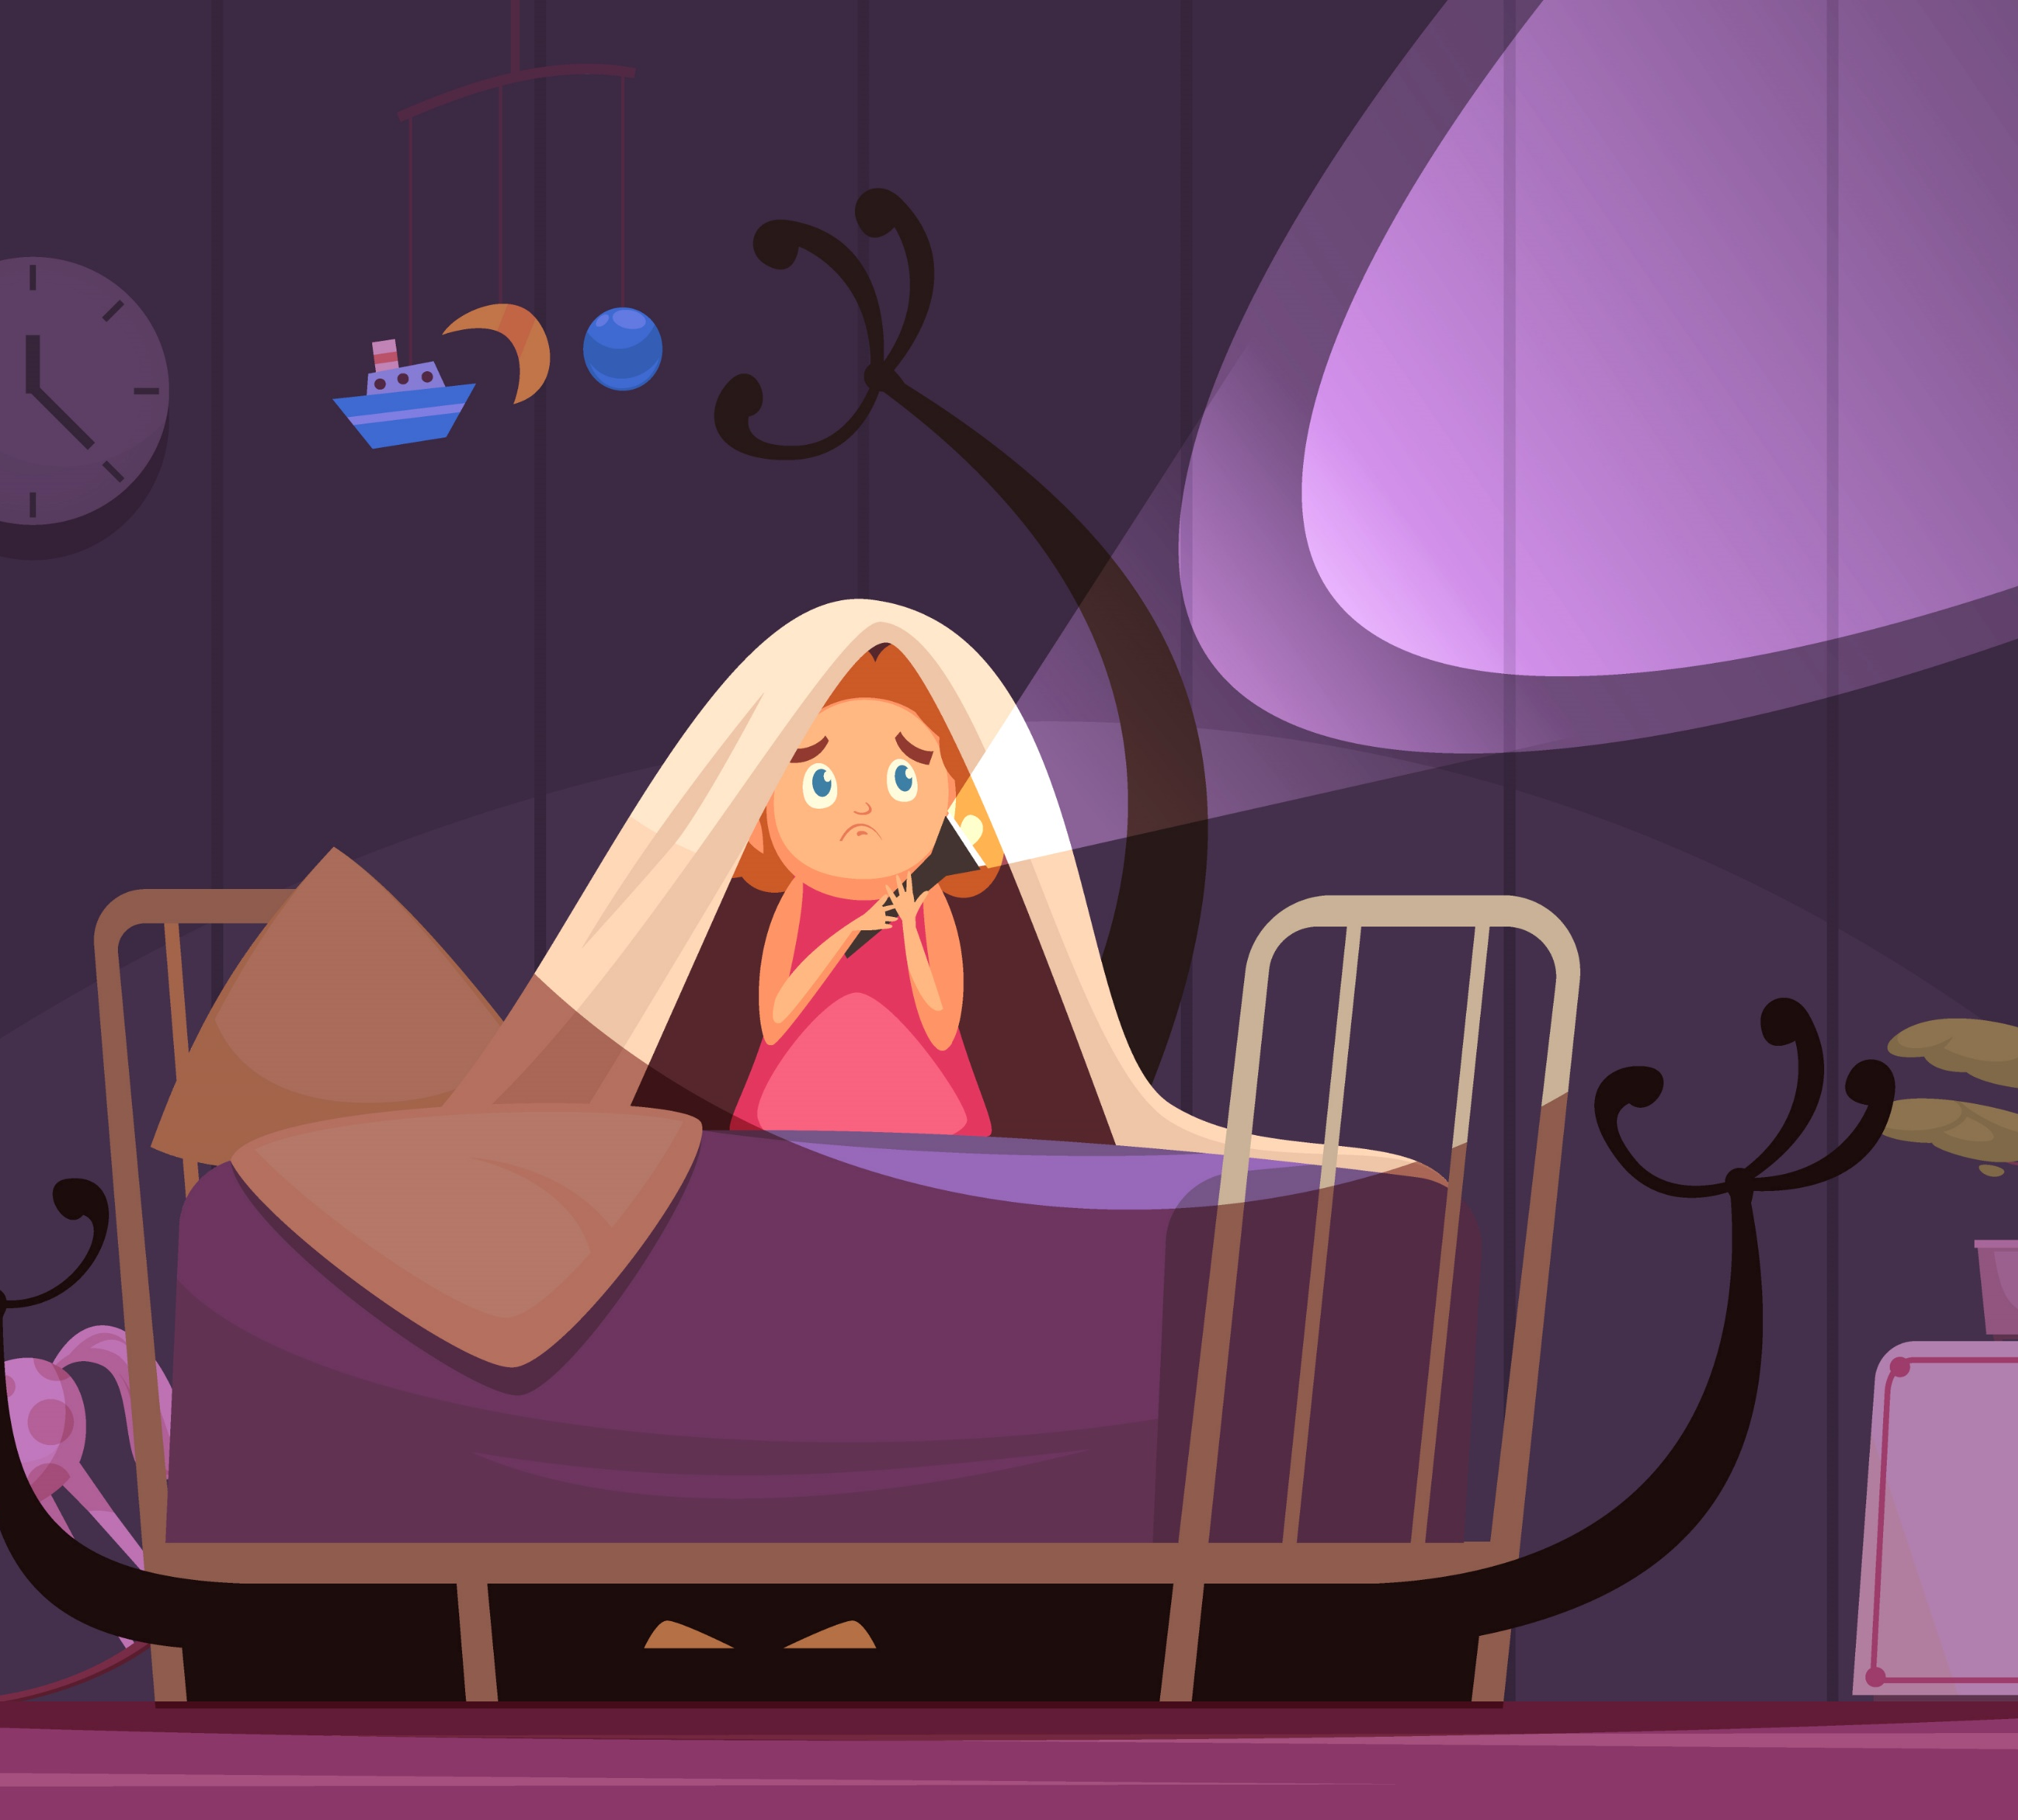
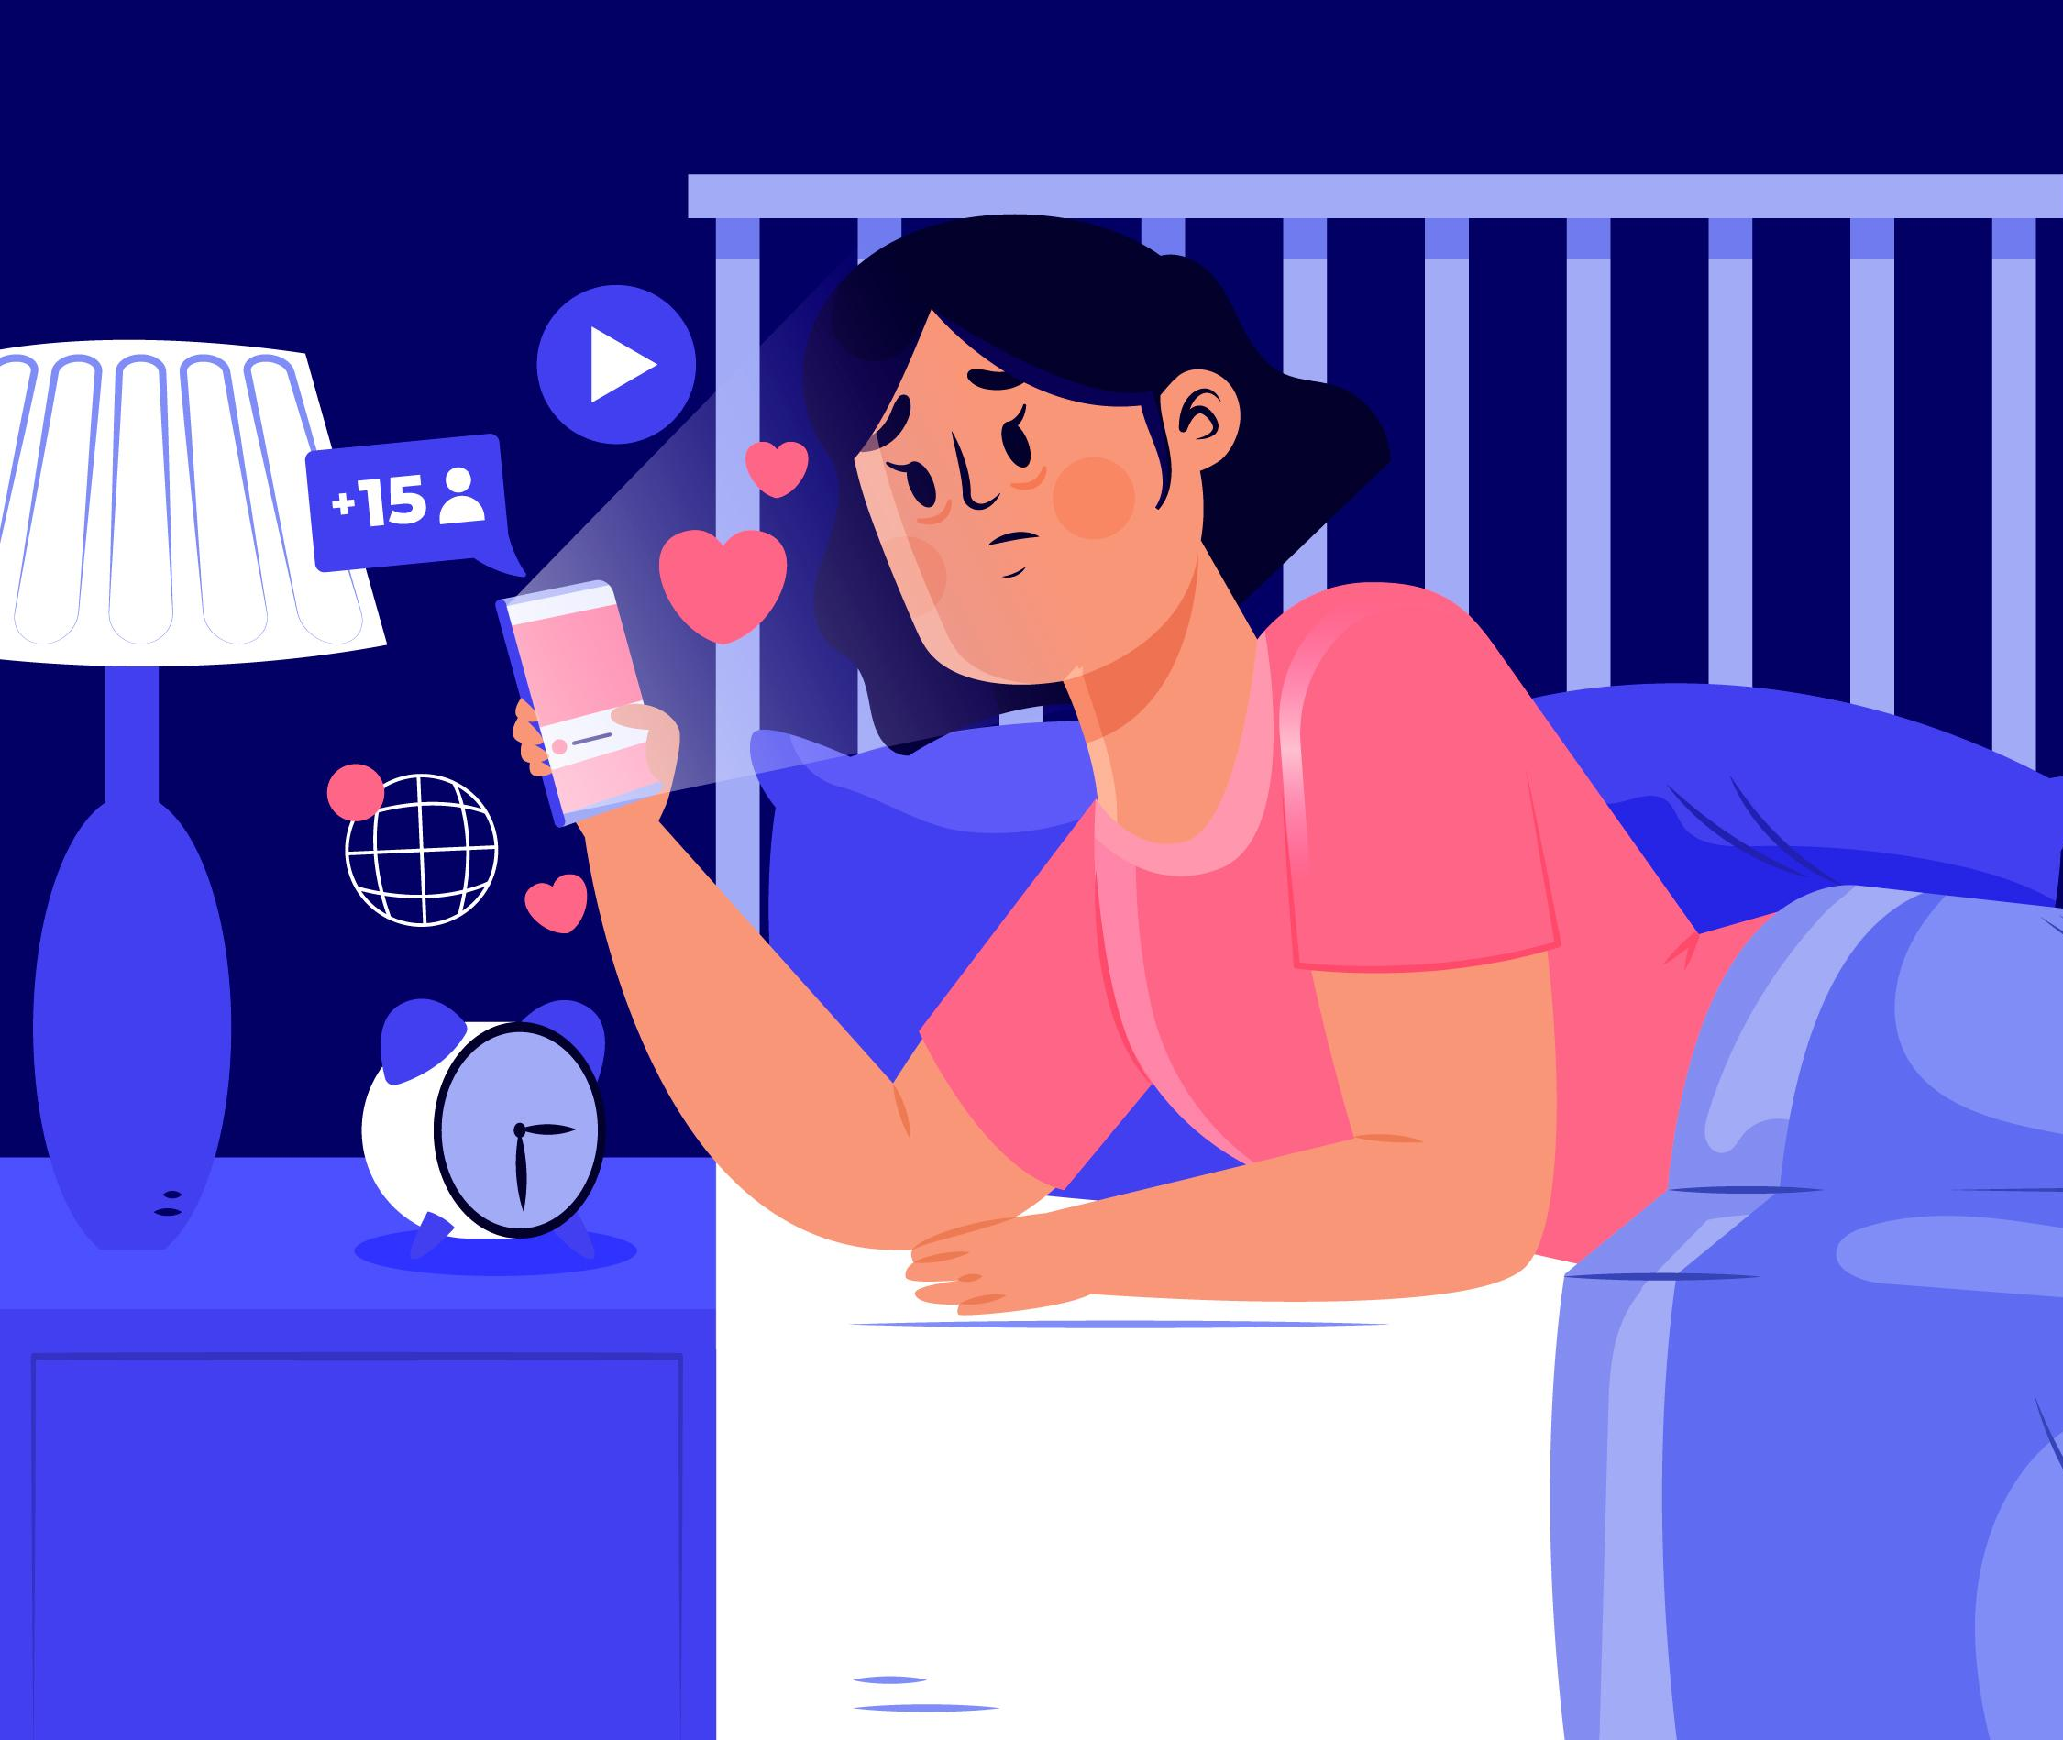
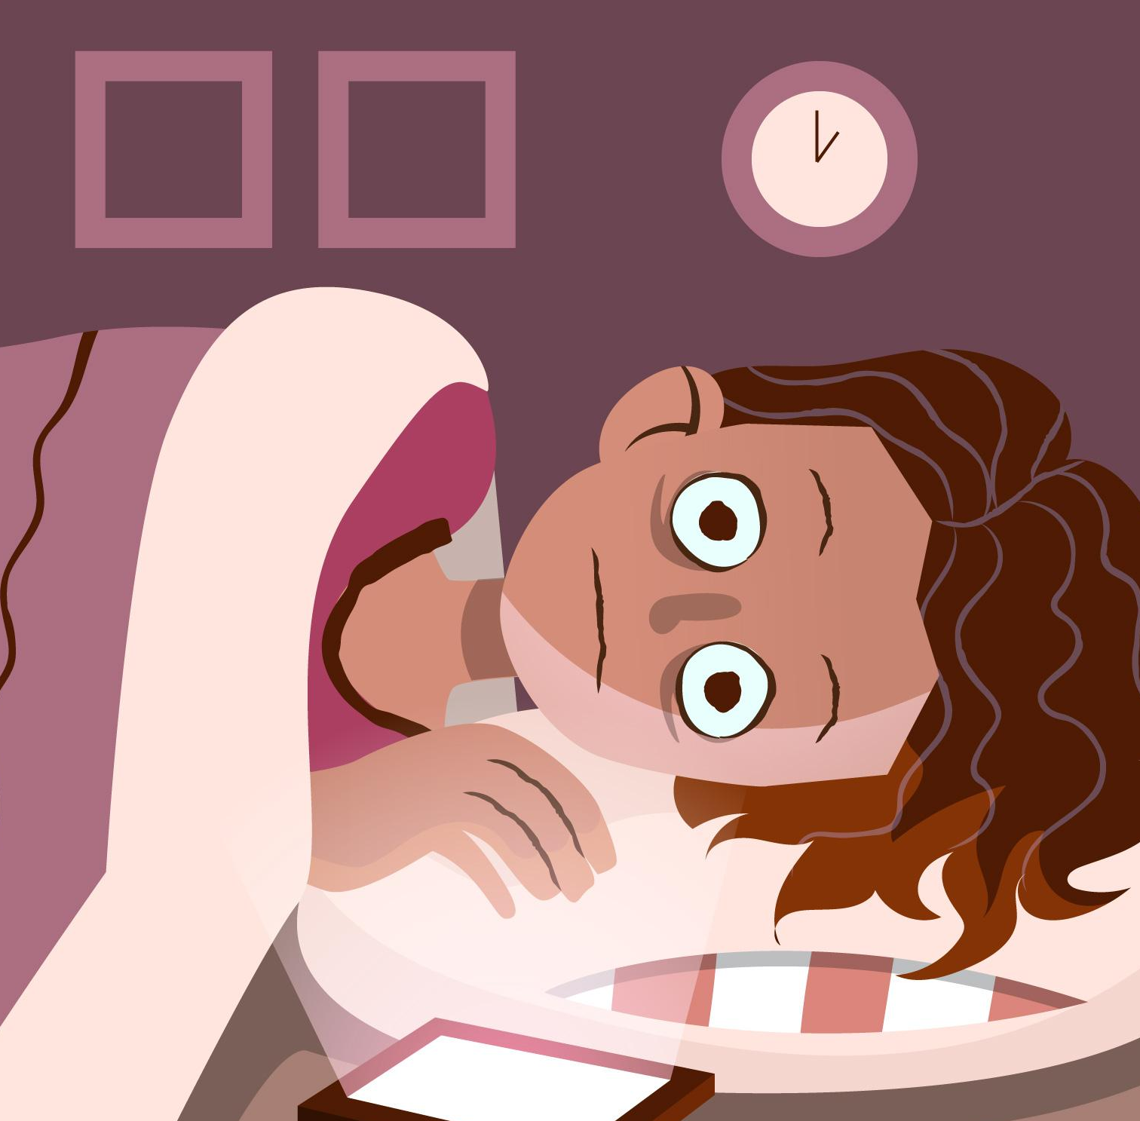
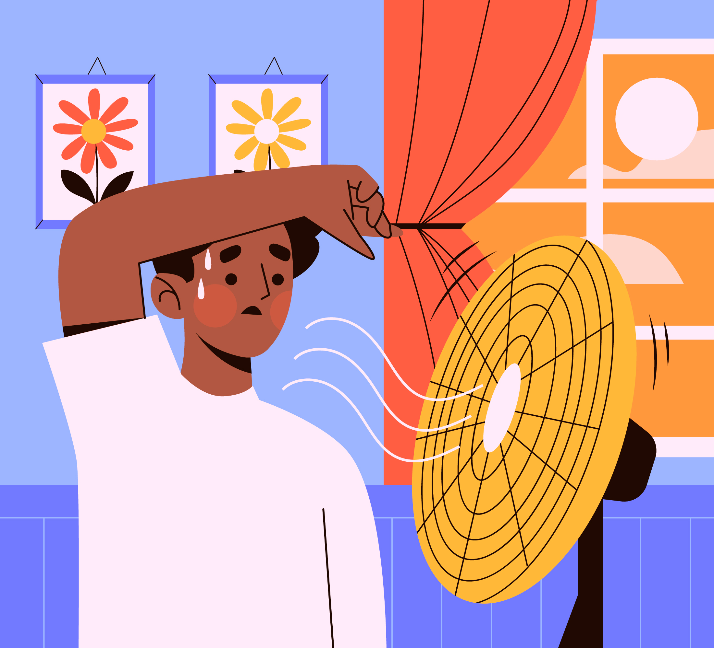
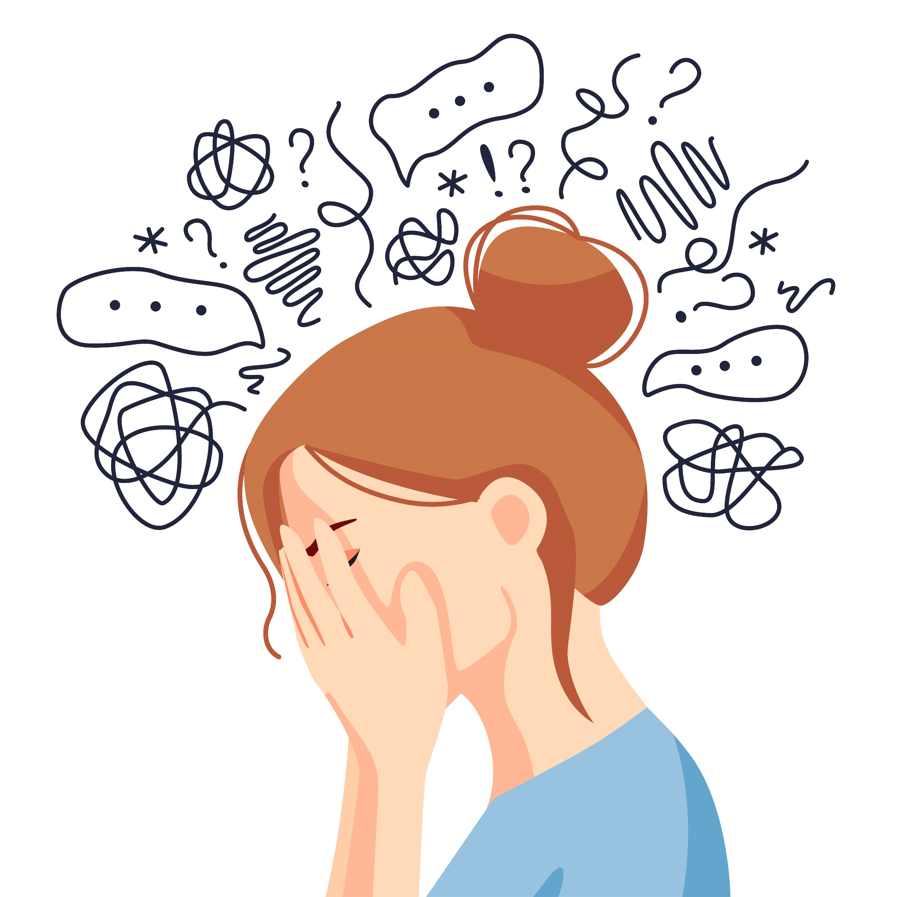
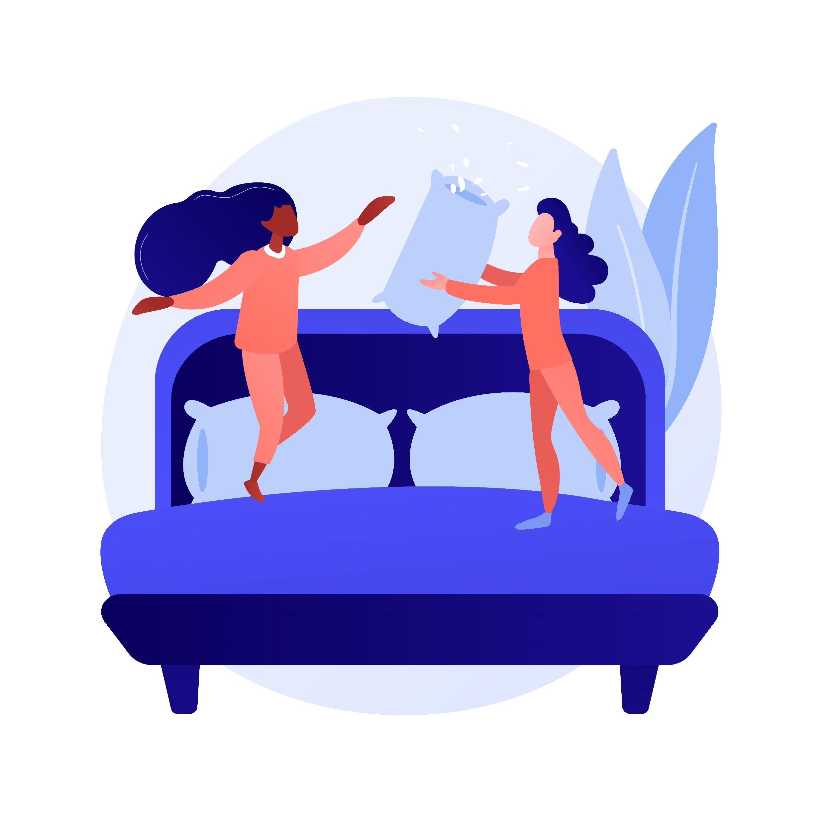
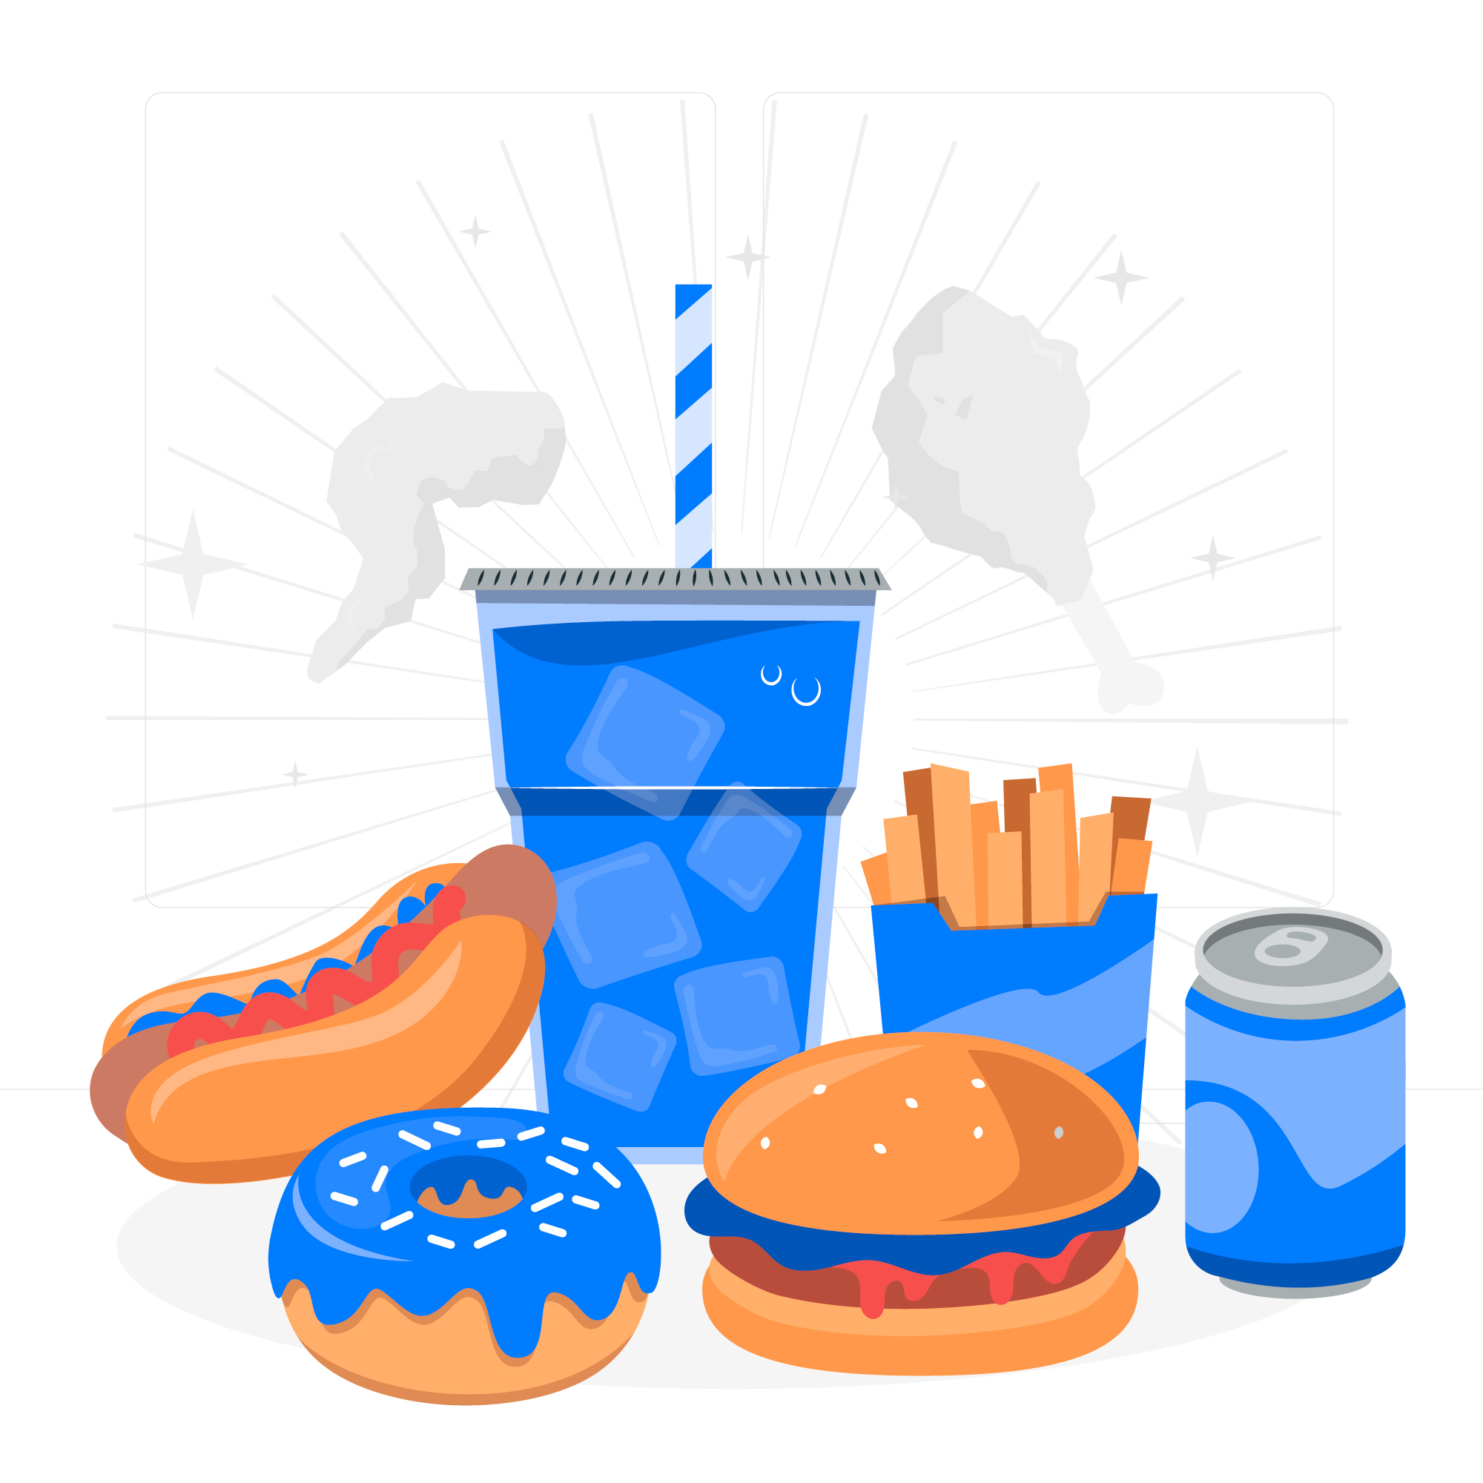
What keeps us awake?
Scared of the dark/noises
Screens too close to sleep time
Not feeling relaxed
Room temperature
Thoughts and Worries
Too much energy
Unhealthy foods
Notes:
We asked children and young people what keeps them awake at night and these were some of the most common answers:
Scared of the dark or unexplained noises.
Screens too close to bedtime or wanting to check their phone during the night.
Not feeling relaxed.
Being too hot.
Thoughts and worries.
Feeling full of energy.
Eating or drinking things that make it harder to sleep.
Explain that all of these thoughts, feelings and experiences are normal. Everybody has times when they struggle to sleep.
Activity
Think - Pair - Share
"Choose one of these problems with the person next to you."
"Can you think of one thing that might help?"
Allow 1-2 minutes.
Take feedback.
Facilitator prompts
Scared of the dark
Try to understand what is making you feel frightened.
Talk to a trusted adult.
A night light may help some children.
Recommend Orion and the Dark as a family film about facing fears.
Screens
We've already learnt why blue light can keep our brain awake.
We don't need to check our phones throughout the night in case we miss something.
Good friends understand that people need to sleep.
Use Do Not Disturb.
Leave devices outside the bedroom if possible.
If you need an alarm, use a separate alarm clock.
Thoughts and worries
Ask:
"What helps you when you have lots on your mind?"
Suggestions:
Read a book.
Talk to a trusted adult.
Write worries down ready to talk about tomorrow.
Gentle breathing or hand massage.
Too much energy
Ask:
"What could help?"
Expected answers:
Be active during the day.
Spend time outside.
Avoid exciting games just before bed.
Food and drink
Explain:
Some foods and drinks contain caffeine, which can make it harder to fall asleep.
Eating a very large meal or lots of sugary foods close to bedtime can make some people feel uncomfortable and make it harder to settle.
“You don't have to be available all the time. Everyone deserves time to rest and sleep. Remember, apps are designed to encourage us to come back. It's okay to choose to switch them off. That means you're in control, not the app."

Slide 20


Screens Down or Screen Time!
We’re walking to school and need to pay attention to the paths/road.
We still need to get ready for school, if we don’t hurry, we might be late.
We’re learning in school and the teacher needs us to use the tablets.
It’s close to sleep time and our adult says it is time for bed.
We’re having tea together with our family.
We have free time to play with our friends.
Notes:
Think about when you need to concentrate the most. Setting your own boundaries is a really positive way to show adults that you’re responsible. Think of it as ‘leveling up’.
In conclusion, the best time to go on your screen is when nothing else needs your attention first, like getting ready to go somewhere, going to sleep and talking with your friends and family.

Slide 21
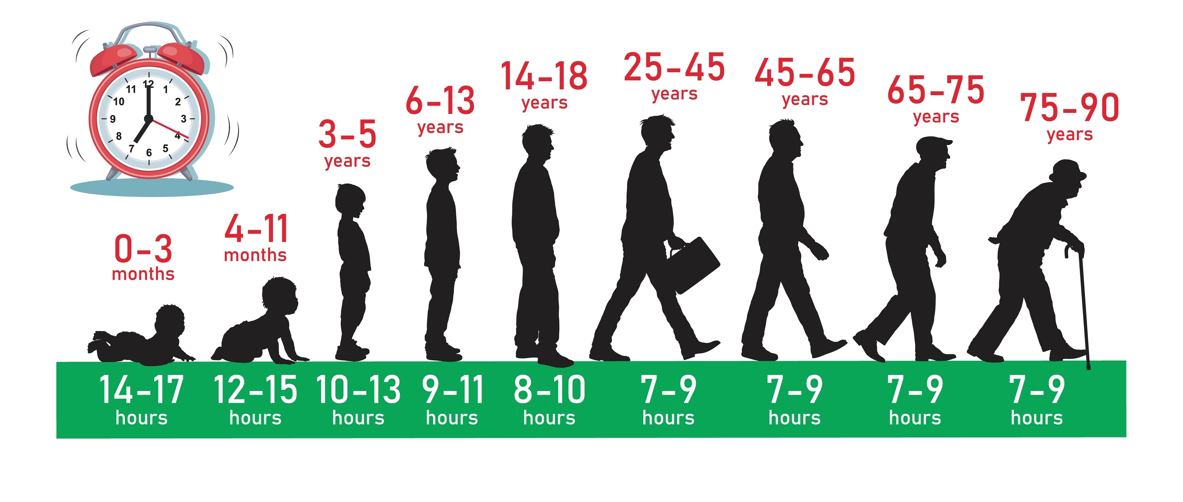
How much sleep is enough?
Notes:
Ask the children to guess how much sleep a:
0-3 month old needs? 14-17 hours
4-11 months 12-15 hours
3-5 years 10-13 hours
6-13 years 9-11 hours
14-18 years 8-10 hours
18-25 is in the middle of 7-10 hours
25+ 7-9 hours
This is the recommended amount and how much sleep each individual needs varies from person to person.

Slide 22
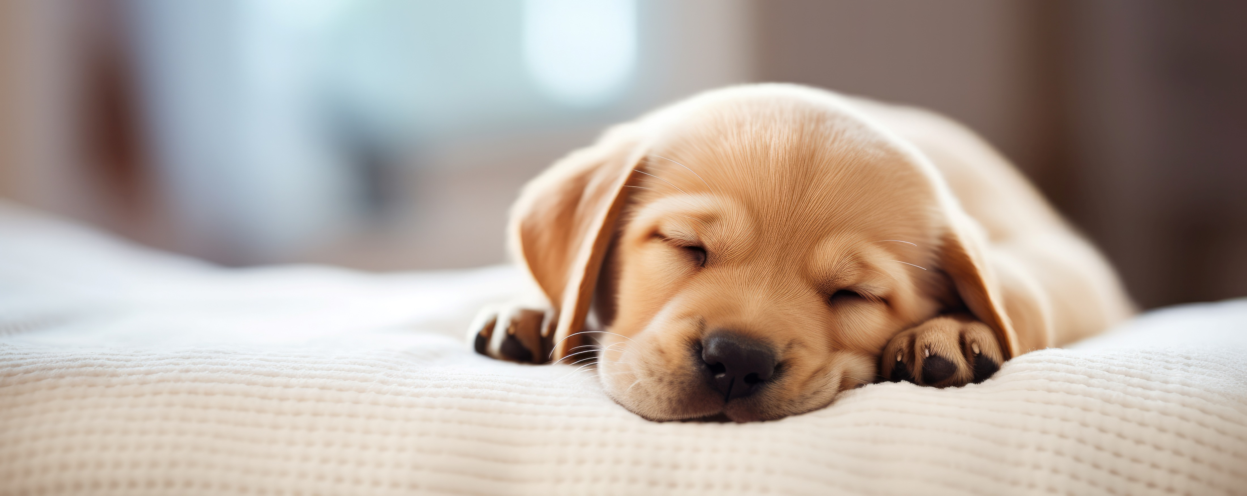
What time should you aim to be asleep by?
Sleep Time | Wake Time
07:00pm | 06:00am
07:30pm | 06:30am
08:00pm | 07:00am
08:30pm | 07:30am
09:00pm | 08:00am
Notes:
Encourage the children to think about what time they have to be up for school. Explain that we should try and get the maximum amount of sleep we can, to be our best selves. Recap back to how they feel when they don’t have a good sleep.
Emphasise that it is difficult getting up of a morning, especially in the winter months, but if we have had a good sleep and jump straight about of bed, ready to kick start our day, we will feel better physically and mentally.

Slide 23
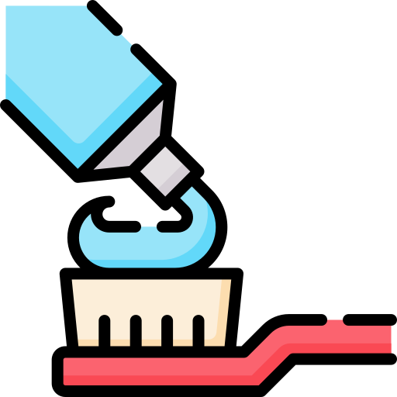
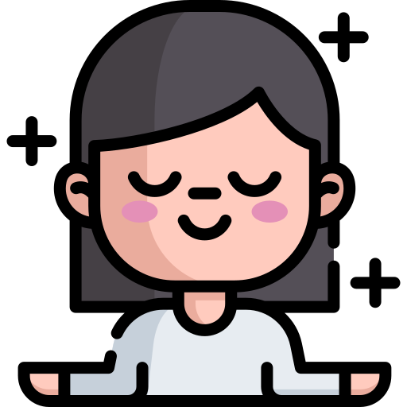

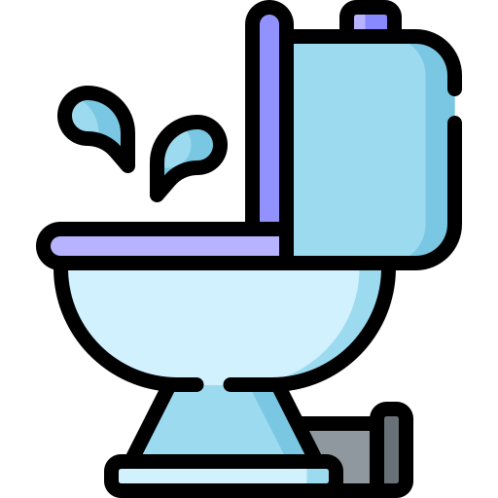
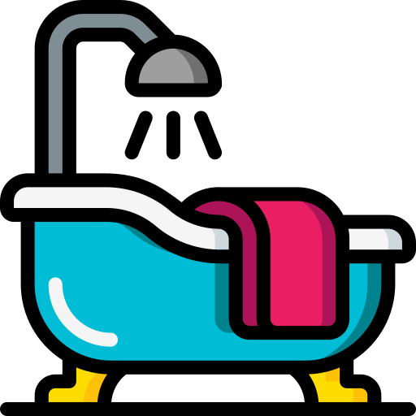
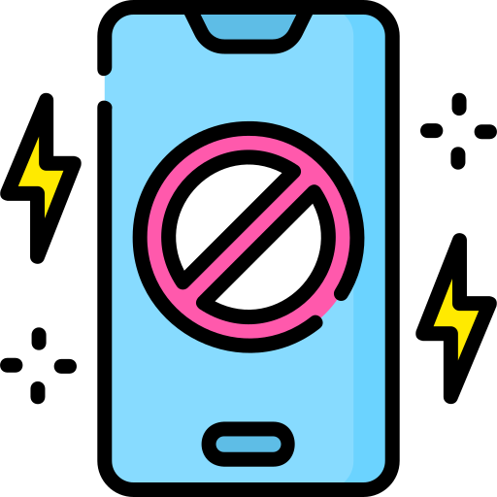
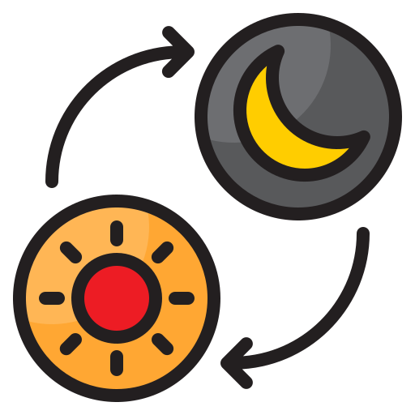

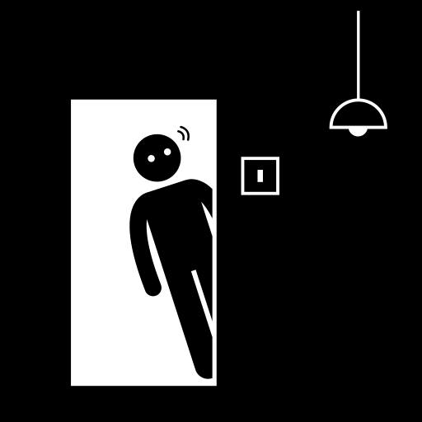
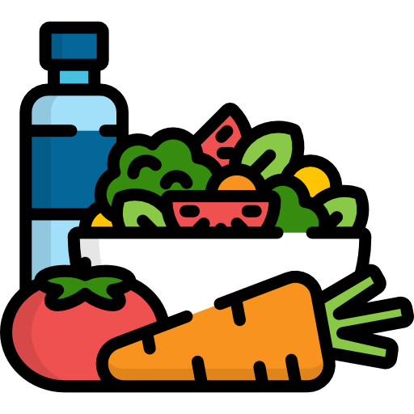

How can we get our brains ready for sleep?
Notes:
Health professionals call this sleep hygiene. Sleep hygiene means the habits and routines that help us get a good night's sleep.
Point to each icon and ask the class what they think it means before explaining.
🦷 Brush your teeth
Getting ready for bed helps tell our brain that bedtime is getting closer.
😌 Relax
Reading, colouring, listening to calm music or gentle breathing can help our brain slow down before sleep.
🛁 Bath or shower
A warm bath or shower can help us relax as part of our bedtime routine.
🌙 Dim the lights
As bedtime gets closer, make the room darker where possible.
This helps our brain produce melatonin and prepare for sleep.
🚪 Dark bedroom
Keep the bedroom as dark and quiet as possible, while making sure it still feels safe and comfortable.
📵 Screens away
Try to avoid screens for at least 30–60 minutes before bedtime.
If possible, leave phones and tablets outside the bedroom or use Do Not Disturb.
🥗 Healthy food
Eating a balanced diet and avoiding foods or drinks with caffeine close to bedtime can support good sleep.
📖 Read a book
Reading can help our brain relax before going to sleep.
🏃 60 minutes active
Being active during the day can help our bodies feel ready for sleep at night.
🕒 Regular bedtime
Try to go to bed and wake up at similar times every day, including weekends where possible.

Slide 24
Healthy Screen Pledge
Choose ONE healthy screen habit that you are going to try this week.
Notes:
Healthy Screen Pledge
Ask the children who will share a healthy screen/sleep habit they will share with the room.

Slide 25
Create your own healthy bedtime plan.
🌞 During the day I will...
📱 I'll switch my screen off at...
📖 Before bed I'll...
😴 My bedtime is...

