Slide 1

Tobacco & Vape Education
Notes:
** Check in with Class teacher any Triggers for students
Introduction – name – organisation – what we will cover – why we are here – Informed choice.
Tobacco smoking /vaping
To give information to YP to support in making an Informed choice for themselves.

Slide 2
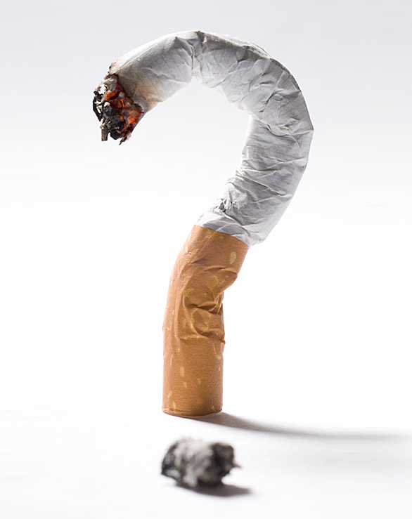
What do you know about smoking?
Chemicals are added in the growing process
Made from tobacco leaves
It’s a drug
Age Restricted
It is addictive
Second-hand Smoke
Affects your fitness level
Costs a lot of money
Can cause lots of health problems
Affects the environment
Notes:
Gather Base Knowledge - keep it concise – read through slide – use as bullet points of areas that can cover in session

Slide 3
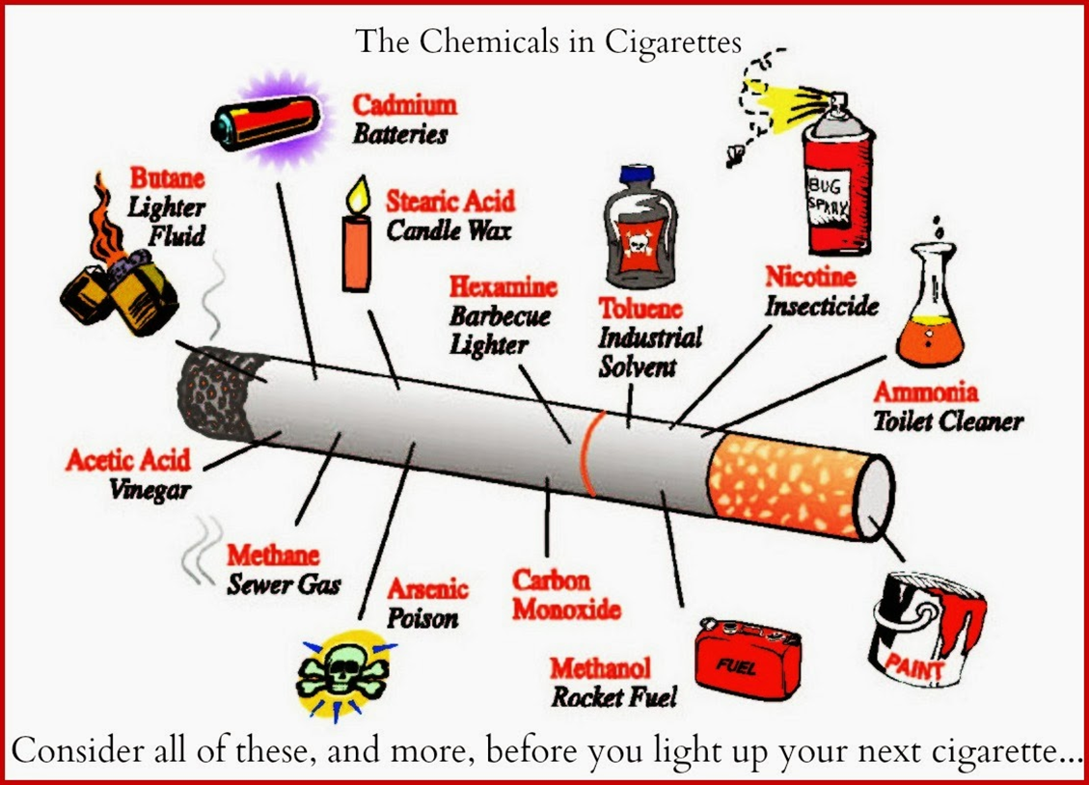
What is in a cigarette?
Health harms of tobacco
Nicotine: Highly addictive substance
Tar: Causes lung diseases
Carbon Monoxide: Reduces oxygen in the blood
Other Chemicals: Over 7,000 chemicals, 69 known carcinogens
Smoking harms nearly every organ of the body. It causes lung cancer, respiratory disease and cardiovascular disease, as well as many cancers in other organs including lip, mouth, throat, bladder, kidney, stomach, liver and cervix.
Notes:
There are over 7,000 chemicals in a cigarette – does anyone know of any ?
Nicotine; Nicotine is a very addictive substance and can have many impacts on the body and brain – naturally occurring chemical in tobacco plant
- Tar is the sticky brown substance that stains the teeth when people smoke. It also causes the fingers to turn yellow-brown.
Tar contains cancer causing particles (carcinogens).
Tar damages your lungs by narrowing the small tubes (bronchioles) that absorb oxygen. It also damages the small hairs (cilia) that help protect your lungs from dirt and infection. This can lead to a range of lung diseases like chronic obstructive pulmonary disease (COPD) and emphysema.
- Carbon monoxide is a poisonous gas cant see it or smell it, it takes some of the place of oxygen in your blood. This forces your heart to work much harder and stops your lungs from working properly.
Your cells and tissues will be prevented from getting the oxygen they need. This can lead to heart disease and stroke.
If you smoke during your pregnancy, carbon monoxide prevents your baby getting the oxygen it needs.
Chemicals in cigarette smoke circulate to all cells in the body
Some of the 7.000 chemicals
Nail varnish remover
Cadmium – battery chemical
Methanol – rocket fuel
Toulene – Industrial solvent
Ammonia – toilet cleaning chemicals
Rat Poison
Benzene - car exhaust – it’s a by product of crude oil used in production of petrol – industrial solvent
Butane – Lighter fuel

Slide 4
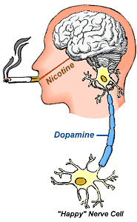
What does Nicotine do?
It takes 10 seconds for nicotine to go straight to the brain.
Nicotine can have profound effects on the developing brain. Young people are particularly vulnerable because their brains are still developing, and nicotine can disrupt this process, leading to lasting changes in areas associated with learning, attention, and impulse control.
1 cigarette could be the start of a lifetime nicotine addiction
Notes:
Nicotine addiction can start with just that 1 cigarette – and for many people it can be the start of a life long addiction.
Teen Brain’s are going through lots of changes up until around the age of 24.
Learning new skills – independence – decision making.
This information is to help you to make your own informed choices.
So that you hopefully choose to make decisions that will support and empower you, in looking after your health, making decisions that can help to support that.
Further information - Nicotine is a Vasoconstrictant – this can reduce blood flow around the body – nicotine effects sympathetic nervous system which release norephinepherine this causes blood vessels to constrict.

Slide 5
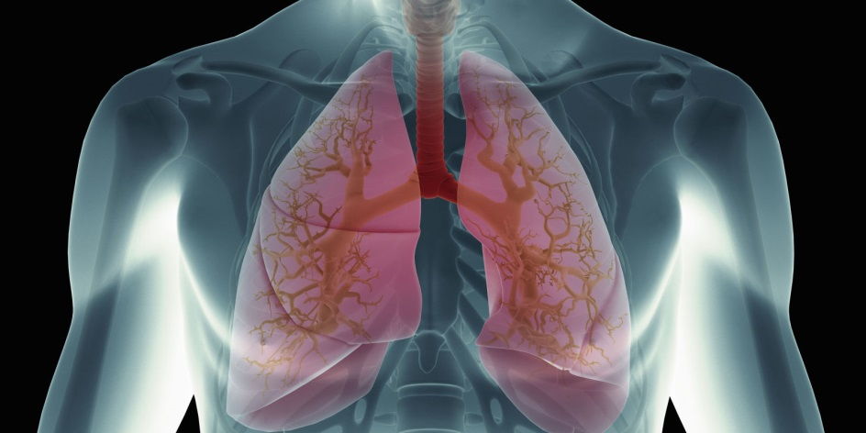
How can smoking affect your health?
Chest Infection and Coughs
Asthma
Cancer
Lung Disease
Heart Disease
Reduced Fitness Level
Blindness
Ear Infection
Poor Circulation
Notes:
**
Reiterate here that not everyone will get an illness though many people do, some people could get 1-2 all of these illnesses, otherscould experience more frequent illness that last longer impact more severely slower in their recovery. The fact is that it’s a huge risk to take and the chance of all of the health impacts heightens hugely when people do smoke. And it’s our decision we can choose – less risk on health impacts or greater risk.

Slide 6
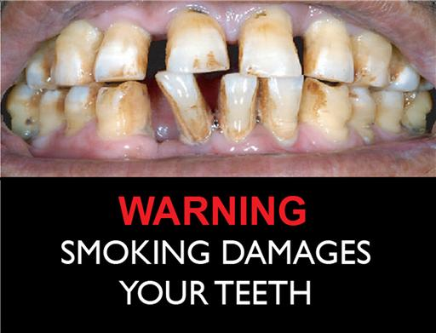
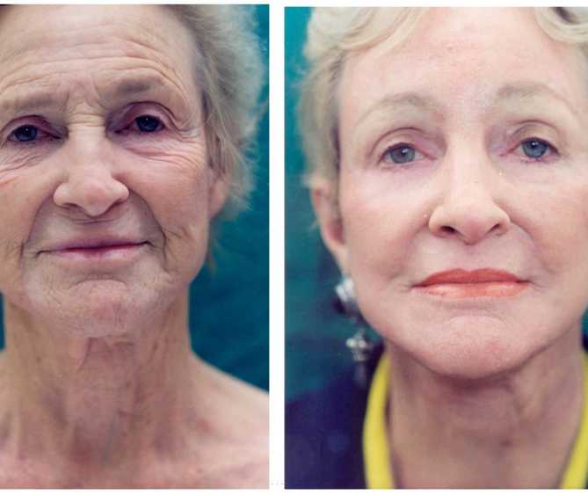
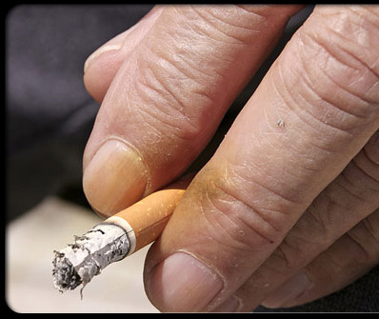
External Impacts of smoking
Wrinkles
Stained Teeth – Tooth Lose
Bad Breath
Stained fingernails
Notes:
Collagen is a natural protein produced in the body
It helps with skin hydration – elasticity – tone and keeps skin smooth as we age the production of colleagen decreases and so naturally people can start to get wrinkles and fine lines their skin tone reduces so skin can be become less firm and loose.
Collagen requires vitamins and smoking can deplete/reduce vitamin absorption so we make even less. This can start to happen earlier when a person is a smoker so they can look a lot older than their years.
Hair also looses its lustre and the tiny capilleries in the skin and eyes have a poorer oxygen supply. So can cause vision impairments and tired looking eyes.
Tar stains teeth – fingers and can discolour the hair
Gum problems such as Gingervitis and reseeding gums can occur causing gaps or even – tooth lose
Taste buds can turn black – loose sense of taste and smell

Slide 7

Why do young people choose to smoke?
Peer pressure
Curiosity
Stress / coping mechanism
Media influence
Rebellion
Social validation
Parental influence
Notes:
Peer Pressure: Young people are often influenced by their friends, family, or social circles. If their peers smoke, they may feel the need to fit in or be accepted by the group.
Curiosity: Young people are naturally curious and may want to try smoking to see what it's like, particularly in the face of societal messages or portrayals of smoking in media.
Stress and Coping: Some young people may turn to smoking as a way to cope with stress, anxiety, or emotional difficulties. They might perceive smoking as a way to relax or manage their feelings. Increase physical stress symptoms BP /HR Increase and once cigarette extinguished as the situation causing stress gone ?
Media Influence: Smoking is often depicted in movies, TV shows, and advertisements, sometimes in a glamorous or rebellious light. This can create an allure, making it seem like a desirable or mature activity.
Rebellion: Smoking may also be seen as an act of rebellion against authority, societal rules, or expectations. It can be a way to assert independence or challenge norms.
Social Validation: Some young people believe that smoking makes them appear more independent, confident, or sophisticated, leading them to start smoking for social validation.
Parental Influence: Young people growing up in households where people smoke – seen to be the norm

Slide 8
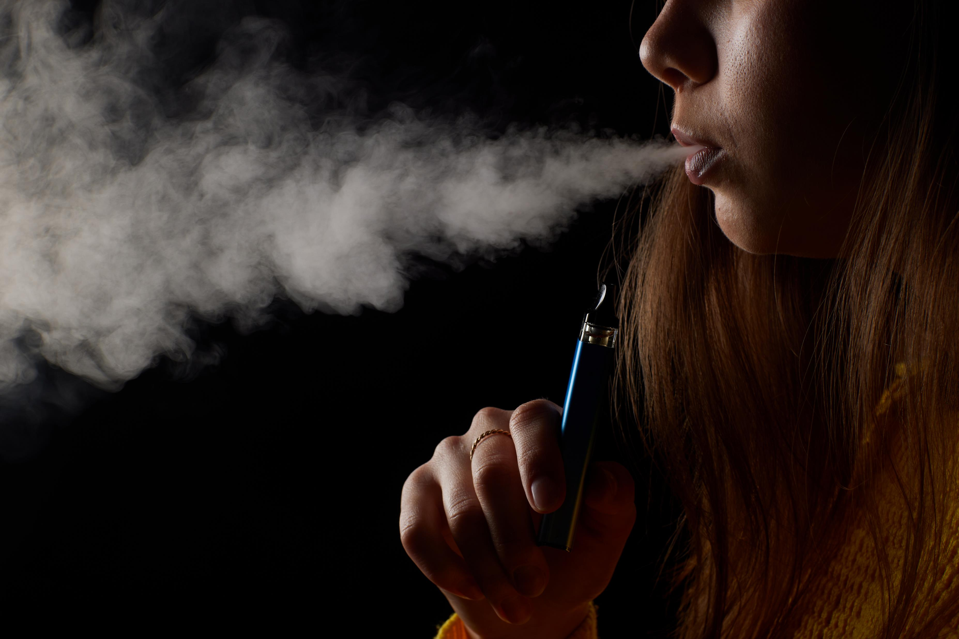
Vaping
Notes:
Vapes / e-cigarettes
Nicotine vapes are electronic devices designed to allow people to inhale nicotine in a vapor instead of the smoke that results from burning tobacco.
Vapes are a successful when used as a quit Aid for adults that smoke, they are not meant for CYP and even more so if not smokers.

Slide 9
Why do young people choose to vape?
Appealing Flavours
Colourful & trendy packaging
Discreetness
Peer influence & social media
Perceived safer than smoking
Notes:
Include Tobacco /Vape Industry
Disposable Vape Ban 1st June · marketed to Younger people
Disposable vapes were banned on 1st June they were available in a wide range of sweet and fruity flavours, such as bubblegum, strawberry, and mango.
Who where these designed to appeal to ? Younger individuals, as they are more likely to be attracted to sweet tastes (Hickson et al., 2020).
· Colourful and Trendy Packaging
The vibrant, eye-catching packaging of disposable vapes, often featuring bright colours and modern designs, appeals to a younger demographic ·
Convenience and Discreetness
Disposable vapes were made small, portable, and easy to use. Their sleek, compact design allowed for discreet use, making them attractive to young people who may want to avoid detection, · Peer Influence and Social Media
Social media platforms and influencers often promote vaping, normalising it as part of youth culture. This peer influence encouraging young people more likely to try vaping, seeing it as a trend or as a way to fit in (Brown et al., 2019). It’s a choice – its promotion its to encourage – is this something that is going to give young people anything back or does it take.
·
Many young people perceive vaping as a safer alternative to smoking, despite the health risks. This misconception is often reinforced by marketing strategies that downplay the dangers of vaping (NHS, 2023).
The UK has strict regulations for e-cigarettes. Products must meet quality and safety standards, and manufacturers must provide detailed information about ingredients to the UK Medicines and Healthcare products Regulatory Agency (MHRA).
Unregulated /black market no way of knowing what is in them – strengths/contents additional chemicals - Vapes sold illegally may contain other drugs.
Tobacco/Vape industry – financial gain Although Vapes are a better option for an adult smoker to use as a quit aid from Tobacco smoking – young people body /brain still developing going through changes key message is don’t smoke /don’t Vape. Young people that do become addicted to Nicotine beit through smoking or Vaping – means longer time for usage and increase to the addiction of Nicotine – adds to the financial gain to tobacco /vaping industry.

Slide 10
Short term effects
Tobacco | Vaping
Coughing & Wheezing | Coughing
Shortness of breath | Shortness of breath
Reduced appetite | Reduced Appetite
Headache | Headaches
Mouth & throat irritation | Mouth & throat irritation
Increased HR & BP | Increased HR & BP
“If you don’t smoke, don’t vape” – Chris Whitty, Chief Medical Officer, May 2023.
Notes:
Compare Tobacco & Vaping – Highlighting we don’t yet know of the Long Term effects – but as we can see Short term effects can be the same.

Slide 11
Long term Risk
Tobacco | Vaping
Reduce lung function | Develop an addiction
Weaken immune system | Gateway to tobacco smoke
Increase risk of infections | Purchase of unregulated Vapes
Impair concentration | Additions of harmful substances
Develop an addiction | Negative Impact on Brain development
Risk of developing respiratory disease e.g. COPD | A LOT still unknown!
Risk of developing cancers
Risk of cardiovascular disease
Poor oral health e.g. bad breath
Notes:
Reiterate unregulated vapes
Addiction
Addition of other substances – illegal drugs
Not been around long enough for conclusive research.
Smoking was perceived healthy in the early days, how far have we come in what we know now – we don’t know enough about long term effects.

Slide 12

Your choice
Notes:
We all make our own decisions and choices and what we choose/decide today impacts are tomorrows – futures.
Tobacco /Vape companies make their products to sell for financial gain - so who may their next customers be ?
Benefits of choosing not to smoke or vape
You make the choice to giving your self
Better Health
More Money
More Energy
Healthier skin teeth – eyes – hair – Slowing down the aging process such as wrinkles /lines
Buy things you want – you can have experiences which may you may not afford if paying for Tobacco/Vape Products.
Look after you – self care – make a decision that empowers you.
That is a few benefits we can give ourselves or we can choose the opposite and actually be paying to do so, smoking/vaping takes it doesn’t give us anything. Who does benefit ?

