Slide 1
Stress Awareness

Slide 2








House Keeping & Introductions
Introducing yourselves
  Name
  Role
  What do you hope to gain from todays training?
Notes:
Fire alarm – is a fire alarm test due? Familiarise yourself with evacuation procedure for the room
Mobiles – on silent, if calls need taking, to be taken outside.
Confidentiality – Anything that is discussed within the room will stay in the room unless it is a safeguarding issue or we feel someone is at risk of harming themselves or others.
Emotive subject – MHA and suicide can bring out different emotions in people and we have had people become upset, please do not be embarrassed, do not feel you have to leave the room but you can if you prefer, a member of the team will check on you. Please do come back to see us.
Respect – we are all individual and have differing opinions and experiences, can we all please respect that.
Questions – please do ask questions, there is no such thing as a stupid question. It will also help us to know if we have covered everything we need to in this training, if we keep getting the same questions then we need to add more to the training.
Additional – make a note of any rules the group would like to add on flip chart and display clearly in room.
Name - Ask people to make a little name plate with the paper in front of them, fold in 1/3 and over 1/3 again. Write names on front and back.
Expectations - make a note of what people hope to gain on flip chart to revisit at the end. Can be stuck to wall.

Slide 3
Aims of The Session
What is stress and why do we need to tackle it?
Understand how the body reacts to stress.
Understand the impact stress can have on us, our mental health and ability to function at work.
Understand the importance of talking about mental health and how to have wellbeing conversations.
Introduce a number of tools available to build resilience and reduce stress.

Slide 4
What Is Stress?
Stress is the feeling of being under too much mental or emotional pressure. Pressure turns into stress when you feel unable to cope. ... Stress causes a surge of hormones in your body. These stress hormones are released to enable you to deal with pressures or threats – the so-called "fight or flight" response.
(NHS Direct 2017)
Notes:
Everybody says they are stressed at some point, but not all stress is the same
Ask the group to write down what being stressed means to them then discuss.
Give the definition
Ask is stress always negative?

Slide 5
Stress . . .
Stress can be defined as the way you feel when you're under abnormal pressure.
The most common situations that cause stress involve work, money matters and relationships with partners, children or other family members
Stress is only healthy if it is short-lived. Excessive or prolonged stress can lead to illness and physical and emotional exhaustion. Taken to extremes, stress can be a killer.
Physical Symptoms
Increases in blood pressure | Increases in heart rate
Increases in perspiration rates | Reduces blood flow to the skin
Reduces stomach activity Cortisol reduces the effectiveness of our immune system. | Cortisol releases fat and sugar into your system
Notes:
Some stress can be positive. Research shows that a moderate level of stress makes us perform better. It also makes us more alert and can help us perform better in situations such as job interviews or public speaking. Stressful situations can also be exhilarating and some people actually thrive on the excitement that comes with dangerous sports or other high-risk activities.
Stress can affect how you feel, think, behave and how your body works. In fact, common signs of stress include sleeping problems, sweating, loss of appetite and difficulty concentrating.
You may feel anxious, irritable or low in self esteem, and you may have racing thoughts, worry constantly or go over things in your head. You may notice that you lose your temper more easily, drink more or act unreasonably.
You may also experience headaches, muscle tension or pain, or dizziness.
Once the pressure or threat has passed, your stress hormone levels will usually return to normal. However, if you're constantly under stress, these hormones will remain in your body, leading to the symptoms of stress.
Stress causes a surge of hormones in your body. These stress hormones are released to enable you to deal with pressures or threats – the so-called "fight or flight" response.
Once the pressure or threat has passed, your stress hormone levels will usually return to normal. However, if you're constantly under stress, these hormones will remain in your body, leading to the symptoms of stress.

Slide 6
Stress Hormones
Adrenalin and Cortisol are the two main hormones responsible for stress reactions in the body.
Adrenalin – Fast acting, providing an immediate response.
Blood Pressure, Heart Rate & Perspiration Rates.
Blood to the skin, digestive & reproductive systems.
Cortisol – Longer lasting for sustained reactions.
Releases fats & sugars for energy.
Reduces effectiveness of immune system.
All these changes are our body’s way of preparing you to fight or run away, but can also cause a number of health related problems.
Notes:
To summarise Adrenalin and Cortisol are 2 of the main hormones which determine our reactions to potentially threatening situations, but there is a third that controls a third response.
However in work we are unable to put these feelings to a practical use, we can’t fight or flight, this is when we need to look at how we can best manage our stress through coping mechanisms, and working to reduce the stressors in work.
The chemicals our body has produced to protect us, will build up and over time these chemicals and the changes they produce can seriously damage our health.
No we know there are different reactions to stress, we will look at the different phases of stress. We will look at each phase and how it affects the body
Physically
Emotionally
Mentally
Behaviourally

Slide 7
Fight, Flight & . . . .
There is one more reaction . . . . .
Freeze
Endorphins – reduce our perception of pain.
This is another way our body works to protect us in harmful and possibly life threatening situations. The release of the endorphins mean that we will experience physical and psychological pain for less intensely.
Notes:
Endorphins – what do we usually associate endorphins with?
They are the feel good hormones that we get when we are doing physical activity that we enjoy. They have another function which is as an analgesic, they reduce our perception of pain. So in a threatening situation where we feel we can’t fight or flight we may freeze, when this happens our bodies will release endorphins so the pain of any injury (physically or psychologically) is experienced far less intensely.
See if the group can think of situations just to confirm the understanding

Slide 8
Alarm Phase
Physical Symptoms
Heart beat faster; Breathe faster; Blood pressure rises; Trembling, Muscle tension; Nausea, vomiting, stomach churning; Changes to bowel movements; Stomach aches.
Psychological Symptoms
Hard to think clearly; Difficulty in concentrating; Mind racing.
Behavioural symptoms
Fight or become aggressive; Run away; Freeze.
Emotional symptoms
Cry Easily; Easily Angered; Becoming anxious.

Slide 9
Why Do Some People Find Situations Stressful And Others Don’t?
Our responses to stress and stressful situations are determined by our perception of the situation.
PERCEPTION
How threatened we feel and how long we have been feeling stressed for will determine which reactions take place within our bodies, one of these reactions is ‘Fight or Flight’
Beliefs
Thoughts

Slide 10
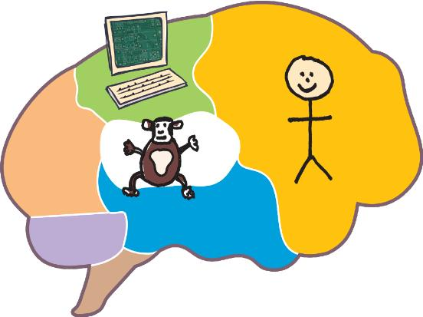
How The Brain Works
The computer- where we process stuff
and it becomes automatic
The human- responsible for our thoughts and actions
The Chimp- oldest part of the brain responsible for keeping us out of danger
Notes:
Chimp – paranoia
Human – logic and thought
Computer stores reactions from past behaviours/situations

Slide 11
What is Wellbeing?
“The concept of wellbeing comprises two main elements:
feeling good and functioning well”
Important attributes for Wellbeing include:
  Our functioning in the world
  Experiencing positive relationships
  Having some control over our lives
  Having a sense of purpose
Notes:
Relaxation and the ability to relax is key to helping us manage and cope with stress. Not incorporating relaxation into our daily schedule can be like missing a main meal

Slide 12
Wellbeing Conversations
Encourage them to identify their own support network and encourage to access other support
Ask what you can do to help them
Create a plan of action together
Connect to support (within organisation and outside)
Arrange to revisit
Spot the signs
Create an opportunity to have a wellbeing conversation
Listen!
Notes:
Need to think about how to encourage males to open up to male managers- think about how we have conversations- more likeley to open up when doing something such as walking and doing something practical
Do we include a case study in this for them to say how they could support someone? Do we do an activity on how to open up a welllbeing conversation?

Slide 13
Looking after your own wellbeing
Research from Anna Freud indicates that taking the following steps can be important in the promotion and maintenance of mental wellbeing:
Knowing personal limits and having the ability to say “no” when necessary
Identifying supportive people that’s you have in your network- Create a buddy system
Talking is key- speak to someone before your leave school
Debrief and detach -Before you leave school/college for the week, identify the thing that’s bothered you most during the week and arrange to consult with someone before you leave –the weekend is yours, make sure you don’t take what isn’t needed home with you!
Notes:
This will help you to have more balance in life and will enable you to take better cares of others
There are times when challenging situations affect us emotionally. If you have a difficult day at school, try to speak to someone before you leave school as this can then help you to process how you are feeling, ask for support and separate your work and home life
Self-compassion- if you take time to stop and reflect on the thoughts in your head, are they more positive or critical? Once you have identified any negative thought, you begin to introduce more positive thoughts and turn the volume down on the critical voices
Create a buddy system. Knowing that there is support around you can feel containing and comforting. You may wish to choose a “buddy” within your staff team. This person can be someone that you can talk to or check in with on a regular basis to help check on your wellbeing levels. “Buddies” may also take part in random acts of kindness and you can get as creative as you like!

Slide 14
Stress Management
Practical Tips For Managing Our Own Stress
5 Ways To Wellbeing (New Economics Foundation, for Gov.uk)
Stress Less Schedule (Dr Kirsch American Institute of Stress)
7 11 Breathing (The Human Givens Institute)
Wellness Action Plan (WAPs)(Professor Chris Williams, University of Glasgow)
Access to Work (Remploy)
Recommended Reading (Books on Prescription)
Mobile Phone & Desk Top Apps

Slide 15




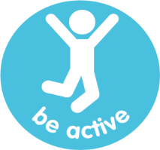
5 Ways To Wellbeing
Will improve confidence and can be fun.
Of the world around you & your feelings.
Do something nice for a friend or a stranger.
Invest time in developing connections.
Exercising makes you feel good.
Notes:
Examples of how to achieve the 5 ways
Learn - try something new, rediscover an old interest, sign up for that course. Take on new responsibility at work. Fix a bike, learn to play an instrument or cook your favourite food. Set a challenge you will enjoy achieving.
Notice – Be curious, catch sight of the beautiful, remark on the unusual, notice the changing seasons. Savour the moment, whether walking to work, eating lunch or talking to friends. Reflecting on experiences will help you appreciate what matters.
Give – thank someone, smile, volunteer your time. Join a group. Look out as well as in. Seeing yourself and your happiness linked to the wider community can be incredibly rewarding and creates connections with the people around you.
Active – go for a walk or run, step outside, cycle, play a game, garden, dance. Most importantly find an activity you enjoy that suits your level of mobility and fitness.
Connect – with the people around you, family, friends, colleagues and neighbours. At home, work, school or in your community. Building these connections will support and enrich you every day.

Slide 16
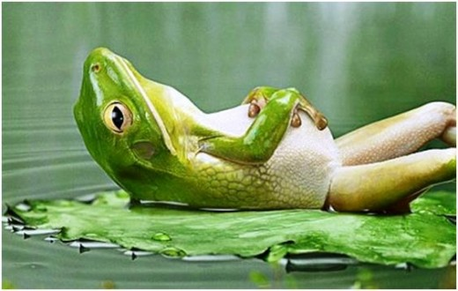
Stress Less Schedule
Building gap time into your day
Build 5 gaps into your day.
  One when waking up.
  3 spaced regularly through the day, e.g. 10am, 2pm & 4pm
  And a final one when you go to bed.
Each gap to be 1 minute for self assessment.
Ask yourself – how am I doing?
Breathe deeply and focus on how your body feels.
Concentrate on your breathing and relax.
This will interrupt stress reactions in your body and help build your resilience to stress.
Notes:
We researched an activity that we could share with everyone who attended the training, as we wanted to give you all something practical that you could take away with you.
We were delivering to a call centre so we were conscious that it would need to be a short but worthwhile task. We found this stress less schedule and thought it fitted perfectly.
The idea is to build 5 gaps into your day, 1 when you wake up, 1 when you go to bed and the other 3 should be spaced evenly through the day.
Stop thinking about everything, concentrate on your breathing, taking nice slow deep breaths in and out. Trace around your thumb and fingers as you are breathing, as you breathe in trace up your thumb, and trace down your thumb as you breathe out.
The idea behind it is rather than your stress levels increasing through the course of the day they are interrupted.
This have been proven to improve your resilience to stress.

Slide 17

7 – 11 Breathing

Slide 18
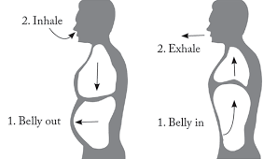
7 – 11 Breathing
  Breathe in for a count of 7
  Breathe out for a count of 10
  Aim for 5 - 10 minutes of 7 11 breathing
  Repeat a few times a day
This type of breathing is not just a diversionary activity from our stresses, it also produces a bodily response.
While adrenalin causes the ‘Fight or Flight’ response . . .
7 11 breathing causes the ‘Rest and Digest’ response. . .
Simply put, the opposite reaction, lowering emotional and physical responses to stress. The out breath stimulates the reaction.
Notes:
Many of us, me included breathe the wrong way. When we are looking to relax and relieve stress, we are looking to take a deep breath in through our stomachs, not the shallower, higher lung breathing. It can take a bit of getting used to and if you can’t do it for 7 11 try 3 5 at first and increase the time, the key is that the longer breath is on the exhale.
Again build up the duration as time allows, doing more than 10 minutes if you have time, I would suggest we make the effort the find the time to do this. Repeating a few times a day.
Fight or flight stimulates the body and raises body responses to stress as we have discussed via the nervous system.
Rest and digest is triggered by the out breath, which is why that breath should always be longer than the in breath. The out breath stimulates the parasympathetic system (I think Paralympics, disabled, this reaction disables the fight or flight response) which will lower blood pressure, dilate pupils and slow your heart rate.
Practising this technique a few times a day will lower your overall stress levels long term. Breathing in and out for the same duration is less effective at lowering these physical symptoms.

Slide 19
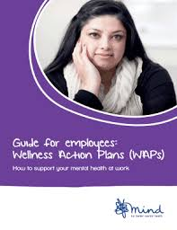

Wellness Action Plan
https://www.mind.org.uk/workplace/mental-health-at-work/taking-care-of-your-staff/employer-resources/wellness-action-plan-download/
Notes:
There is a guide online on the Mind Website to assist you in completing these. You could also devise your own. HBC are doing this as it covers both work and homelife.
It is more a prevention document, than a reactionary.
We want to be providing support for staff to keep them well.

Slide 20

Wellness Action Plan
The WAPs are a personalised, practical tool we can all use – whether we have a mental health problem or not – to help us identify what keeps us well at work, what causes us to become unwell and the support we would like to receive from our manager to boost our wellbeing or support us through a recovery.
www.mind.org.uk

Slide 21

Support for Staff
Schools in Mind is a free network for school staff hosted by Anna Freud, the network shares academic and clinical expertise regarding wellbeing and mental health issues for schools
www.mentalhealthyschools.org.uk
www.mindfulteachers.org
www.remploy.co.uk/ Access to work mental health support services
Education Support Free 24/7 helpline: 08000 562 561
Education support offer counselling
Notes:
Mental healthy schools head together lots of teaching resources
Whatever you need, we’re here for you 24/7 including over the Christmas break. Our trained counsellors will listen to you without judgement and will help you think through the problems you are facing to find a way forwards and feel better. No issue is too big or too small.
Depending on your needs they might:
deal with your call personally and offer emotional support straight away
offer action plan support (coaching)
transfer you to one of our trained and accredited counsellors for counselling
connect you to one of our other services such as grants or information
assist with referral for long term treatment (for example, to your GP)
Access to Work Mental Health Support Service
This confidential service delivered by Remploy is funded by the Department for Work and Pensions and is available at no charge to any employees with depression, anxiety, stress or other mental health issues affecting their work; A support plan to keep them in, or return to work
Ideas for workplace adjustments to help them fulfil their role
Practical advice to support those with a mental health condition.

Slide 22

Access to Work Mental Health Support Service
This confidential service delivered by Remploy is funded by the Department for Work and Pensions and is available at no charge to any employees with depression, anxiety, stress or other mental health issues affecting their work.
Notes:
Hand out the guidance notes from Kate for Managers to refer to Remploy

Slide 23

Coping strategies
Dealing with change
Relaxation
and fatigue management
Communication and working with others
Memory aids
and strategies
Time
management
Management of treatment and medication
Organisation planning and prioritisation
Mood and behaviour management
Taking
instructions
Anxiety and stress management

Slide 24
Access to Work Mental Health Support Service
Our specialist advisers provide:
Tailored work-focused mental health support for nine months
Suitable coping strategies
A support plan to keep them in, or return to work
Ideas for workplace adjustments to help them fulfil their role
Practical advice to support those with a mental health condition
https://www.remploy.co.uk/employers/mental-health-and-wellbeing/workplace-mental-health-support-service-employers
Notes:
So far, we have supported thousands of people across Britain, with a 93 per cent success rate of people retaining their employment after six months.
Please note
To be eligible for this service, individuals need to be in permanent or temporary employment and have a mental health condition (diagnosed or undiagnosed) that has resulted in workplace absence, or is causing difficulties to remain in work

Slide 25
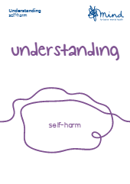
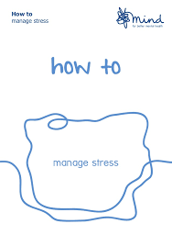

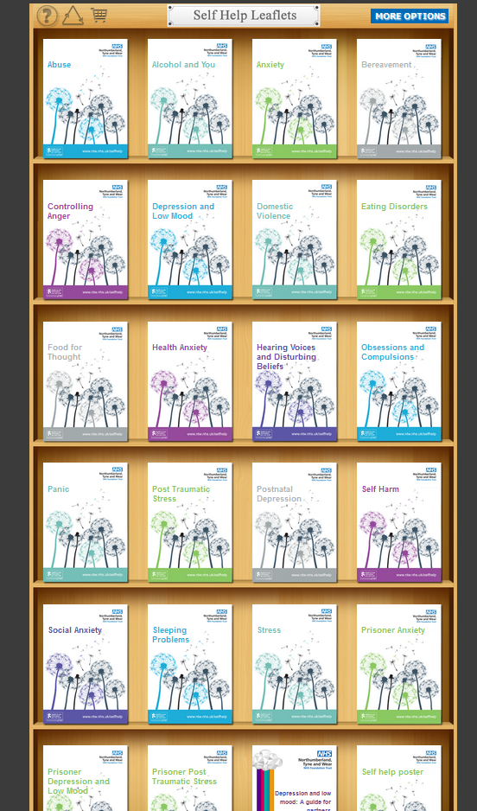
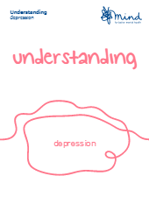
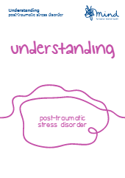

Self-Help
https://shop.mind.org.uk/shop/booklets
https://web.ntw.nhs.uk/selfhelp/
Notes:
Books on prescription are a range of self-help books that are available from all 4 Halton libraries. You can go along to the library and take the books out yourself as you would any other, or if you go through your gp you can take them out for 8 weeks.
There are 4 sets in the range:-
Children & YP Mental Health
Adults Mental Health
Dementia
Health
Leaflets are done really cleverly with all the titles in a tick of, tear off list on the last page that you can just hand in to staff at the library.

Slide 26
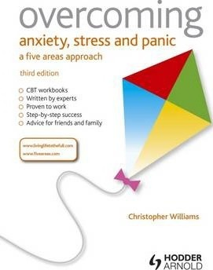

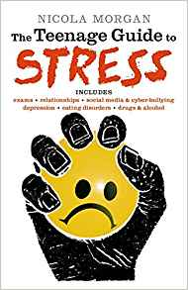

Reading Well
https://reading-well.org.uk/
Notes:
The following are just some of the titles in the adults and CYP range around stress.
Self-help books are a really good way for us to help control and manage our own mental health, sometimes we have to help ourselves and not rely on things being done to us, the easy option, slimming pill etc.

Slide 27


Mindfulness Apps
Mindfulness is a state of being fully awake to life; being aware and undistracted in the present moment and observing life as it unfolds without analysis or judgement. It is about focusing attention on the here and now, rather than thinking about the past or worrying about the future.
https://insighttimer.com/
https://www.smilingmind.com.au/
Insight Timer
Smiling Mind
Notes:
All apps are centred around mindfulness
Stop - stop what you are doing. Check in with what you are thinking and how you are feeling.
Breathe – Practice mindful breathing to create space between your thoughts, emotions and reactions.
Think – Broaden your perspective and strengthen your force field of peace with personalised meditations and activities. Your dance space ☺
Insight Timer is an alarm that times your mindfulness practice while simultaneously helping you to use your smartphone as a spiritual link to a worldwide community of meditators using “insight connect.”
Smiling Mind – mindfulness meditation for both children and adults, easy to use also guided mindfulness programmes designed for different age ranges
- reduce worries stress and anxiety
- more energy
- creates a sense of calm
- learn to relax and regulate emotions
- enhance awareness and creativity
- improve concentration and increase productivity
- develop empathy and connectedness
- enjoy better health & sleep.
You can get lots of other apps that will help reduce stress and help you relax, from music and sounds to colouring in and jigsaws.

Slide 28





Available Support
Doctor
Helplines & online support
Samaritans 116 123 (free phone for all ages) (National)
CALM 5pm—12am 0800 58 58 58 (Men only) (National) https://www.thecalmzone.net/
Mind Runcorn branch 01928 563612 (Adults) (National)
Halton Veterans Association— 07967 795 179 Billy Jones (veterans & their families) (Local)
CGL (formerly Crime Reduction Initiative and Ashley House) 0151 422 1400
If there is alcohol/drug misuse. Recreational or prescribed medication.
www.live-life-well.net See Live Life Well for other local services available. (All ages)
Local Counselling Services – See leaflet.
Citizens Advice Halton 0344 477 2121 (National) Live Well Spend Well
Friends / Family Ask if there is a close friend or family member they feel they can openly share their feelings with.
Think Wellbeing Halton (IAPT Halton) (Provided by North West Borough Healthcare).
0151 292 6952 for self referral for group CBT. Dedicated Veterans service available.
Notes:
Fast-track help for people with money/debt worries.
Citizens Advice Halton is urging local people who are struggling paying the bills or who are in debt to get help from their accredited Money Advice Team.
Often when a life changing event happens (you lose your job, you have a child, you experience a relationship breakdown) it is so easy to get into a downward spiral of debt. If you've missed even just one important payment like your rent, your council tax, your credit card, Citizens Advice Halton can help. Their advisers can help you review your household budgets and also what rights you have to get some breathing space to get your finances back on an even keel.
Please don't ignore the bills or borrow yet more money to pay off your debts or arrears... get advice. Citizens Advice Halton have a call-back service (tel: 0151 257 2449) so all you need to do is leave your name and number and a Money Adviser will call you back, usually that day. Alternatively people can Email: advice@citizensadvicehalton.org.uk

Slide 29
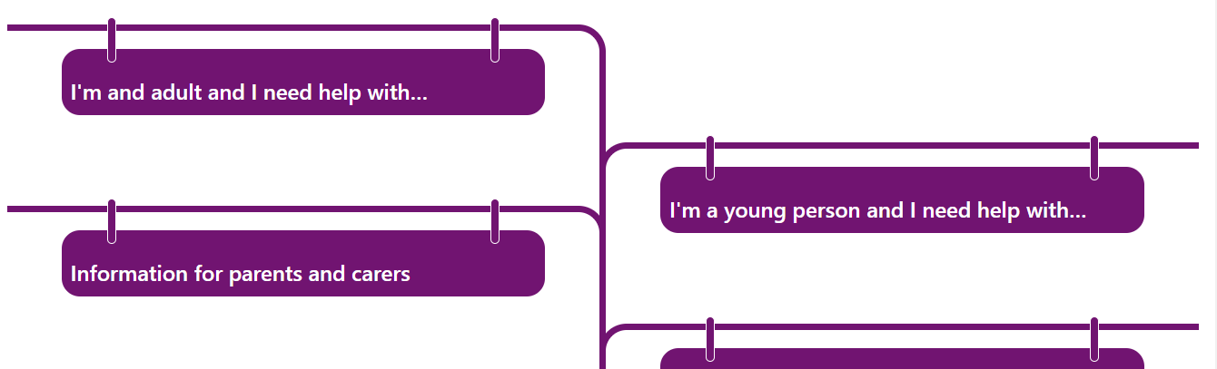
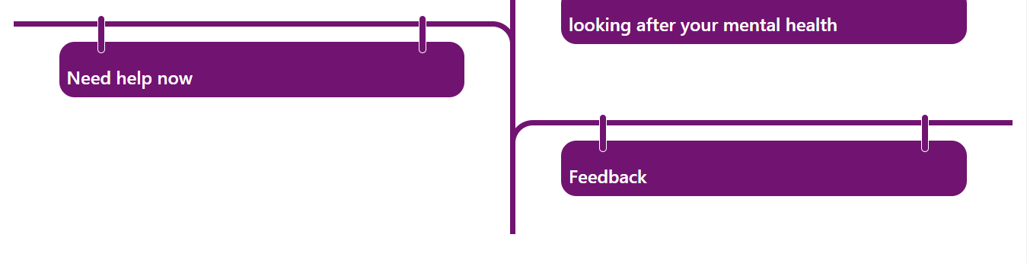
Mental Health Info Point
www.halton.gov.uk/mhinfopoint

Slide 30
Mental Health Hubs
The Aim of the Hubs is to give the public a direct link to the many different services out there who can provide you with help and support to manage your mental health. If you have a mental health issue, don’t be afraid to talk about it, come along and speak to those who can help.
Runcorn Shopping City (Main Square)
      -1st Thursday of every month 9am -2pm*
Greenoaks Widnes (In the main walk through)
- 3rd Wednesday of every month 9am – 2pm*
Come along to the Mental Health Hubs and see what local support services are available in Halton.
*times are subject to change.
Your Mental Health Matters

Slide 31
Additional Training
Mental Health Awareness Sessions. (Generic & for Managers)
Designed to give you practical skills and understanding of mental health and how you can manage your own mental health. Approx. 2hrs.
Stress Awareness & Management Sessions. (Generic & for Managers).
Designed to give you a greater understanding of stress and it’s impact, along with practical skills on how you can manage your own stress. Approx. 3hrs.
Self-Harm Guidance for Professionals.
Designed to increase your skills, knowledge and confidence to have conversations about suicide. Approx. 2hrs.
Halton Suicide Awareness.
Designed to increase your skills, knowledge and confidence to have conversations about suicide. Approx. 2hrs.
If you would like more information please ring 0300 029 0029

Slide 32
Useful Websites
www.haltonhealthimprovement.co.uk
http://www.hse.gov.uk/stress/
https://www.time-to-change.org.uk/get-involved/get-your-workplace-involved/employer-pledge
http://www.nwbh.nhs.uk/
https://web.ntw.nhs.uk/selfhelp/
www.mind.org.uk
www.live-life-well.net

Slide 33

Difficulty Accessing Services?
If you have or are experiencing difficulties accessing services or sending referrals please add details to the comments box on the feedback form or alternatively you can contact Healthwatch.
Healthwatch Halton is the independent patient champion for health and social care in Halton. Our job is to champion for the consumer interests of those using health and social care services across Halton and give local people an opportunity to speak out about their concerns and health care priorities.

Slide 34


