Slide 1
Self-Harm Pathway Training

Slide 2
Ground Rules
House keeping
  Fire alarm
  Mobiles
  Toilets
  Confidentiality
  Emotive subject
  Respect
  Questions
  Any you would like to add?
Introducing yourselves
  Name
  Role
  What do you hope to gain from todays training?
Notes:
Fire alarm – is a fire alarm test due? Familiarise yourself with evacuation procedure for the room
Mobiles – on silent, if calls need taking, to be taken outside.
Confidentiality – Anything that is discussed within the room will stay in the room unless it is a safeguarding issue or we feel someone is at risk of harming themselves or others.
Emotive subject – MHA and suicide can bring out different emotions in people and we have had people become upset, please do not be embarrassed, do not feel you have to leave the room but you can if you prefer, a member of the team will check on you. Please do come back to see us.
Respect – we are all individual and have differing opinions and experiences, can we all please respect that.
Questions – please do ask questions, there is no such thing as a stupid question. It will also help us to know if we have covered everything we need to in this training, if we keep getting the same questions then we need to add more to the training.
Additional – make a note of any rules the group would like to add on flip chart and display clearly in room.
Name - Ask people to make a little name plate with the paper in front of them, fold in 1/3 and over 1/3 again. Write names on front and back.
Expectations - make a note of what people hope to gain on flip chart to revisit at the end. Can be stuck to wall.

Slide 3
Aims Of The Session
To gain understanding of what is Self-Harm
To gain understanding of why people Self-Harm/ Risk factors for Self-harm
Tips for Talking to Someone who Self-Harms
To learn about local support services for Self-Harm
Notes:
Local pathway how to use it.
Local service and support
Interactive Session with group work and role play.

Slide 4
Defining Self-harm
How would you define Self harm?
What are some of the ways in which people self-harm
Notes:
’.Self-harm is ‘a way people cope with overwhelming feelings of pain and distress. By hurting themselves they may feel better for a while and be more able to cope with their lives’.
SH is when somebody intentional damges or injures the body- ita a way of coping with emotional distress. SH is a way people cope with overwhelming feelings of pain or distress- by hurting themselves they feel better for a while and able to cope

Slide 5
What is Self-Harm?
NICE defines self-harm as “ any act of self-poisoning or self-injury carried out by a person” NICE state that self-harm is an expression of personal distress, not an illness and there are many varied reasons for a person to harm him or herself ( NICE 2004)
Self-Harm most frequently takes the form of cutting, burning, non-lethal overdoses or inserting objects into your body, hair pulling and excessive risk taking.
Notes:
The phrase self-harm is used to describe a wide range of behaviours. Self harm is often understood to be a physical response to an emotional pain of some kind, cutting, burning, pinching but there are many ways to hurt yourself including abusing drugs and alcohol or having an eating disorder, poor self care.
Some young people have described self harming as a way to express something that is hard to put into words
Change emotional pain into physical pain
Have a sense of control
The bottom line is that anything that causes you harm – even slight harm – which in some small way makes you feel better emotionally, can fall under the umbrella of self-harm. The important thing isn’t to focus too much on the labeling, but to recognize when help is needed and find some support as soon as possible.
NICE defines self-harm as “..any act of self-poisoning or self-injury carried out by a person, irrespective of their motivation. This commonly involves self-poisoning with medication or self-injury by cutting. Self-harm is not used to refer to harm arising from overeating, body piercing, body tattooing, and excessive consumption of alcohol or recreational drugs, starvation arising from anorexia nervosa or accidental harm to oneself.” (NICE, 2013)

Slide 6

What is Self-Harm?
Young people who self-harm do so because they have no other way of coping with problems and emotional distress in their lives … It provides only temporary relief and does not deal with the underlying issues.’
Truth Hurts, Mental Health Foundation (2006)
http://www.mentalhealth.org.uk/publications/truth-hurts-report1/
Notes:
Truth Hurts was the first major national study to include the views and perceptions of young people who had self harmed
The Grey areas
Risk taking behaviour
Mental health conditions
Impulse control disorders

Slide 7
True or False?
Self-Harm is attention seeking
True/False
✓
People who self-harm could stop if they wanted to
True/False
✓
It’s only a teenage thing- you will grow out of it True/False
✓
People who self-harm are always suicidal
True/False
✓
Notes:
Self harm is attention seeking. FALSE- many people who self harm don’t talk to anyone about it! People who self-harm often go to great lengths to cover up their injuries. The attention that self-harming does bring is often negative and doesn’t help to relieve distress. So important to listen this helps somebody who is experiencing distress and dealing with the pressures of everyday life
People who self-harm could stop if they wanted to. FALSE- Self-harm can become a addictive behaviour for some people. Telling somebody to “just stop it” will not work. They need help and understanding to recover, and learn other strategies for coping with emotional pain and stressful situations. “I wish I never started because it becomes an addiction.
It’s only a teenage thing- you will grow out of it. FALSE definitely not just something that affects young people. If somebody is hurting themselves, either by cutting, repeatedly banging their head or pulling their hair out, it’s a sign that something is seriously bothering them.
People who self-harm are always suicidal- False, Self-harm can become an addictive behaviour. For some people it is how they deal with emotional pain, they need to learn other strategies for coping with this pain and stressful situations. Self-harm is an expression of personal distress and while it is not always the case that someone is attempting suicide when they self-harm, there is significant risk of this in the future.
Know the is a link between a history of self-harming and suicide. People who self-harm aren’t usually trying to kill themselves. For many it’s a coping mechanism used to survive – not die. Many more people self-harm than kill themselves –However, some people who self-harm also have suicidal feelings. More training on local suicide pathway can be given
Self harm is attention seeking. FALSE- many people who self harm don’t talk to anyone about it! People who self-harm often go to great lengths to cover up their injuries. The attention that self-harming does bring is often negative and doesn’t help to relieve distress. So important to listen this helps somebody who is experiencing distress and dealing with the pressures of everyday life
What is the effects of this stigma?
Increase feelings of shame and guilt
Encourage likelihood of hiding self-harm
Reduce willingness for open discussion/disclosure
Increase judgement
Add to risk
Reduce likelihood of adults identifying young people
Increase angry responses
Increase in panicked responses
Increase in “not taking it seriously” responses
Inaccurate and inappropriate referrals

Slide 8
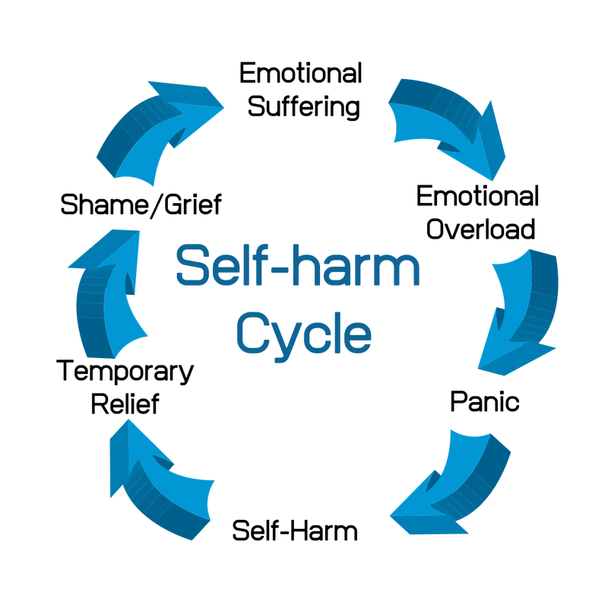
Notes:
Emotional suffering- stress life event- becomes to much for the young person- coping by SH
Cutting triggers your bodys chemistry - Endorphins are released to help the body deal with pain and stress and cause an actual high designed to cover over real physical pain. When you self harm, your brain is flooded with endorphins, which gives you a rush, and a sense of calmness and relief that makes you feel like everything is ok. Some people claim the high can last up to 90 minutes, but what happens when that high wears off? Unfortunately people can crash . (NHS 2021)

Slide 9
Self-Harm Statistics
10% of young people Self-Harm Nationally
Research has shown young women are most likely to self-harm although the percentage of young men is on the increase (2)
Most young people reported that they started to hurt themselves around the age of 12
Halton had 146 Hospital admissions as a result of self harm for 10-24 year olds in 2015/2016 Significantly worst than the rest of England.
Notes:
Most self-harm happens in the community without seeing any health services such as Accident and Emergency departments. Research suggests that cutting is the most common form of self-harm in the community, whilst overdosing or self-poisoning is the most common form of self-harm that leads to hospital admissions (Hawdon et al, 2012).
Young minds States 2017

Slide 10
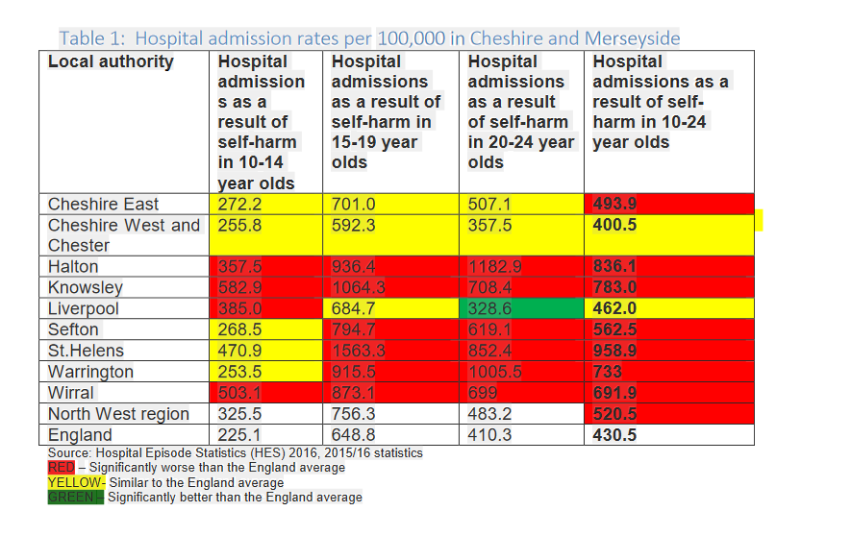
Self-Harm Statistics
Notes:
Many who die by suicide have never been in contact with services
•Up to a half of people who self-harm do not seek help
•Online access to good quality advice and support is essential
Why is this important?
Photo by

Slide 11
Group activity what are the risk factors for someone to self-harm?

Slide 12
Risk Factors For Self-Harming
Experience of a mental health disorder. This might include depression, anxiety, personality disorders
Socio-economic disadvantage
Social isolated
Stressful life events
Being part of the LGBT community
Having been bereaved by suicide (Mental Health Foundation 2016)
Young people who self harm are 50 x higher risk of suicide within the first year of self harming (2)
Notes:
CYP with autism
individual factors:
Depression/
anxiety
Poor communication skills
Low self
esteem
Poor problem
solving skills
Hopelessness
Impulsivity
Substance misuse
Bereavement
Perfectionism
Exam pressure
ffamily factors
Unreasonable expectations
Neglect or abuse (physical, sexual or emotional)
Child
being Looked After
Poor parental relationships and arguments
Parental separation
and / or loss
Depression, deliberate self
harm or suicide in the family.
Social Factors
Difficulty in making relationships/ loneliness
Bullying
Difficult time of year
LGBTQ more likey to be discriminated against/ suffer distress over sexuality-

Slide 13
Why People Self-Harm
Some of the reasons why young people self-harm:
Difficulties at home
Arguments or problems with friends and family
School pressures
Bullying
Depression
Anxiety
Low self-esteem
Transition and changes, such as changing schools
Alcohol and drug use
Notes:
Source Mental health foundation 2017 & young minds 2018 web site
Self-harm is a way for some people to deal with difficult or negative emotions and psychological distress (Young Minds 2018). Historically people who self-harm have been dismissed as ‘attention seeking’; but there is now a greater understanding that
this is not the case and self-harm is a behavior employed that indicates an individual may need additional support to cope.
Some of the reasons why young people self-harm:
Difficulties at home
Arguments or problems with friends and family
School pressures
Bullying
Depression
Anxiety
Low self-esteem
Transition and changes, such as changing schools
Alcohol and drug use

Slide 14
So why self harm in particular?
Function | Could meet this need….
To make me feel real | Counteracts dissociation
To punish me | Temporarily lessens guilt and shame
To stop me from feeling | When strong feelings are too dangerous
To physically mark the body | Translation of emotional pain into physical sensation
To let something bad out/release | Symbolically getting rid of shame
To regain control | I’m in charge
To stop the thoughts and emotions | Disrupts distressing emotional states

Slide 15
Signs & Behaviour To Be Aware Of
Withdrawal or isolation from everyday life
Signs of depression such as low mood, tearfulness or lack of motivation
Changes in mood
Changes in eating/sleeping habits
Talking about self-harming or suicide
Abusing drugs or alcohol
Signs of low self esteem
Unexplained cuts, bruises or marks
Covering up all the time, when in hot weather
Notes:
Taken from NHS direct
Also they may be no warning signs at all. It is therefore important that if you suspect someone self harming that you ask them openly and honestly.
Increasing in self-harming frequent or change methods/ switch in methods with self cutting/ put CYP more at higher risk
Low self-esteem
Be aware-situations and circumstances can change which can alter the persons state of mind and rationale.
If you are concerned there is a safeguarding issue or vulnerable child or young person is at risk contact children and family contact and referral team I cart

Slide 16
START THE CONVERSATION
Have you noticed a change in behaviour and/or mood of a young person. Are you concerned about their state of mind?
Have they experienced changes in . . .
LIFE EVENTS -Bereavement/ relationship problems/school pressures/ difficulties at home
PHYSICAL HEALTH - Appearance, low self-esteem, weight change, low energy, ill health, increased drug and alcohol use.
MENTAL HEALTH - Changes in mood / Socially Isolated / Hopelessness / Withdrawing publically.
SIGNALS - Remember to listen with ALL your senses
Notes:
Set plenty of time aside to talk to so not interruption. Young people really need to know that you are listening to them
Acknowledge how difficult it might be to open up about their self harming, don’t focus details about specific injuries or behaviours. Instead talk about how they are feeling and what they are going through.
Reassure them that you are there for them and that there are lots of sources of support available to them.
Avoid giving ultimatums, “ stop or else” as they never work, this might stop them talking to you.
YP would like to be listen to and their feeling took into consideration, as adults we can think we know everything and do the talking for them which makes the young person feel worse.
( Halton self-harm guidance for frontline workers ref young addiction)
It is important that all attempts of suicide or deliberate self-harm are taken seriously and that and that YP is listen to carefully. All mention of suicidal thoughts should be noted and reported appropriately following safeguarding procedures and guidance from suicide pathway- which training can be given

Slide 17

Case Study 1
I am 14 and started self-harming. Everyday was the same. Arguments, fall-outs and loneliness. I just can’t take the stress anymore.
Notes:
Role Play in Pairs if Alice disclosed this to you what would you do?
How would you talk to Alice?
Where would you sign post?
Self-harm is a big problem in the UK but it can be difficult to talk about.
Think about why it might be particularly difficult for self-harmers to seek help.- Most self-harmers will find it difficult to seek help initially because they may scared of feeling embarrassed, ashamed or 'told off' for their behavior, when actually what they're looking for is support and understanding.
The act of self-harm is often about feeling in control. It can be difficult to talk about because it's not always possible to put feelings or reasoning in to words.
Iv been told what to do from the moment I wake up to the monemet I go to sleep- imp sick of it this is just my secret way of asserting a bit of control in my life
With the right help and support most people who self-harm can and do fully recover
The only way to understand a YP experience is talk to them about what is happening for the. Questions that may be useful in developing that conversation:
I’ve noticed that you seem worried/preoccupied/trouble. Is there a problem
I’ve noticed that you have been hurting yourself and I am concerned that you are troubled by something at present
We know that when young people are stressed/ worried by things, they cope in different ways and self injury is one of these ways. Is this something you have tried or thought about?

Slide 18
Things not to say
•What have you done that for?
•Don’t be so silly
•It’s just superficial (etc)
•You must stop at once
•Attention-seeking
•Why?
Things to say…
•Thank you for telling me
•You’re not on your own with this
•You are important and deserve support
•You are doing the right thing by asking for support
•I’m sorry things are so difficult
•Tell me more about what’s happening for you at the moment
•So you are telling me…(reflect)
•I want to help, and there are places we can get you some support
•How are you? (x 2)

Slide 19
Cutting for me releases all the built up anger and frustration and pain I feel inside. There are many things that happen to me in my life which cause the pain I feel and how I release it.
Mostly the feelings of isolation like being outcast pretty much from relationships altogether …
School is stressful, home life I can’t handle sometimes.
Notes:
What is being described here is a coping strategy, however dysfunctional. Helpful responses will include alternative ways of coping that are meaningful and effective for that young person. Case study online form young mind 2018

Slide 20

Notes:
https://www.youtube.com/watch?v=uKGciUB8OSg

Slide 21
ASK the question . . . . . .
Have you had thoughts of, or are you Self-Harming?
BE DIRECT TO AVOID MISUNDERSTANDING
NB: The reaction the young person receives when they disclose their self-harm can have critical influences on whether they access support services
Notes:
Almost half GPs feel that they don’t understand young people who self-harm and their motivations
Don’t feel comfortable asking the question.
Are there any changes to their self-harm? What triggered them

Slide 22
Tips For Having Self-Harm Conversations
Managing Self-Harm is everyone's Responsibility
Make Time
Listen
Be open and Honest
Don’t Judge- You don’t need to understand why they self-harm, key is listen to them
Think about body language and facial expressions/ don’t be shocked when you hear about what they have done
Let them be in control of their decisions
Offer Support/ know local support services
Notes:
Set plenty of time aside to talk to so not interruption. Young people really need to know that you are listening to them
Acknowledge how difficult it might be to open up about their self harming, don’t focus details about specific injuries or behaviours. Instead talk about how they are feeling and what they are going through.
If a young person is not with their family ask them who would they like to contact
What doesn’t help?
Trying to force change by telling them to stop doing it.
Tell them off - “what did you do that for?” “oh don’t be silly”
Blame the person for your own shock and upset
Panic or try quick solutions.
Either ignoring their injuries or overly focusing on them.
Labelling self-harm as 'attention seeking’.
Believe that a young person who has threatened to harm themselves in the past will not carry it out in the future.
A supportive response is one that demonstrates respect and understanding together with a non-judgmental stance, are of prime importance together with a focus on the person, not what they have said or done. Remember, most young people who self-harm:
do not have mental health problems – they are under stress and have no other means of managing their emotions;
feel shame and stigma – it is not easy for them to talk about it.
Do
Do
Take time to really hear the young person - try to find out what is causing the distress/what risks the young person may be exposed to and who they trust and find supportive.
Find out what is troubling them/where they worried about something?
How long have they felt like this?
Are they at risk of harm from others?
Explore how imminent or likely self-harm might be
What other risk taking behaviour have they been involved in?
Ask about the young person's health and any other problems such as relationship difficulties, abuse and sexual orientation issues?
Firstly, take stock of your own feeling and thoughts before asking any questions. If your feelings or thoughts about the young person’s behaviour are negative in anyway, they will be communicated to them non-verbally when you talk to them and hinder the helping process.
See the person, not the problem. Talk in a genuine way. Address them as you would wish to be addressed. For example:
‘I’ve noticed that you seem bothered/worried/preoccupied/ troubled. Is there a problem?’
‘I’ve noticed that you have been hurting yourself and I am concerned that you are
troubled by something at present.’
‘I don’t think I am the best person to help you, I don’t know enough about the things that are bothering you and what to do about it. How would you feel if I arrange for you to see………………….I can be with you if you like.’

Slide 23
Supporting Questions
Self-harm can be treated- thousands of people every year stop self-harm with the right help.
Start by thinking about why they do it:
What was happening when they first started?
Is there something that triggers the urge to harm yourself?
Are they accessing professional support? Do they have a safety plan?
Notes:
Protective factors are the things in a persons life that will help to keep them safe and reduce their risk of suicide.
Problem solving skill/ people who SH haven’t got them skills
Professional support can be from a number of services, ask have they spoken to them about their thoughts, are they in touch with their key worker? Do they have a care plan or a keep safe plan?
Care Plan – a plan of care agreed between the individual and their support agency/agencies, ask if this is meeting their needs, if not will they contact their key worker to discuss or will they give you permission to speak to them on their behalf?
Keep Safe Plan - The keep safe plan can be completed by anyone. The person themselves – hence why It is on there…a mum helping her son/daughter, a friend with a friend . . . . They can be completed with someone who stated they had, had suicidal thoughts, the idea being it is a list of people who they know they can talk to frankly and honestly…we would also give them a few extra copies so they could do it themselves in the future if their circumstances changed…such as their GP, circle of fiends etc…
Coping strategies- ask the young person what else help you to cope? What do you enjoy doing
Plans – people who are feeling suicidal or intend to take their own life through suicide will not see a future and be unlikely to be making future plans.
Support – a good support network who they can talk freely and openly. Encourage them to talk to them about how they are feeling. Even just having that close support can be protective, I have had people disclose suicidal thoughts but have then said they would not act on it as they could not put their family through that. You would still let them know you are going to refer them on to professional services to discuss in more detail, especially if you are non-clinical.
Jobs/Hobbies – having a purpose and a sense of belonging, people relying on them.
Faith – cultural or religious beliefs that discourage suicide.
Pets – people can be as closely linked to their pets as someone else would be to their children and this should never be overlooked as a protective factor.

Slide 24
Protective Factors
Factors that will keep them safe, Are they accessing support? Do they have a key worker or a care plan?
Plans for the future
Support from family, friends, school
Hobbies, clubs, groups
Pets
Faith

Slide 25
Notes:
https://www.youtube.com/watch?v=kT5cr-HTTEQ

Slide 26
There is no Magic Wand

Slide 27
Concerned About A Young Persons Intent to Self-Harm
GP
Helplines & Online Support
Childline 0800 1111 online or phone anytime
Reach to 85258 24/7
Young Minds Crisis Messenger; TEXT YM to 85258
Parents Helpline: 0808 802 5544 from young minds (0-25 yrs.)
Samaritans 116 123 ( free phone number for all ages)
Papyrus 0800 068 4141 or text 07860 039 967 (0-35 yrs & anyone worried about someone)
Amparo (Listening Ear) 0330 088 9255 for those bereaved by suicide
Kooth.com online support (10-25 yrs)
Child Bereavement UK 01928 577164 support for those who have suffered a close bereavement
Notes:
Young minds parent helpline, 9:30-4 everyday any concerns appointment with service within 7 days

Slide 28
…..cont Concerned About A Young Persons Intent to Self-Harm
Web Sites:
www.youngminds.org.uk
www.childline.org.uk
www.harmless.org.u
www.selfharm.co.uk

Slide 29
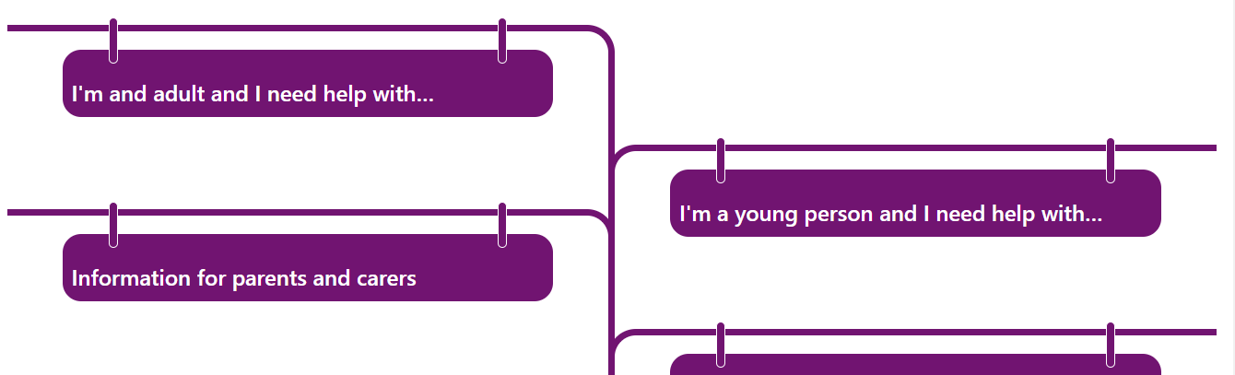
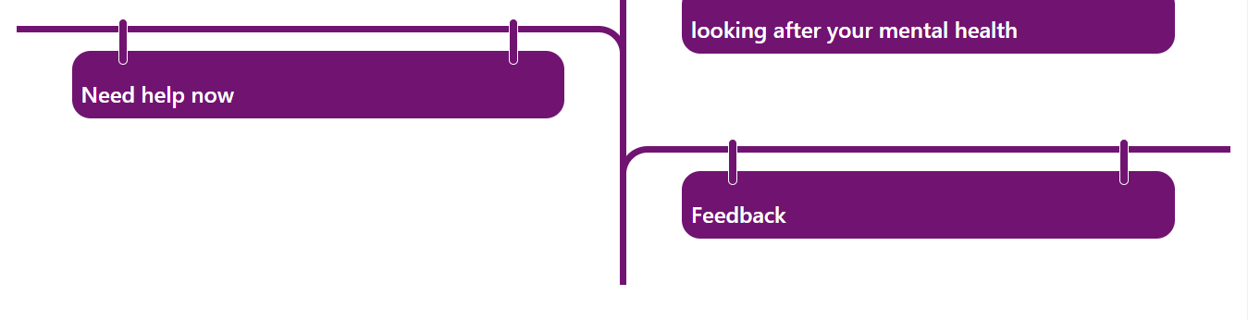
Mental Health Info Point
www.halton.gov.uk/mhinfopoint

Slide 30
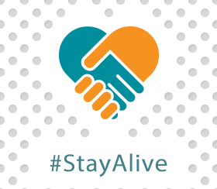
Useful Apps
If you are having thoughts of suicide or if you are concerned about someone

Slide 31

Notes:
What's the difference between DBT and CBT? CBT focuses on helping you to change unhelpful ways of thinking and behaving.
DBT also helps you to change unhelpful behaviours, but it differs from CBT in that it also focuses on accepting who you are at the same time. DBT places particular importance on the relationship between you and your therapist, and this relationship is used to actively motivate you to change.

Slide 32
Evidence of Self-Harm
No Immediate Risk to Physical Health
All of the previous if appropriate
Refer to CAMHS Assessment & Response Team (CART) for any information, advice and guidance needed 01925 579405
Child and Family contact and referral team ( icart) for any safeguarding concerns, advice and guidance 0151 511 7722
School Nursing Team, Any enquiries for school nursing support 0151 495 5018 or 01928 593 055
Give information for KOOTH.COM to ALL young people
Notes:
What's the difference between DBT and CBT? CBT focuses on helping you to change unhelpful ways of thinking and behaving.
DBT also helps you to change unhelpful behaviours, but it differs from CBT in that it also focuses on accepting who you are at the same time. DBT places particular importance on the relationship between you and your therapist, and this relationship is used to actively motivate you to change.

Slide 33
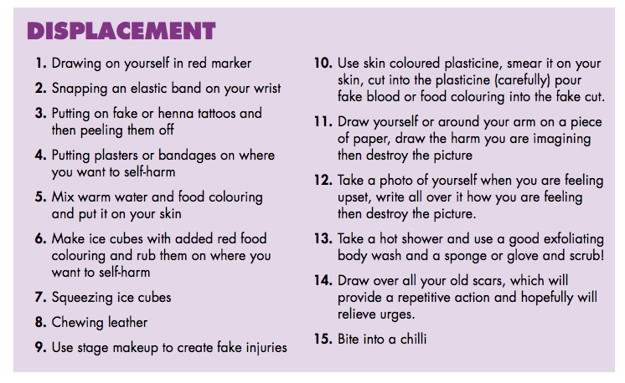
Evidence of Self-Harm
No Immediate Risk to Physical Health Distraction Strategies
Notes:
Young Minds 2016

Slide 34
If you Self-harm to express pain and intense emotions you could: Paint, draw or scribble on a big piece of paper with red pen Start a journal in which expressers your feelings Write down any negative feelings and then rip the paper up Listen to music | If you Self-harm to calm and soothe yourself, you could: Take a bath or hot shower Pet or cuddle with a dog or cat Wrap yourself in a warm blanket Massage your neck, hands and feet Listen to calming music
If you Self-harm to release tension or vent anger you could Exercise vigorously, run, dance, jump rope Punch a cushion or mattress or scream into your pillow Squeeze a stress ball Rip something up ( sheet of paper, a magazine Make some noise ( play an instrument) | If you Self-Harm you feel disconnected or numb you could Call a friend ( you don’t have to talk about self-harm) Take a cold shower Hold an ice cube Chew something with a very strong taste
Ref helpguide.org
Notes:
Because self-harm is helping a child to cope with difficult feelings, it is important to think of other ways they might manage their feelings. These can include distraction, stress management techniques, and thinking of alternative methods of discharging extreme emotions. Sometimes joining a social activity or sports group can be helpful as a distraction. This can also provide a form of social support.
Some people find that putting off harming
HAVING YOU MIND OF THE EMOTIONAL PAIN REPLACING it with shock factors wow give your body a shock physical feeling of some kind.
Hugs relsease oxidicene felling about about 9 mins

Slide 35
Urgent Medical Attention Required
If life is in danger contact emergency services immediately!
Emergency Help- 999, Urgent Care Centres, A&E.
CAMHS Response Team: Manage all front door emergency assessments
01744627618 9am-9pm
Crisis line on 0800 051 1508 – If young person in Mental Health Crisis
Notes:
Self harm vai self poise- all young people go to a&e
If a cyp has ingested anything straight to A&E
this team sees every young person who presents at A and E with self harm or suicidal ideation and provides an assessment and plan of action. They don’t share these plans with schools but if a teacher is aware a young person has attended A and E they can ask the young person about the plan of support put in place and if the young person agrees the staff member can contact CAMHS response team for guidance on this specific young person
The team can also be reached via NHS 111 in Halton and Warrington
Contact patients GP, if surgery closed voicemail will inform you of contact details for local out of hours GP service which can offer support and guidance
Follow up with parent or carer. Consider amber action

Slide 36
Useful Websites
www.selfharm.co.uk
www.harmless.org.uk
www.thesite.org/mental-health/
www.live-lifewell.net/
www.papyrus-support.com
www.minded.org.uk/
https://web.ntw.nhs.uk/selfhelp/
Notes:
Self harm UK is a project dedicated to supporting young people impacted by self harm, providing a safe space to talk, ask questions and be honest what's going on.
The site is self-harm support for people aged 16-25
Live life-well self help support information
MindEd e-learning modules, which offer
free training about a broad range of mental
health problems in children and adolescents,
including self-harm; they are written with a
general rather than a professional audience
in mind, so are intended to have a wide reach
GP first point of contact refer to CBT service
First Aid Training: British Red Cross

Slide 37
Self Help Support
Books on prescription, we would recommend:
The Truth about Self-Harm, Celia Richardson
Am I depressed and what can I do about it? Shirley Reynolds
My Anxious Mind, Michael Tompkins
Coping with Self-harm A guide for parents and carers ( will email this out)

Slide 38
Additional Training
Children & Young Peoples Suicide Prevention Training
Designed to increase your skills, knowledge and confidence to have conversations about suicide. Approx. 2hrs.
Mental Health Awareness for anyone working with CYP
Designed to increase your skills, knowledge and confidence to have conversations about Mental Health. Approx. 2hrs.

Slide 39
Mental Health Hubs
The Aim of the Hubs is to give the public a direct link to the many different services out there who can provide you with help and support to manage your mental health. If you have a mental health issue, don’t be afraid to talk about it, come along and speak to those who can help.
Runcorn Shopping City (Main Square)
      -1st Thursday of every month 9am -2pm*
Greenoaks Shopping Centre Widnes (mobile stall, not a shop unit)
- 3rd Wednesday of every month 9am – 2pm*
Headzup Halton Every Wednesday from 2:30-4:30 at the Hub Grangeway Runcorn and Friday Kingsway Library 2:30-4:30
Come along to the Mental Health Hubs and see what local support services are available in Halton.
Your Mental Health Matters

Slide 40
Any Questions?

