Slide 1


MAGIC MILK

Slide 2
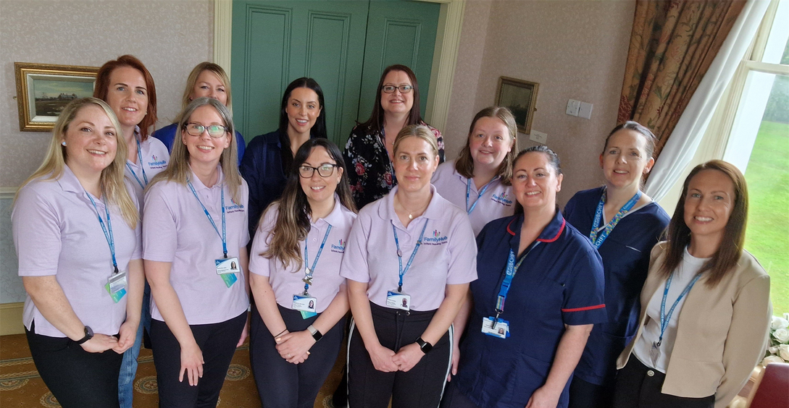
HELLO!
Notes:
what types of milk are there?

Slide 3



QUESTION TIME
Notes:
Table has pictures of mammals and babies, get them to look at the images.
Not enough time ?-Find your matching partner
(game to pair mammal and baby 10mins)

Slide 4
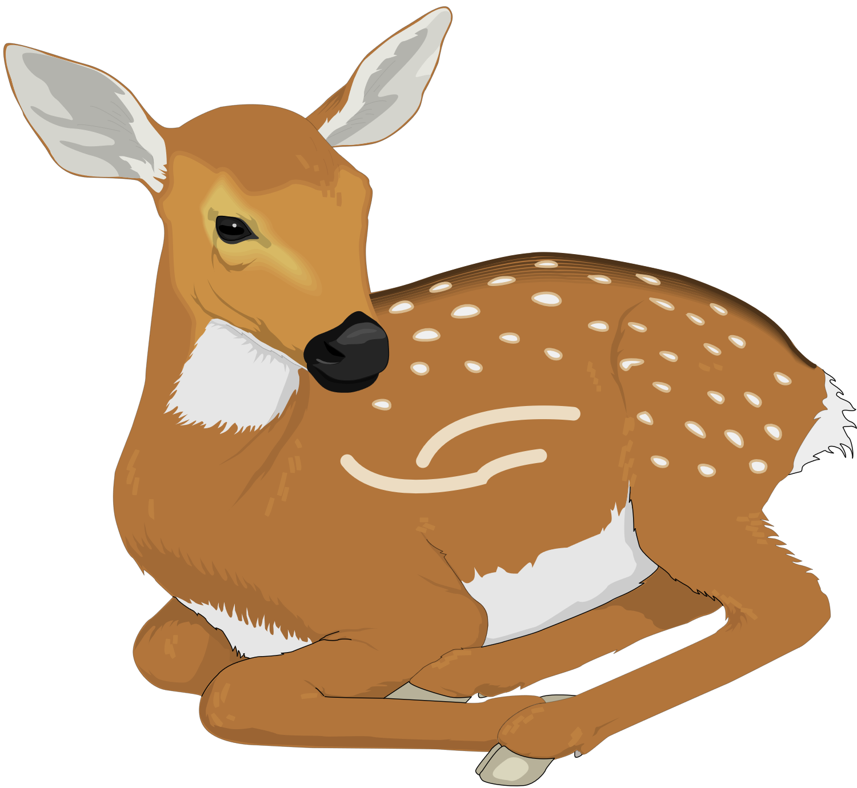
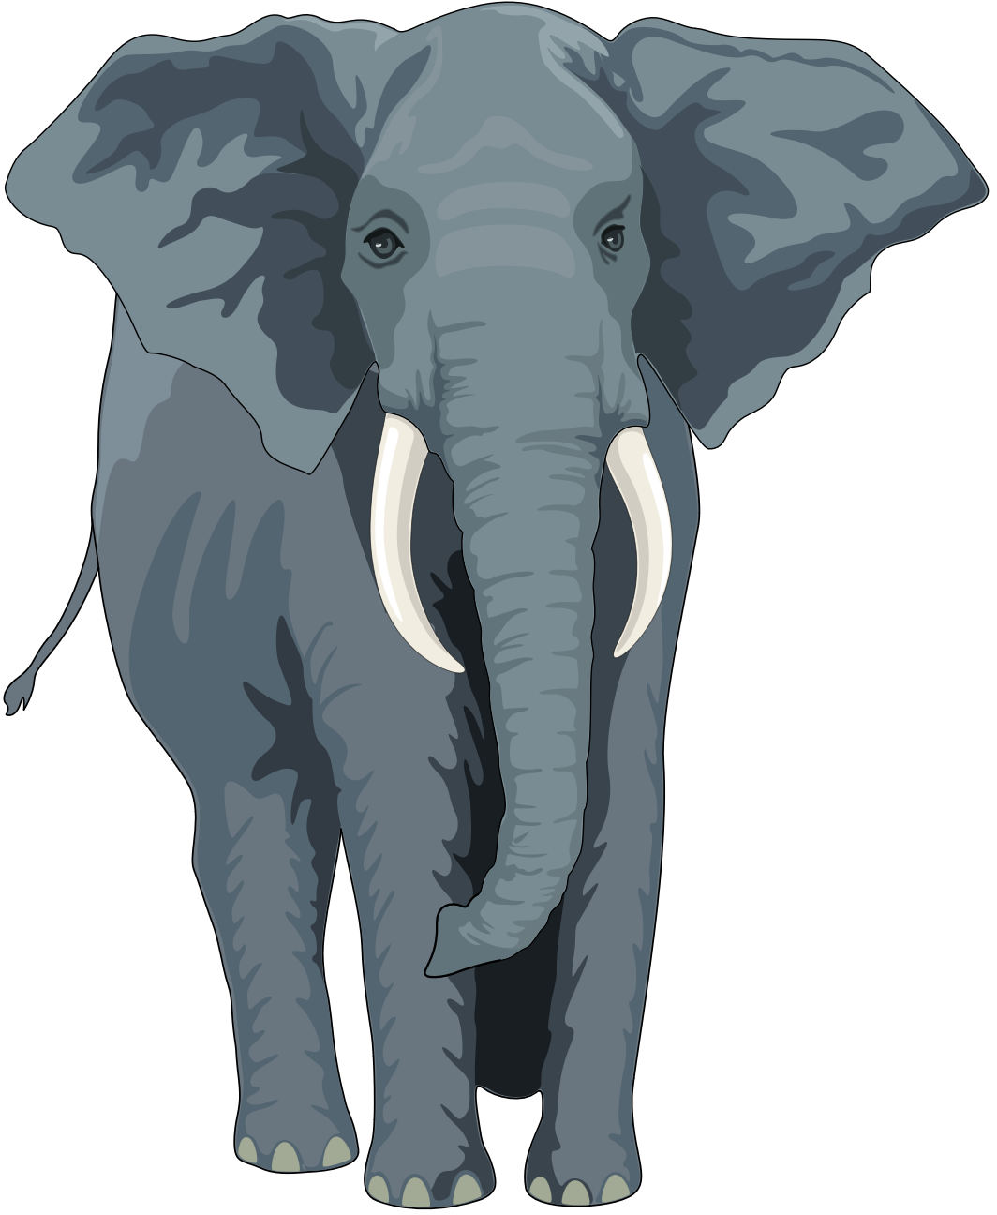
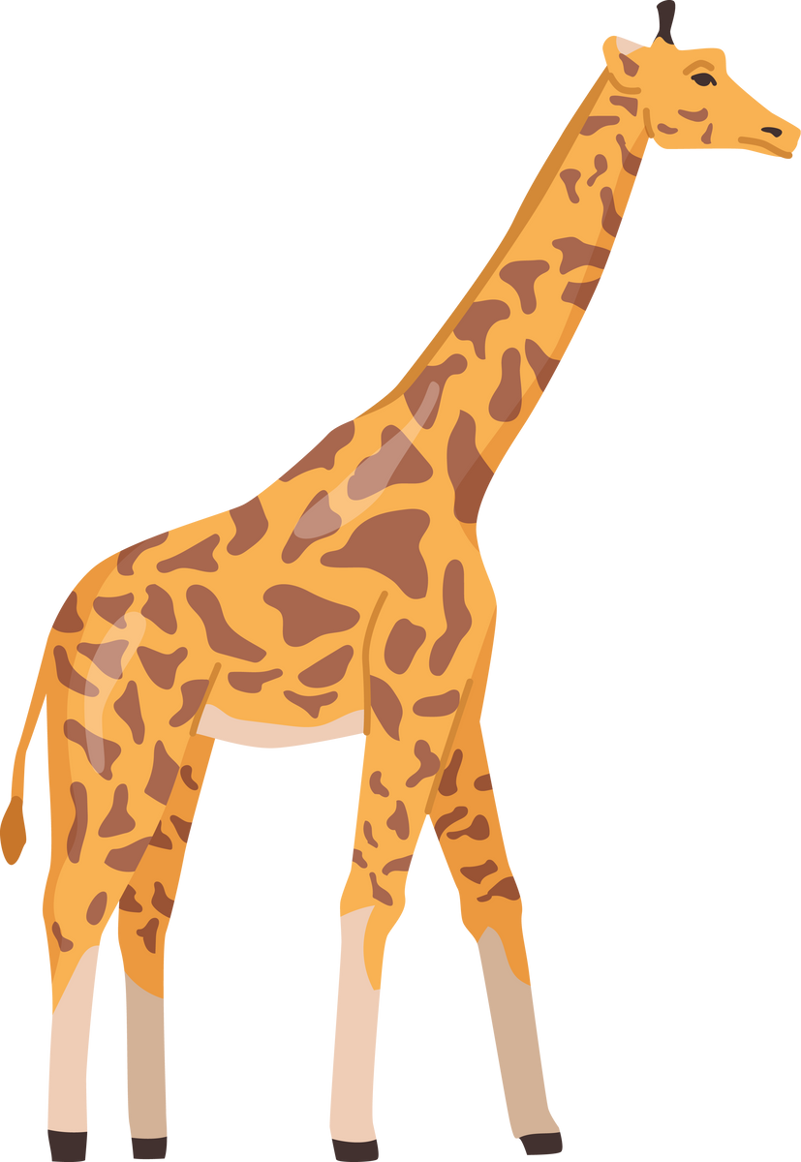
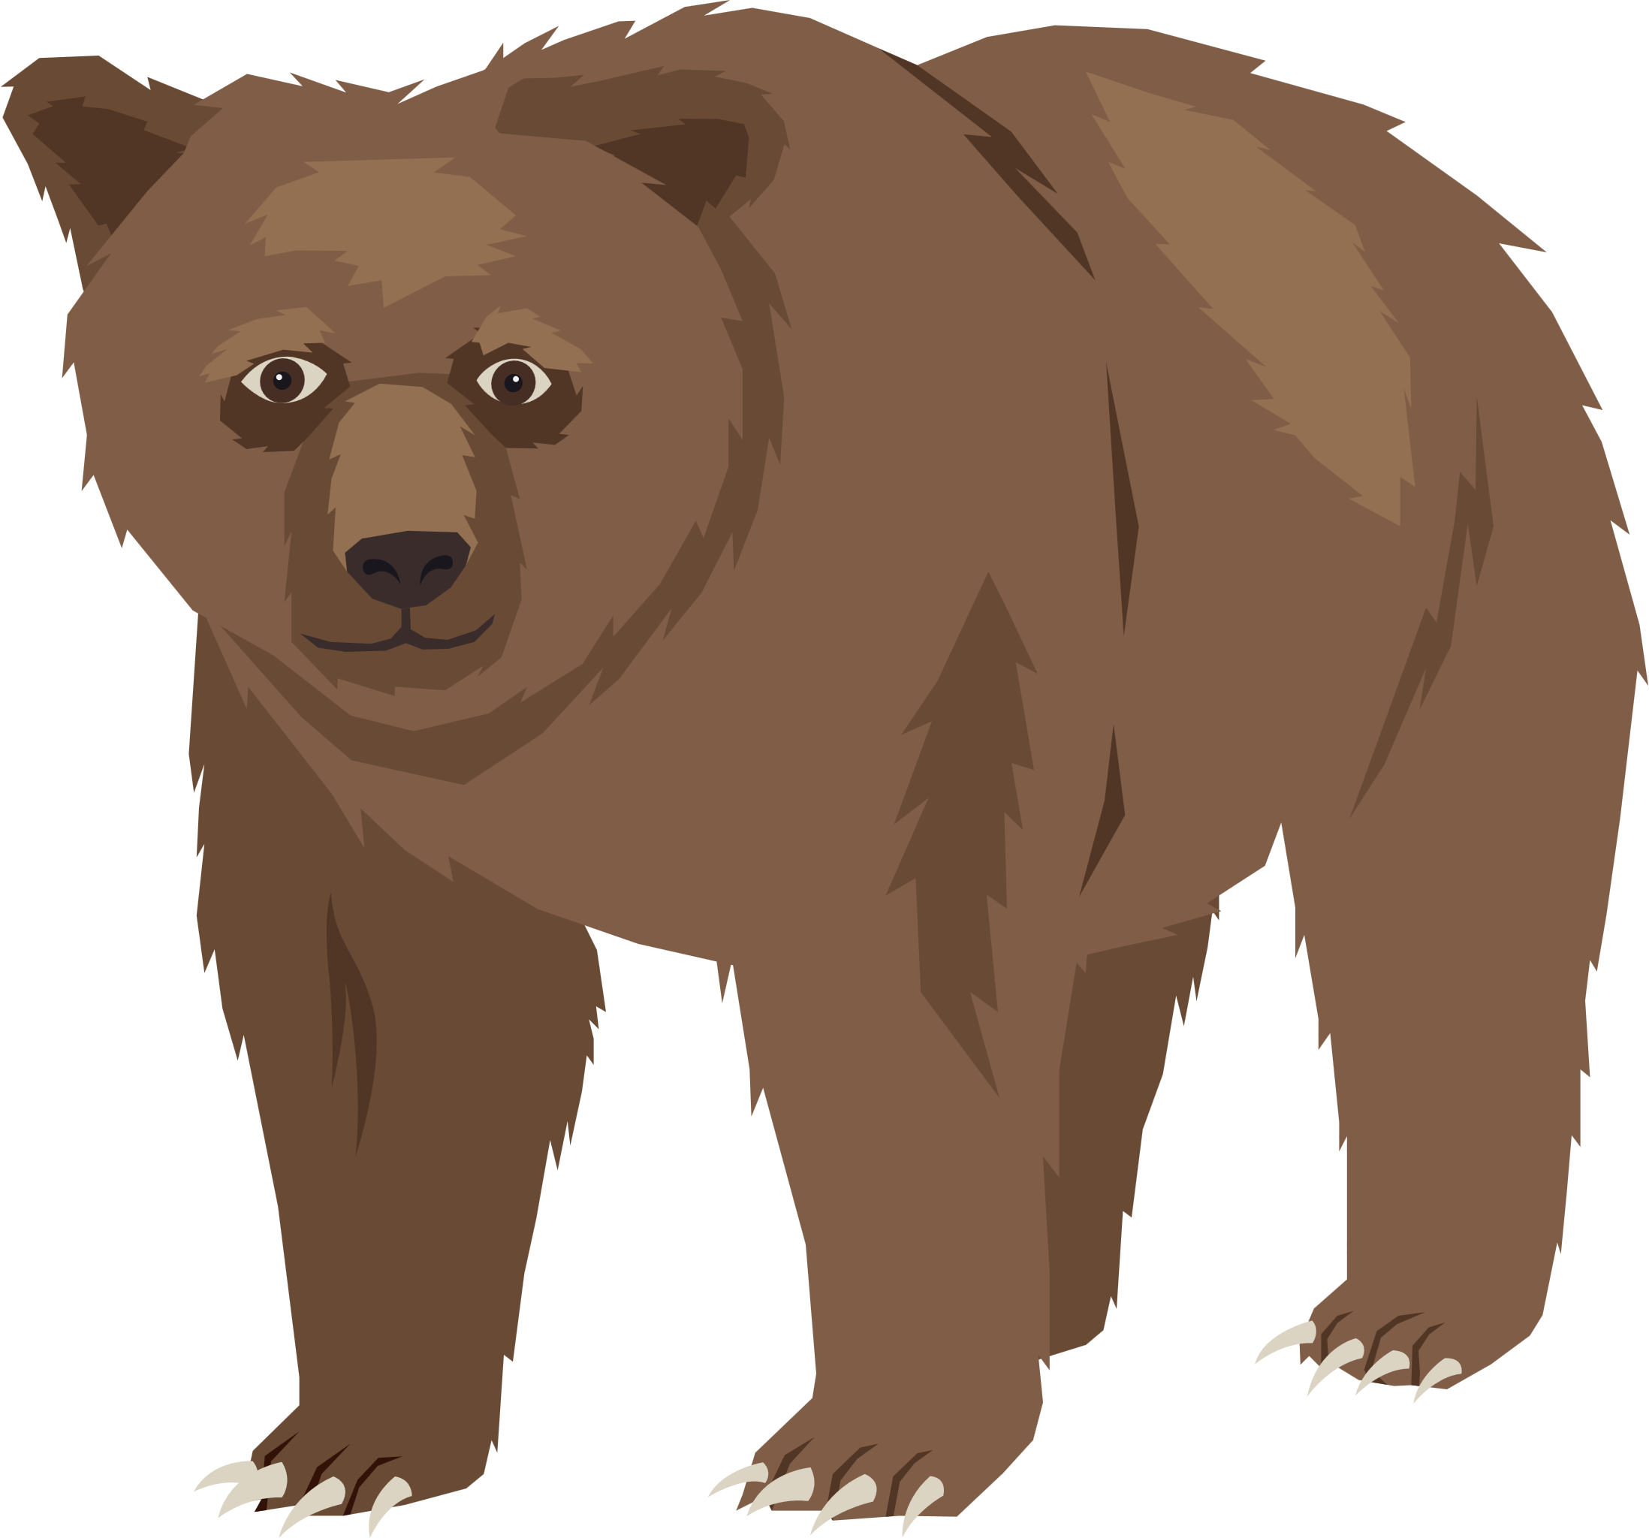
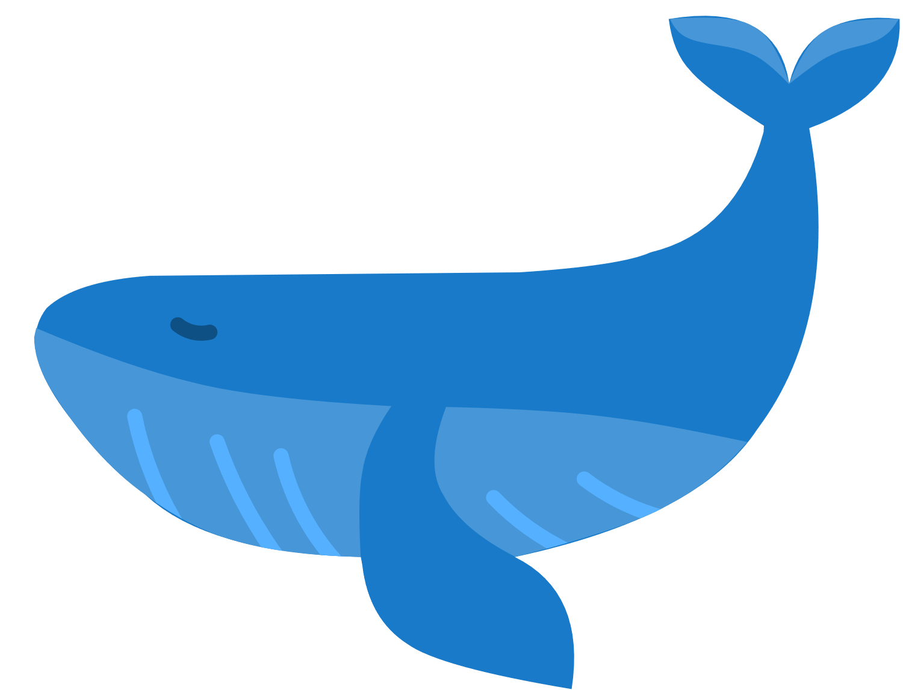
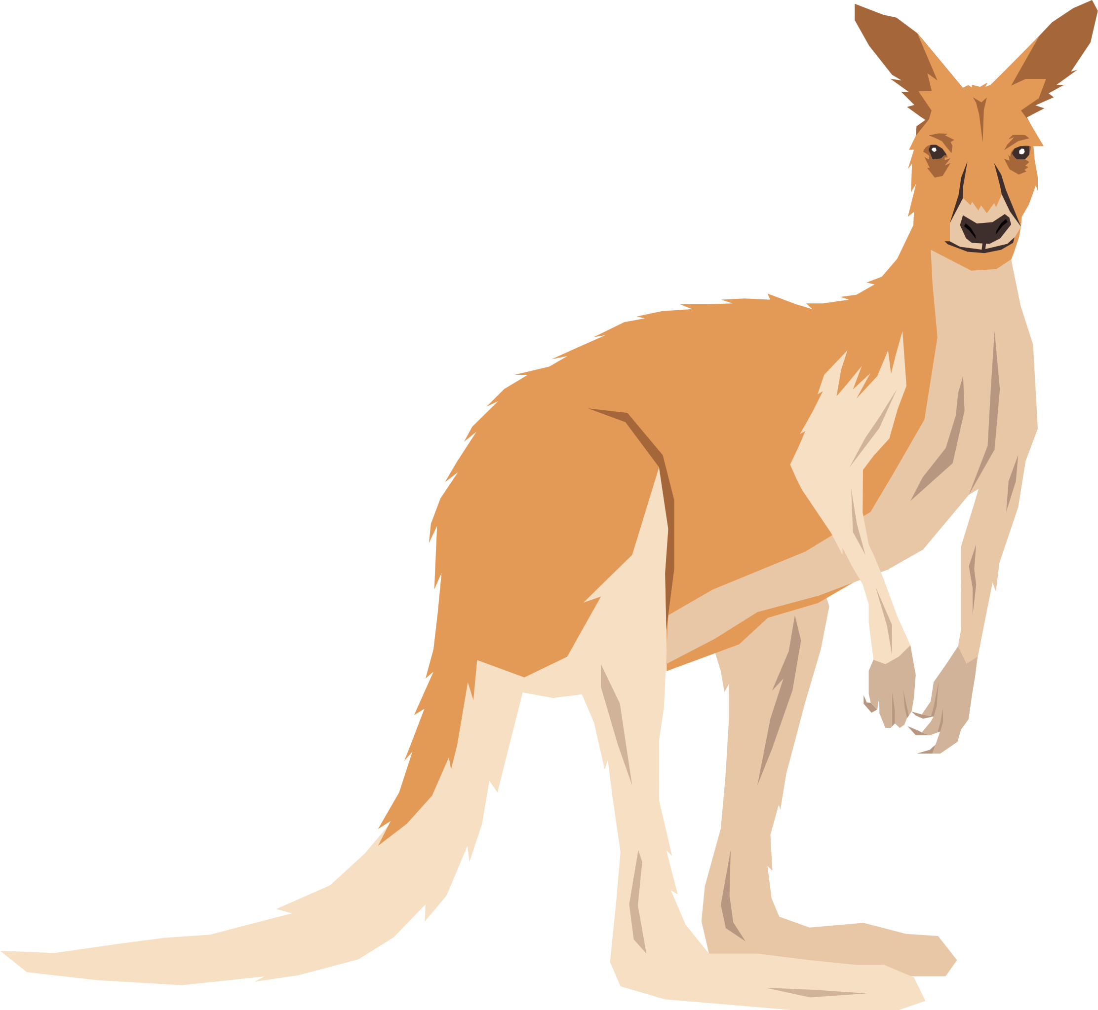
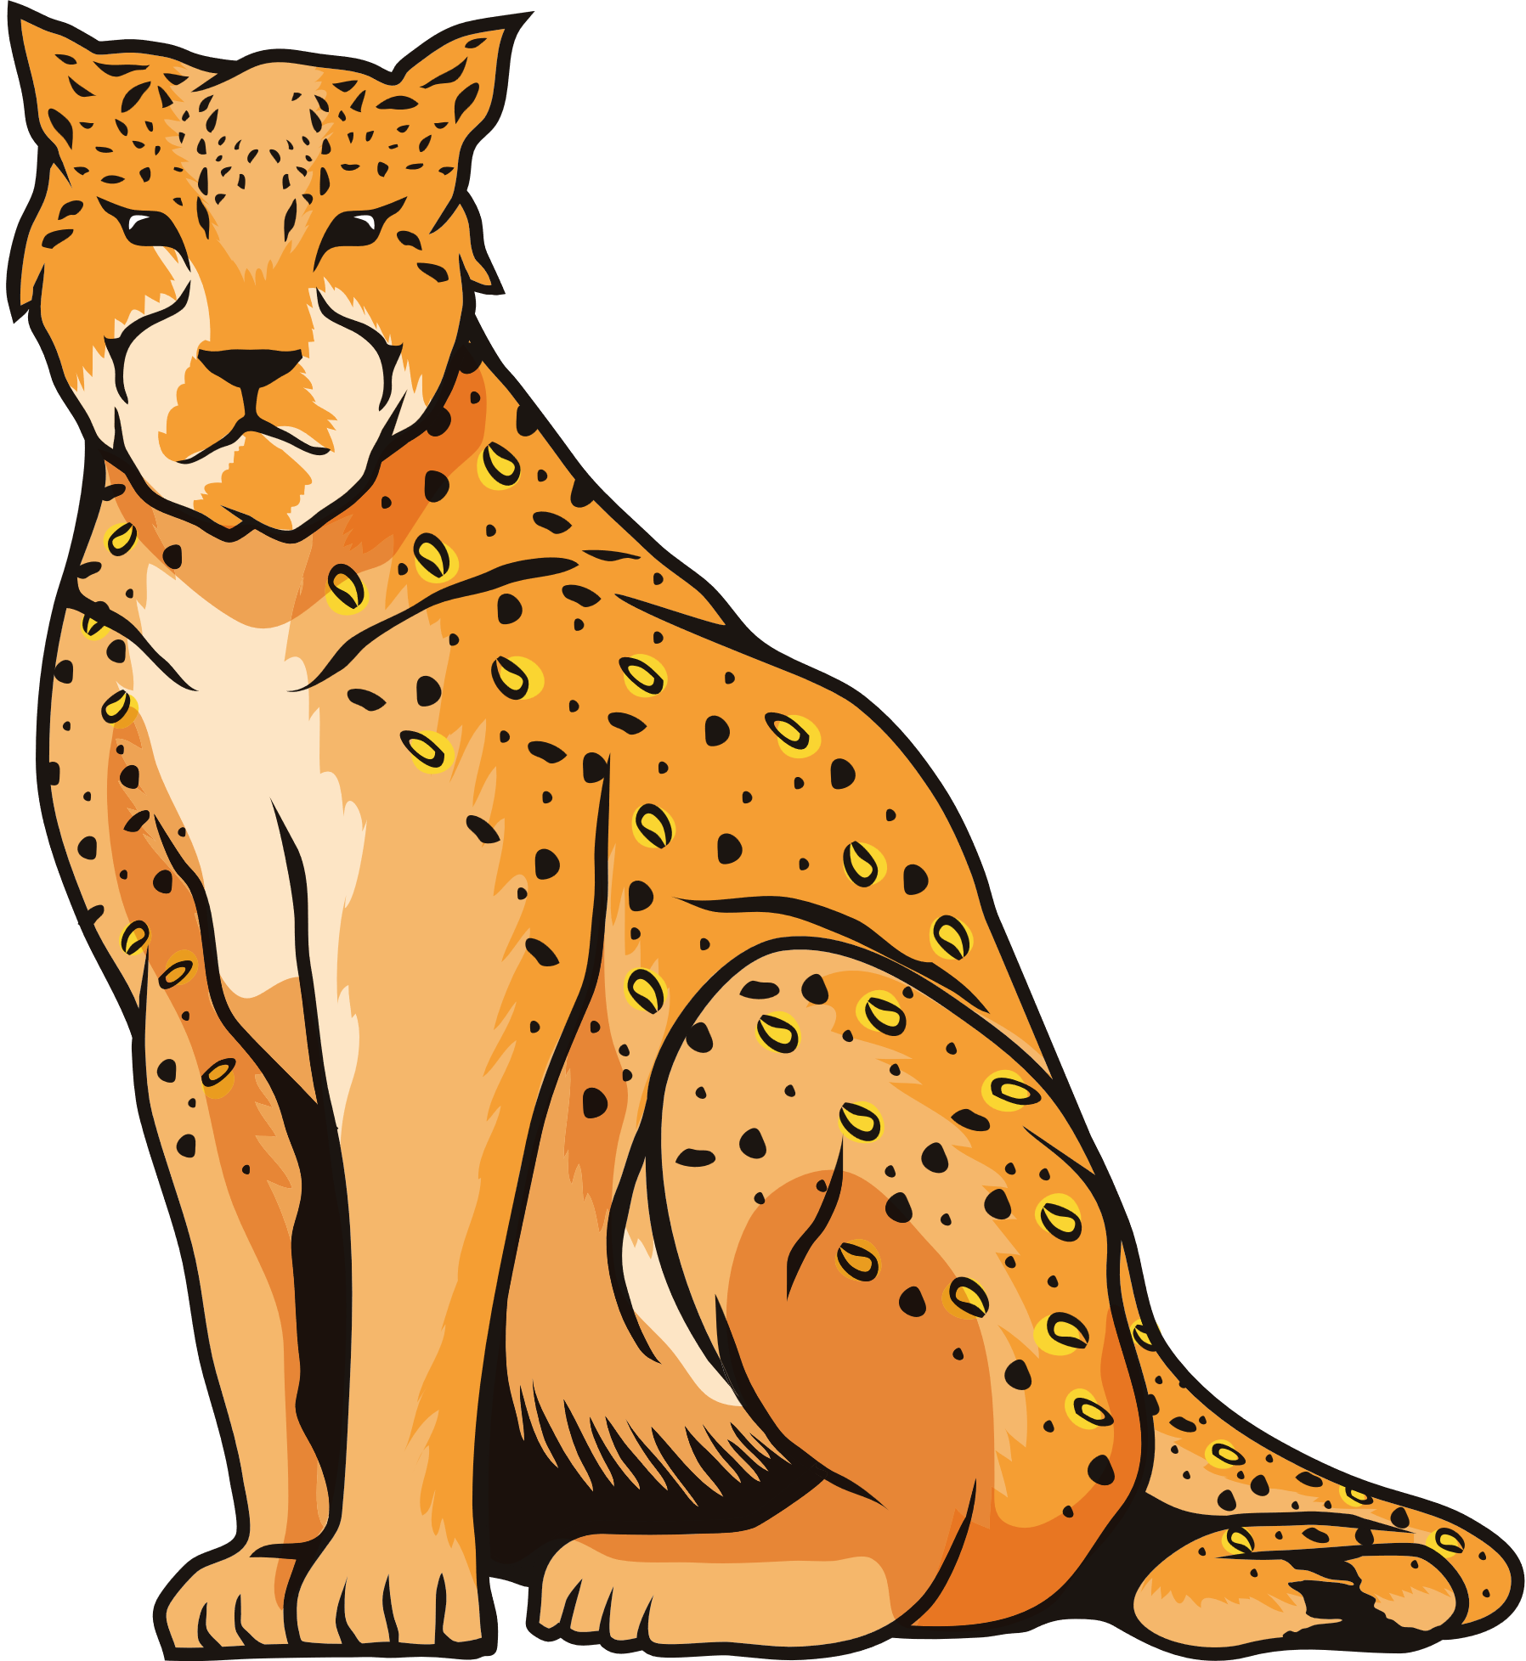
WHAT ANIMALS ARE THESE?

Slide 5


Slide 6
WHAT IS A MAMMALS FIRST SOURCE OF FOOD?

Slide 8
CAN YOU NAME ANY OTHER MAMMALS?

Slide 9
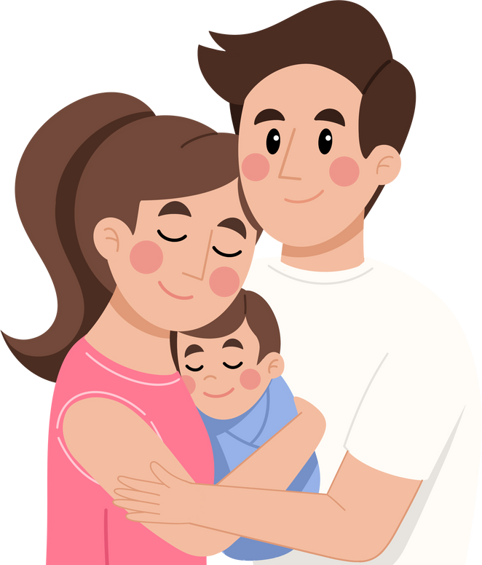
HUMANS
What is a humans first food?

Slide 10
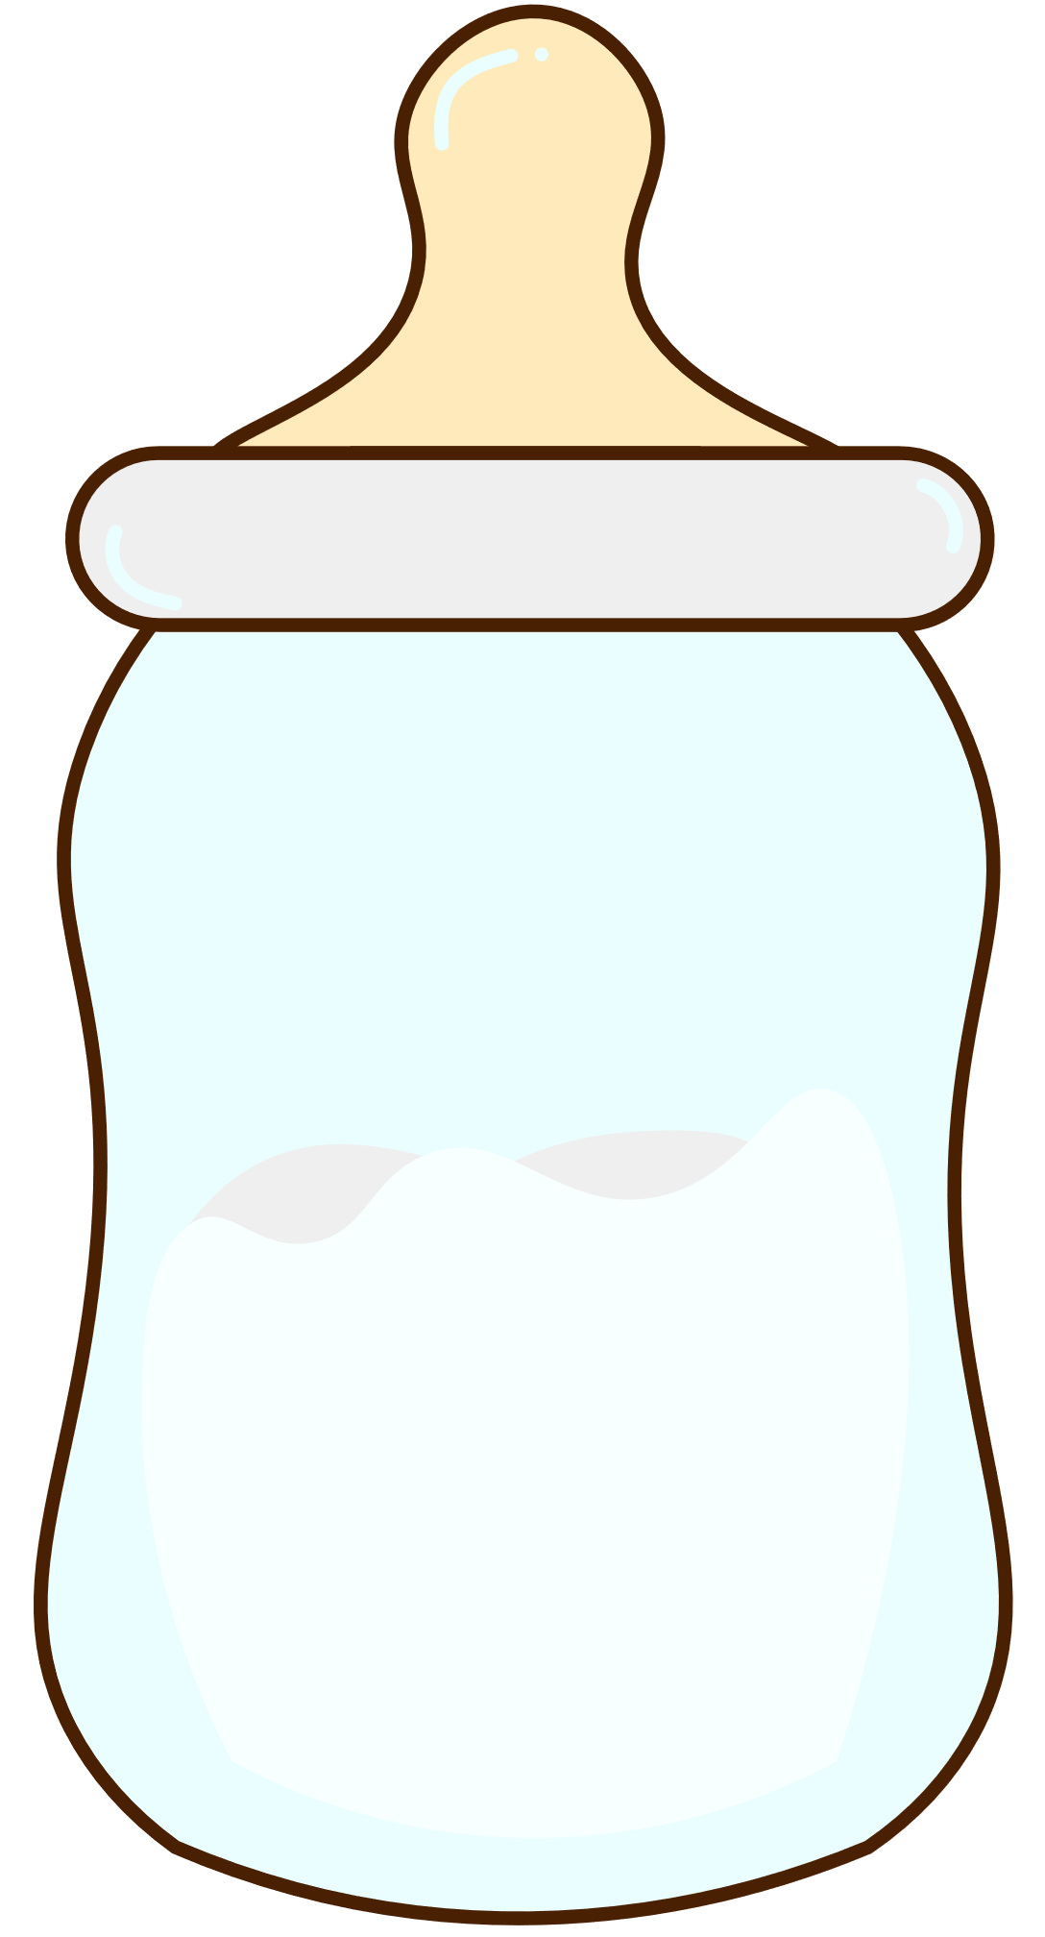
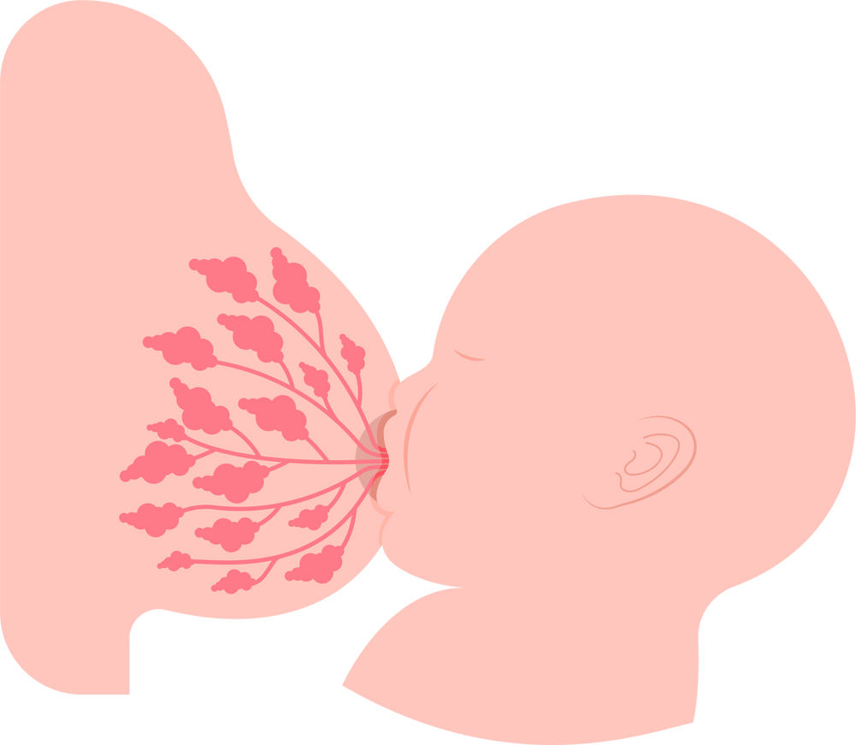
Breastmilk
Formula Milk
Notes:
Discuss both milks
formula milk can be life safing so its a good thing we have it, equally which do we think as mammals is designed for our tummies and natural for our babies to drink?

Slide 11
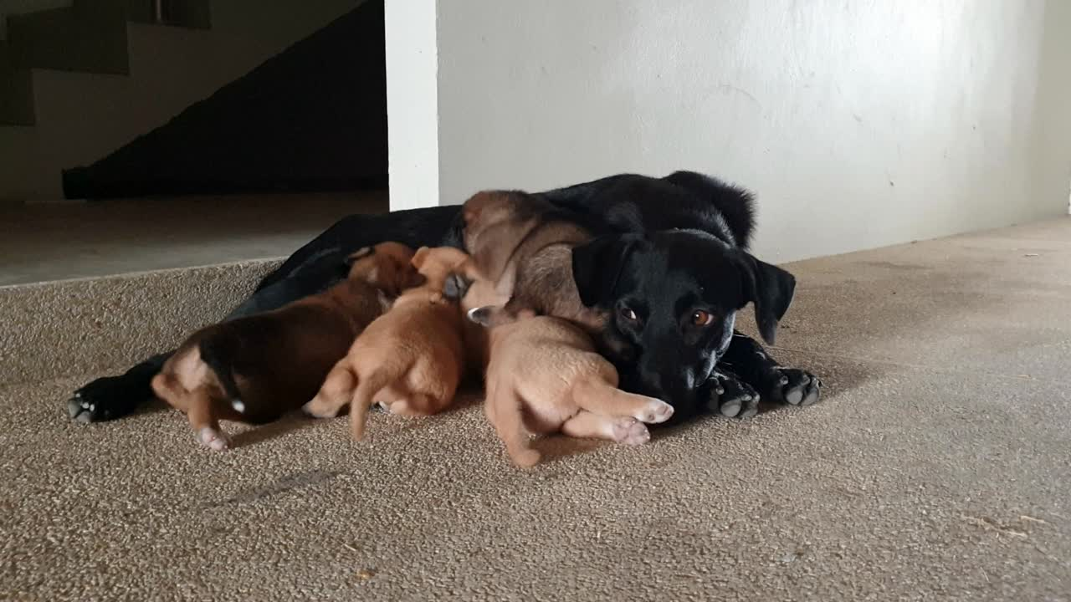
Notes:
My friends dog has had puppies!!
can you guess how many pups she had?

Slide 12
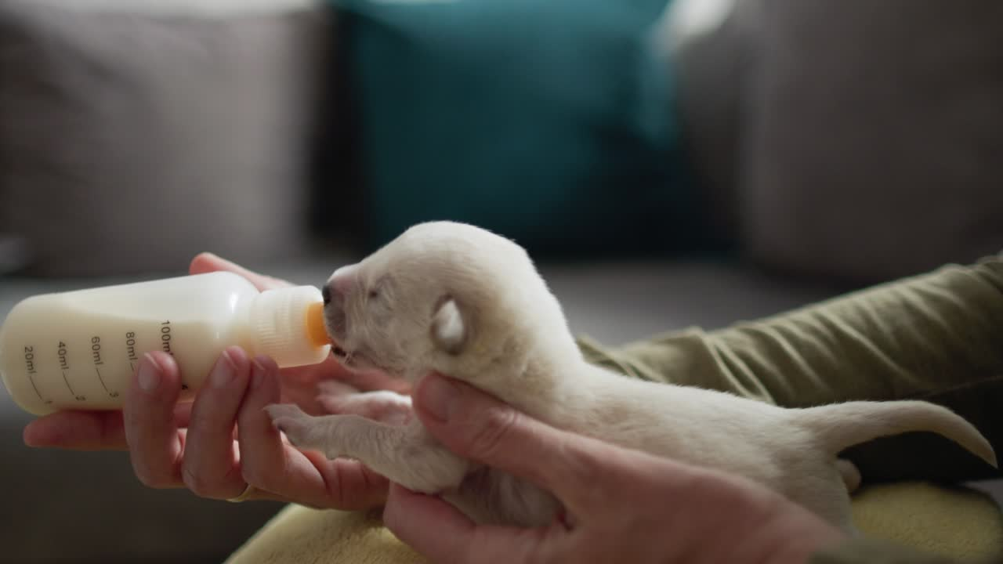
Notes:
Sometimes mammals can need a little help and support with formula.
This is a life saving thing we can offer to them

Slide 13
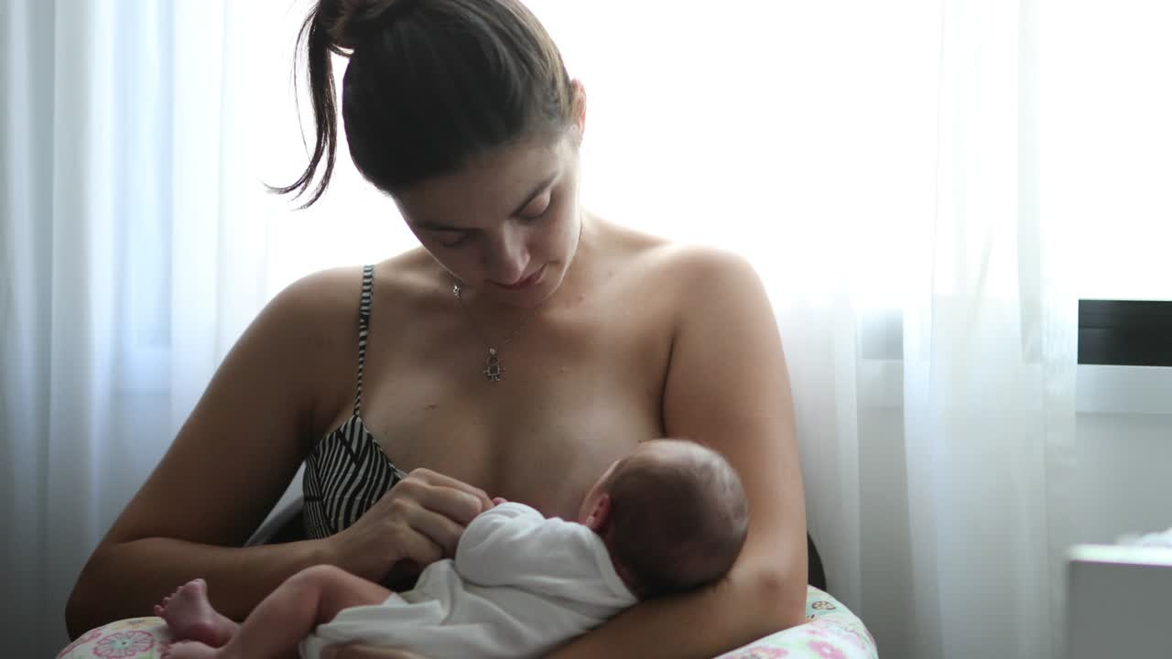
What is this mammal doing?
Notes:
What is this mammal doing?
Discuss both milks
it is natural for human babies to feed from their mother and its designed for their tummies

Slide 14
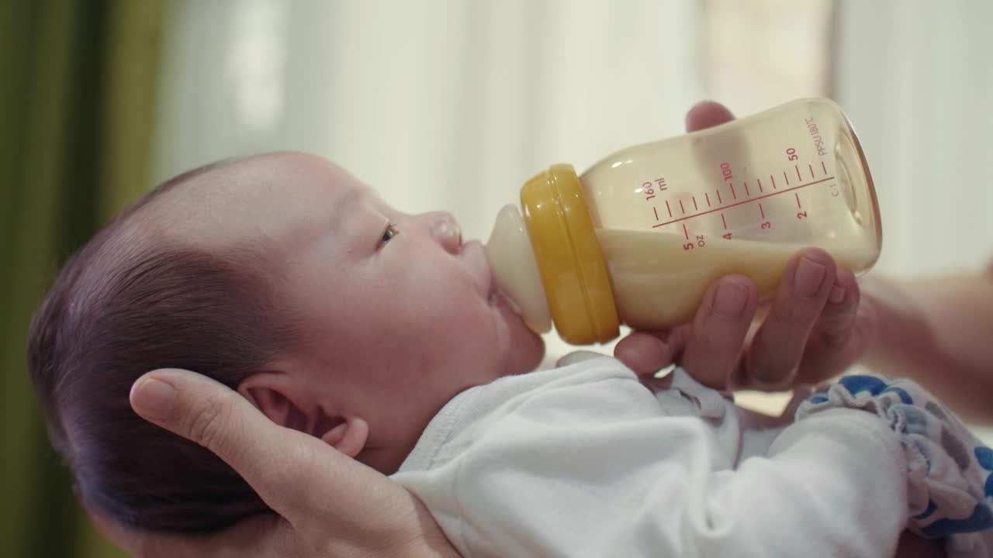
Formula Milk
Notes:
Formula is a type of milk a baby can drink too, it can be life saving

Slide 15
TASK TIME
Notes:
playdough

Slide 16



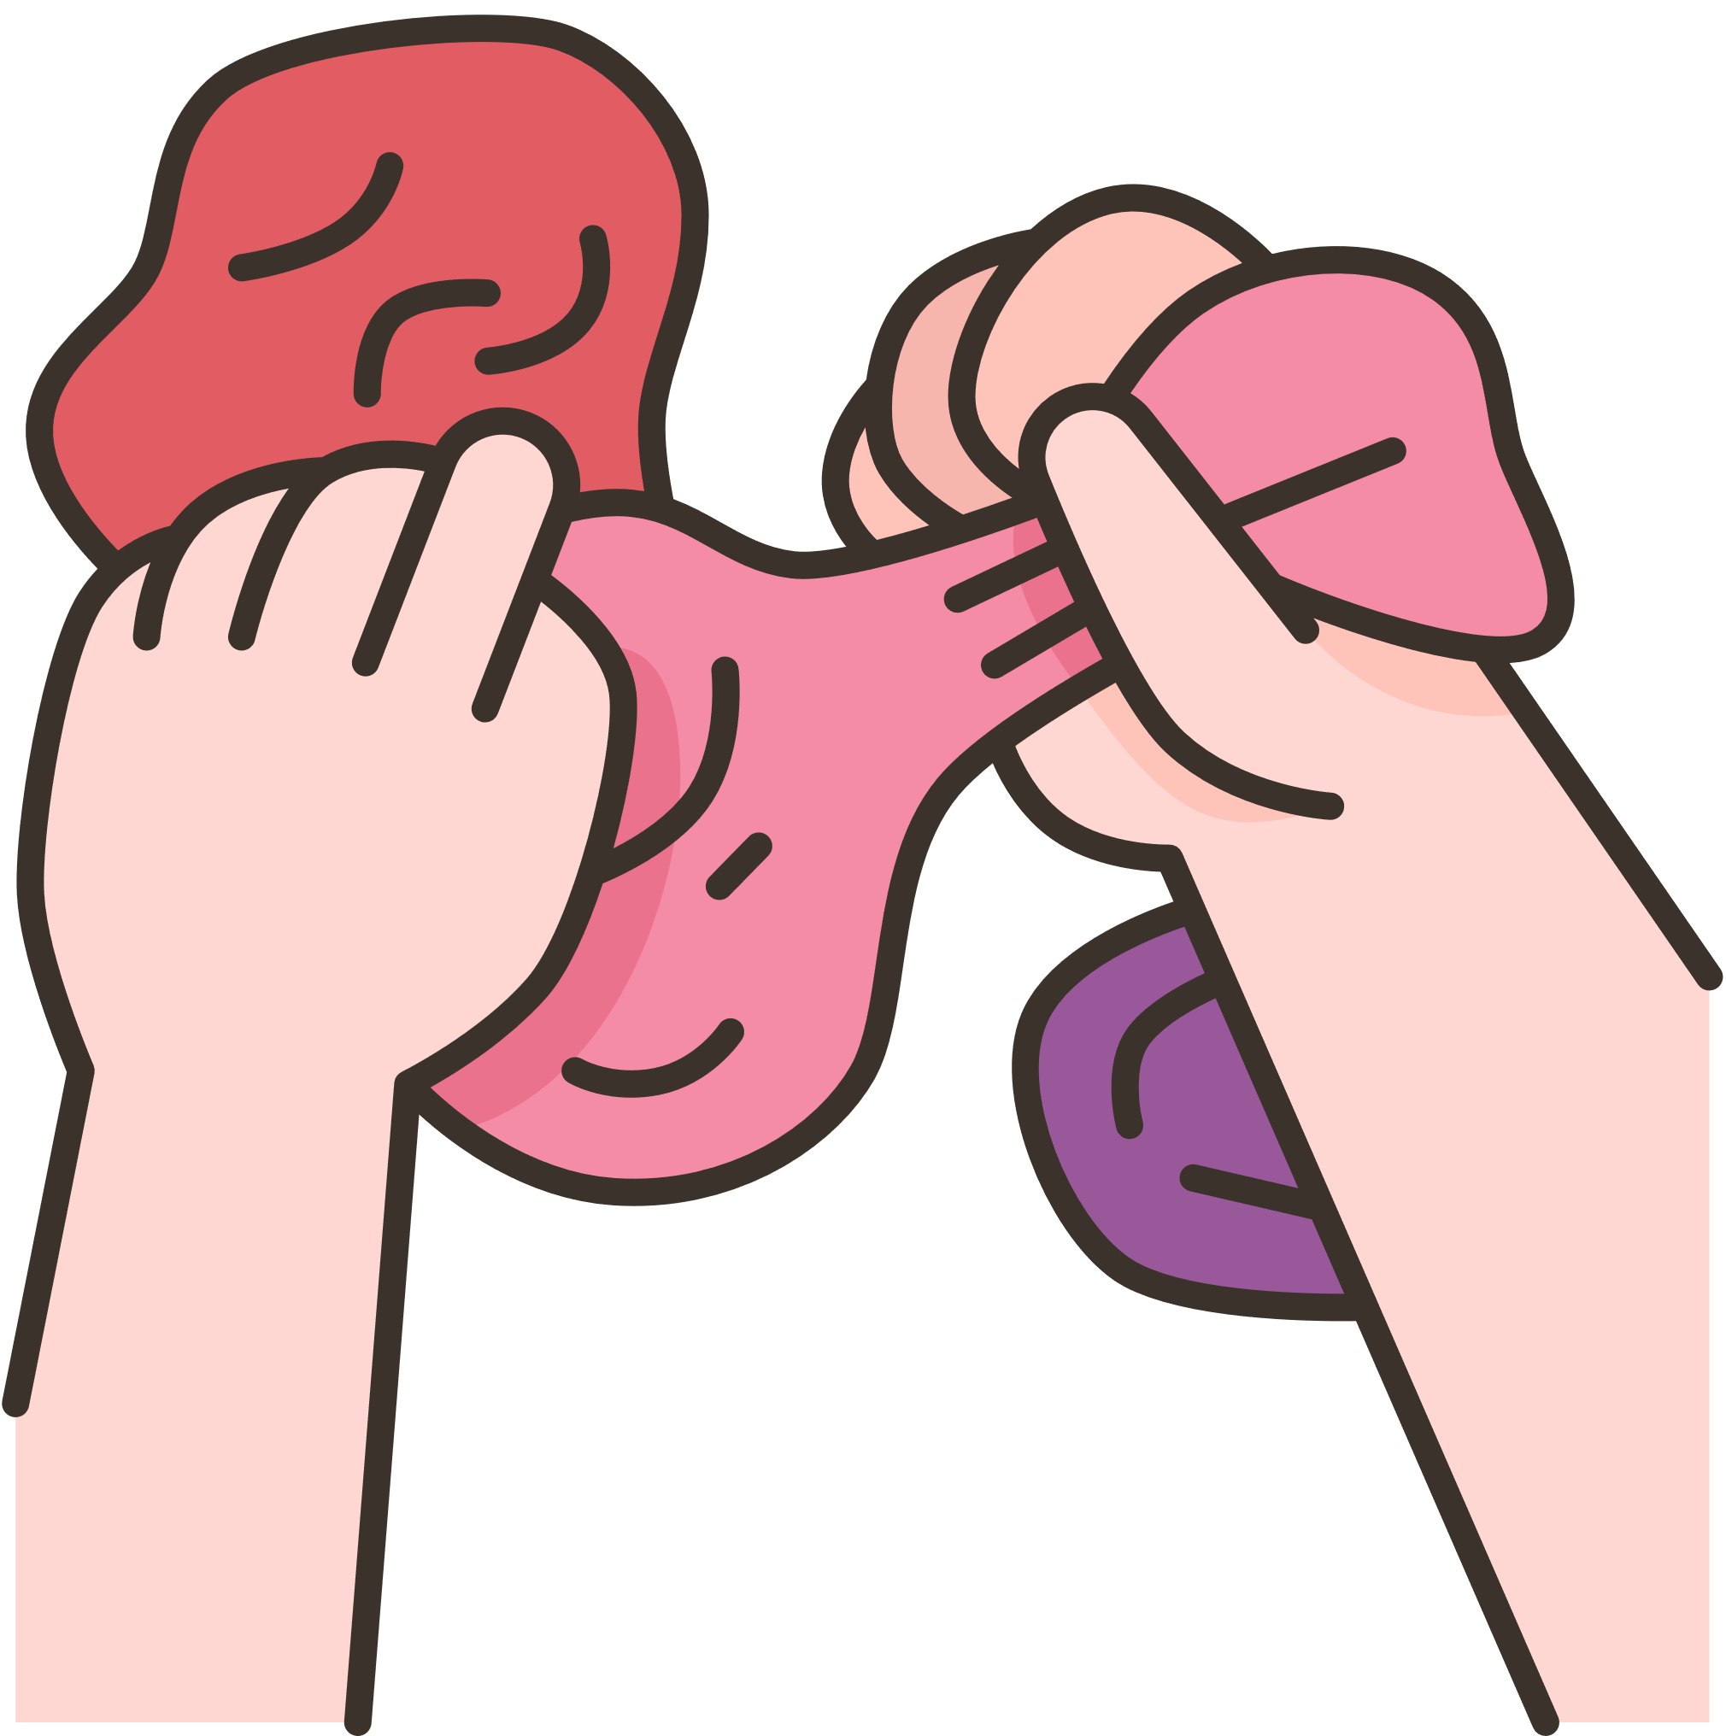

CAN YOU MAKE...

Slide 17
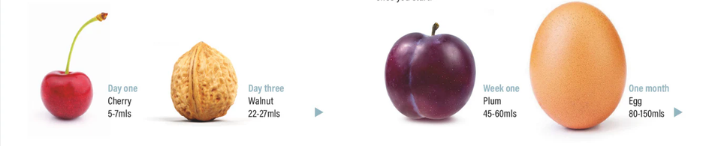
WHAT DO YOU THINK THESE SIZES REPRESENT?
Notes:
discuss tummy sizes:
discuss human milk is forever changing, what it is made up of, the amounts etc
(example: Hot day = more milk)
important to not over feed, why babies need little and often

Slide 18
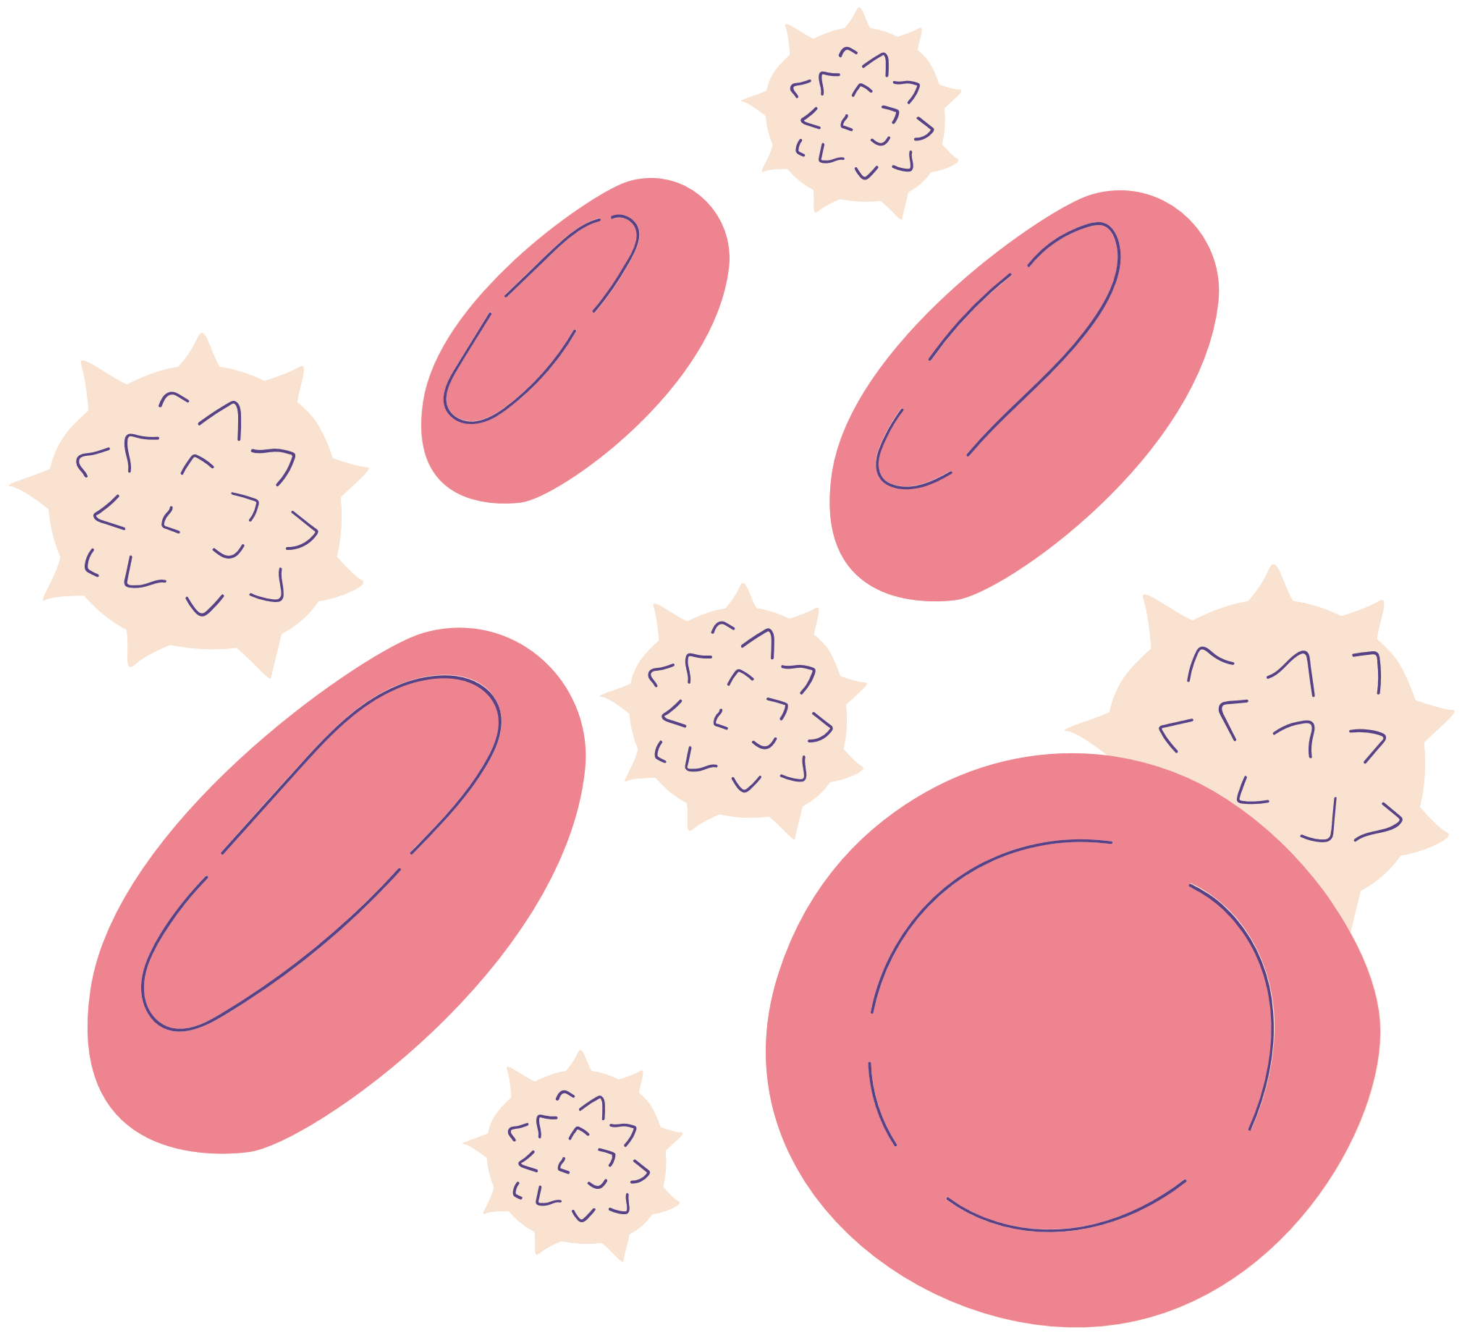
LIVING CELLS
A living cell is like a tiny building block that makes up all plants, animals, and people, and it works like a little factory to keep things alive and growing
Notes:
teaspoon on table

Slide 19
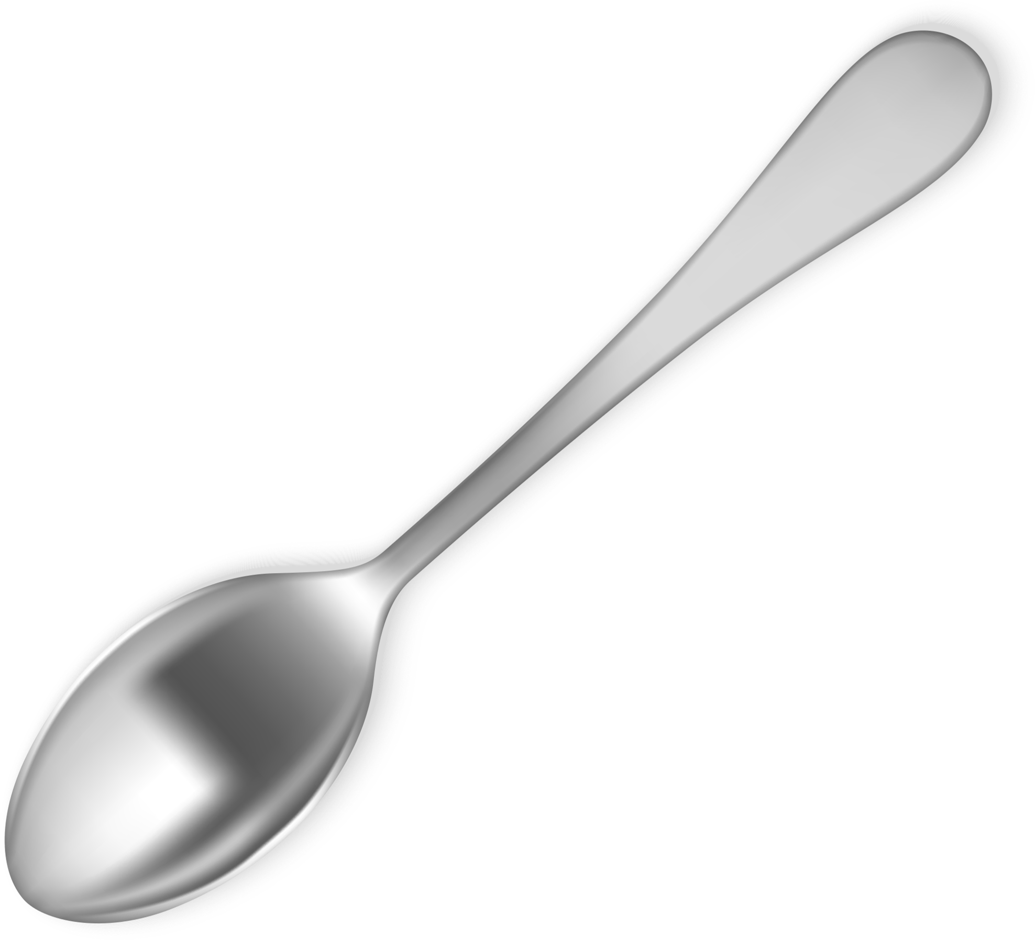
TEASPOON
How many living cells are in one teaspoon of colostrum?
Notes:
teaspoon on table

Slide 20
TEASPOON
Up to 3 million!
Notes:
breastmilk is magical
is contains all a baby needs as well as protective factors for them and helps a baby grow and develop for the first 6 months a beyond

Slide 21
TASK TIME
Notes:
hand out clear cups
syringes with markers on
jug with cloudy/milky water
4 vols on each table, pour the amounts of milk
or do a demo and ask for helpers for each amount
Ask questions:
Are you surprised by the amount
Why do you think babies need to feeding little and often?
What might happen if we feed a baby too much or too fast?
Do you eat and drink the same amounts everyday?

Slide 22
Notes:
discuss tummy sizes
again
are they surprised?
breastmilk is forever changing
A mother can detect if the baby is not well and will create antibodies to protect that baby

Slide 23
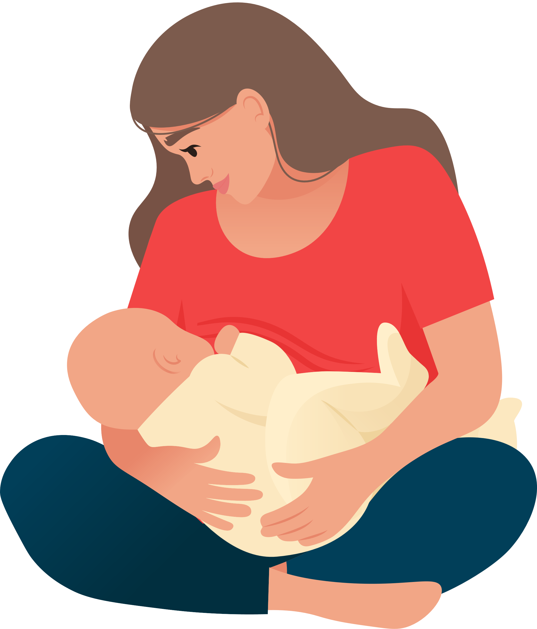
TRUE OR FALSE...
A baby only needs breastmilk for the first 4 months of it’s life.
Breastmilk is forever changing, it is never the same milk, it can even contain more water on a hot day!
Breastmilk protects a baby from germs, infections & builds their immune system. A mothers body can also detect when baby is not well & create a medicine like milk for baby.

Slide 24
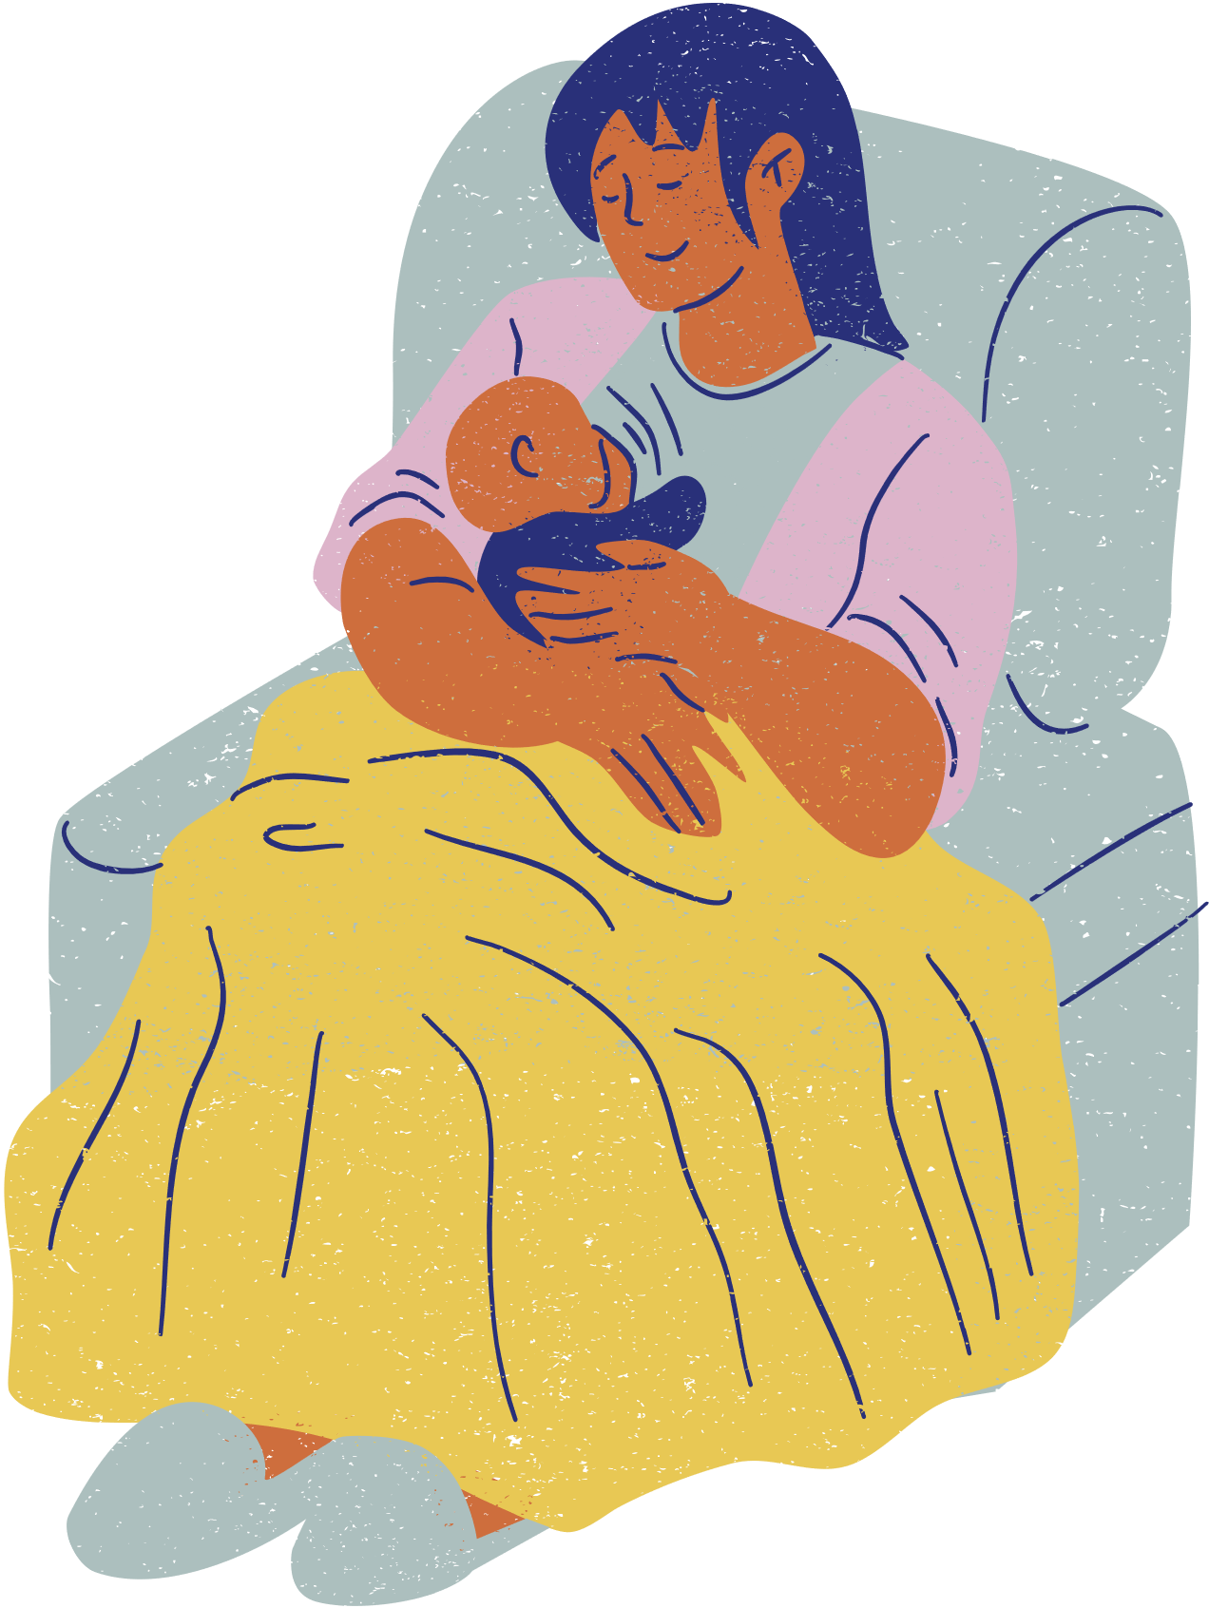
DID YOU KNOW...
A mother who is breastfeeding can become very thirsty!
A mother and her baby should feel relaxed and calm whilst feeding.
You can choose to breastfeed your baby anywhere, it is protected by the law.
Notes:
Discuss point further:
How can we support a bfing mother?
Why do you think it needs to be calm environment to feed your baby?
Why do you think breastfeeding in a public place is protected by the law?

Slide 25


  ALL BABY MAMMALS NEED WHAT TO SURVIVE?
  HOW SMALL IS BABY’S STOMACH WHEN THEY ARE BORN?
  HOW LONG SHOULD A BABY HAVE MILK FOR?
  WHY IS BREASTFEEDING GOOD FOR A BABY?
  HOW CAN WE SUPPORT A MOTHER TO FEED HER BABY?

Slide 26

THANK YOU!

