Slide 1
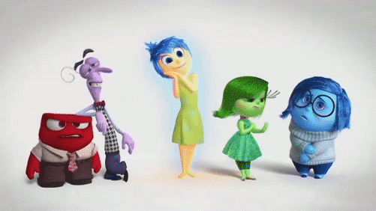
Mental Health

Slide 2



What does mental health mean to you?
Its how you think, feel and act
Our emotions (positive and negative)
Notes:
MH influences how we think and feel about ourselves and others and how we interpret events. it also influences our ability to cope with change, transition and life events: having a baby, moving house, experiencing bereavement.
Mental illnesses are characterized by alterations in thinking, mood or behaviour associated with significant distress and impaired functioning. Examples of specific mental illnesses include: Mood disorders: major depression and bipolar disorder. Schizophrenia. Anxiety disorders. Personality disorders. Eating disorders.
Everyone has Mental Health - how we feel, think, act, talk. Everything that we feel and experience and how we cope with that.
Mental Health and Mental illness are two separate issues.
Thinking about how negative thoughts about ourselves impact our behaviour. If young people are having thoughts they’re no good, everyone’s better than me. No body likes me etc it will result with negative feelings and ultimately negative behaviour which usually is either isolating themselves/ withdrawing or being aggressive.

Slide 3





5 Ways To Wellbeing
Trying/Learning different things
Take Notice
Give something back
Be Active
Connect with friends and family

Slide 4
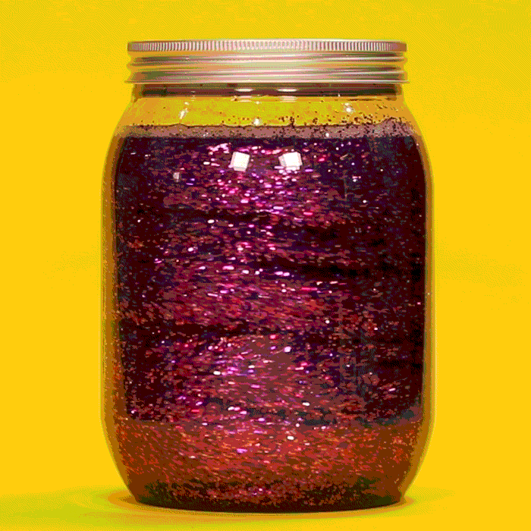
Mind Jar Experiment

